Slide 1
Notes:
Slide 1: “IFPTI Fellowship in Food Protection”
Transition
(Click for next slide)

Slide 2
IFPTI Fellowship Cohort VII: Research Presentation
D’Ann L. Williams, DrPH, MS, LEHS
Notes:
Slide 2: “IFPTI Fellowship Cohort VII: Research Presentation—Enter Fellow’s Name, Credentials”
Instructions
Introduce yourself, if not already introduced.
Greet the participants: “Good morning/afternoon.”
Transition
(Click for next slide)
2

Slide 3
Direct-reading and Rapid-test Methods Used to Evaluate Food Safety Controls in Maryland High-priority Firms
D’Ann L. Williams, DrPH, MS, LEHS
IFPTI 2018-2019 Fellow
Maryland Department of Health
Notes:
Slide 3: Direct-reading Rapid-test Methods Used to Evaluate Food Safety Controls in Maryland
High-priority Firms
Good (morning/afternoon/evening) – I am D’Ann Williams the Chief of the Center for Food Defense and Emergency Response at the Maryland Department of Health Office of Food Protection
I will be discussing my research that evaluated the use of Direct reading instruments in high-priority firms in Maryland and how they are used to evaluate food safety controls in the firms.
Instructions
Introduce the study topic.”
Identify your agency, if you haven’t already.
Transition
“Let’s talk about some background information to help frame the importance and objectives of the study.” (Click for next slide)

Slide 4
Background
FSMA Preventive Controls Rule mandates reducing or eliminating food safety hazards
Direct-reading (DRI) and rapid-test (RT) used for GMP and preventive controls
Multiple instruments are commercially available
Little information on how these instruments are actually being used
Notes:
Slide 4: “Background”
Instructions
Enter any instructions, if applicable.
Discuss each bullet on the slide.
Use supporting information and engagement question to facilitate a discussion.
Supporting Information
Enter any supporting information, if applicable.
Engagement Questions
Enter any engagement questions (include answers as appropriate), if applicable.
Key Point
Enter any key point, if applicable.
Transition
“Enter a transition statement, such as ‘Let’s talk about …’ or ‘Now let’s discuss…,’ etc.” (Click for next slide)

Slide 5
ATP Direct-Reading Instruments
System Sure ATP - Hygiena
Accupoint ATP - Neogen
Lum-T Charm Cole Parmer
Notes:
There are various manufacturers of ATP monitors that employ the oxidation reaction of luciferase with ATP to produce photons of light that are then read and reported as relative light units (RLU) by a luminometer
Adenosine triphosphate (ATP) is a molecule responsible for transferring energy within a cell. If ATP is detected on a surface, something living or (previously living) is present as well.
These are just a few of the instruments that were identified by our operators during this research project. They all operate basically the same way, using a photodiode and a photomultiplier to detect and measure emitted light based on the chemical reaction between luciferase and ATP.
This next slide has a cartoon that illustrates the chemical process that is employed by these instruments.

Slide 6
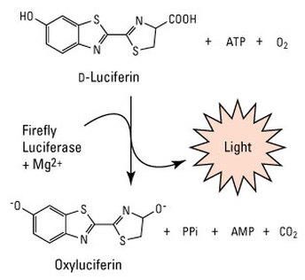
ATP Luciferase Reaction
ATP - Adenosine triphosphate
Monitors report reaction as light intensity units RLU as indicator of protein concentration
Light
ThermoFisher - https://www.thermofisher.com/order/catalog/product/16176
Notes:
Adenosine triphosphate (ATP) is a molecule responsible for transferring energy within a cell. If ATP is detected on a surface, something living or (previously living) is present as well. The monitors report light intensity as an indicator of protein concentration or a living cell.
ATP sanitation verification systems measure the ATP collected from food contact surfaces or liquids as an indication of the cleanliness of the surface, or purity of the liquid,” said Neogen’s Erick Pardo. “They work by measuring the light created when ATP contacts a reagent in the system’s sampling devices. The higher the levels of food residue and microorganisms in a surface or water sample, the more ATP, and the more light produced.”
Luciferase is an enzyme. An enzyme is a chemical (called a catalyst) that interacts with a substrate to affect the rate of a chemical reaction. The interaction of the luciferase with oxidized (oxygen-added) luciferin creates a byproduct, called oxyluciferin. More importantly, the chemical reaction creates light.
Most bioluminescent reactions involve luciferin and luciferase. Some reactions, however, do not involve an enzyme (luciferase). These reactions involve a chemical called a photoprotein. Photoproteins combine with luciferins and oxygen, but need another agent, often an ion of the element calcium, to produce light.
fluorescence does not involve a chemical reaction. In fluorescence, a stimulating light is absorbed and re-emitted. The fluorescing light is only visible in the presence of the stimulating light. The ink used in highlighter pens is fluorescent. Phosphorescence is similar to florescence, except the phosphorescent light is able to re-emit light for much longer periods of time. Glow-in-the-dark stickers are phosphorescent.

Slide 7
ATP Luciferase Reaction
ATP
Firefly
Luciferase
+ Mg²⁺
ThermoFisher - https://www.thermofisher.com/order/catalog/product/16176
Notes:
Adenosine triphosphate (ATP) is a molecule responsible for transferring energy within a cell. If ATP is detected on a surface, something living or (previously living) is present as well. The monitors report light intensity as an indicator of protein concentration or a living cell.
ATP sanitation verification systems measure the ATP collected from food contact surfaces or liquids as an indication of the cleanliness of the surface, or purity of the liquid,” said Neogen’s Erick Pardo. “They work by measuring the light created when ATP contacts a reagent in the system’s sampling devices. The higher the levels of food residue and microorganisms in a surface or water sample, the more ATP, and the more light produced.”

Slide 8
ATP Luciferase Reaction
Firefly
Luciferase
+ Mg²⁺
ATP
ThermoFisher - https://www.thermofisher.com/order/catalog/product/16176
Notes:
Adenosine triphosphate (ATP) is a molecule responsible for transferring energy within a cell. If ATP is detected on a surface, something living or (previously living) is present as well. The monitors report light intensity as an indicator of protein concentration or a living cell.
ATP sanitation verification systems measure the ATP collected from food contact surfaces or liquids as an indication of the cleanliness of the surface, or purity of the liquid,” said Neogen’s Erick Pardo. “They work by measuring the light created when ATP contacts a reagent in the system’s sampling devices. The higher the levels of food residue and microorganisms in a surface or water sample, the more ATP, and the more light produced.”

Slide 9
ATP Luciferase Reaction
Firefly
Luciferase
+ Mg²⁺
Light
AMP
ThermoFisher - https://www.thermofisher.com/order/catalog/product/16176
Notes:
Adenosine triphosphate (ATP) is a molecule responsible for transferring energy within a cell. If ATP is detected on a surface, something living or (previously living) is present as well. The monitors report light intensity as an indicator of protein concentration or a living cell.
ATP sanitation verification systems measure the ATP collected from food contact surfaces or liquids as an indication of the cleanliness of the surface, or purity of the liquid,” said Neogen’s Erick Pardo. “They work by measuring the light created when ATP contacts a reagent in the system’s sampling devices. The higher the levels of food residue and microorganisms in a surface or water sample, the more ATP, and the more light produced.”

Slide 10
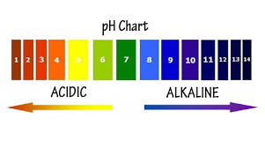
Instrument/Measurement Limitations
Limitations - physical, chemical, instrument, or user interface
ATP Luciferase Methods Affected by:
Sanitizers - pH
Temperature and Time
Notes:
All measurements have limitations, and the instruments as well as the ATP method have reported limitations.
Temperature and time also can be limiting factors. Some swabs must be refrigerated for storage, but must be at room temperature before using for sampling. Others do not require refrigeration. Time can be a factor when sampling as well, once the enzyme is applied to the swab the reaction begins and the strength of the response can degrade over time.
Others do not require refrigeration. Time can be a factor when sampling as well, once the enzyme is applied to the swab the reaction begins and the strength of the response can degrade over time.
Velazquez conducted research in the 90s looking at sanitizer effects on the enzymatic reaction of ATP monitors available at the time and found that residual sanitizers on sampled surfaces can have differing effect on the bioluminescence signal obtained. The type of sanitizer as well as the concentration of the sanitizer can have a quenching or enhancing effect on the results.
“Enhancement of the signal in some cases, may lead to false-positive results for the sanitation crew resulting in an extra cost of labor and investment as well as delays in production when surfaces are falsely classified as dirty. However of more concern is the situation when the ATP bioluminescens signal is quenched, suggesting the surface is clean and sanitized when there still may be organic material, or surviving microorganisms present that could lead to contamination”
For reference:
Limitations – “Antimicrobial disc assays demonstrated that in some cases the cleanser or sanitizer concentration was not effective against the bacteria, but enhanced or quenched the detection of bioluminescence signal, leading to fall-positive or false negative results” (madeline Velazquez, Journal of Food Prot. Vol. 60, No. 7, 1997 pg 799-803

Slide 11
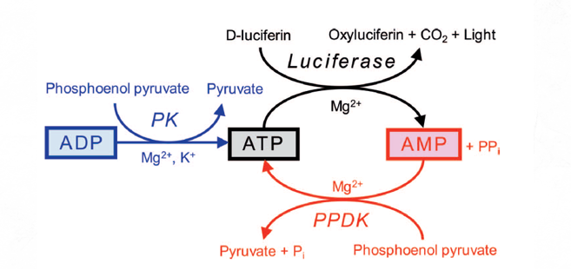
Instrument/Measurement Limitations
ATP Values Affected by:
R_{x} Transitional - ATP, ADP, AMP
Product and product state (raw vs aged/finished)
Source Bakke and Suzuki, J. Food Prot. Vol 81, No.5 pg 730
Notes:
All measurements have limitations, and the instruments as well as the ATP method have reported limitations.
Overall A3 – 2xs higher than just ATP
A3 method 3x higher than just ATP method in milk products (highly processed foods, butter, ice cream, cheese and coffee creamer >than 3xs
Raw meat – fish contain ADP
Eggs, processed meat, seafood, sausage, bacon, beef jerky, canned fish and dried fish- AMP
Grains, nuts, pasta, noodles, peanut butter, beer, mostly low responses and consist of AMP
Fruits and vegetables mostly AMP and ADP different based on species
“Enhancement of the signal in some cases, may lead to false-positive results for the sanitation crew resulting in an extra cost of labor and investment as well as delays in production when surfaces are falsely classified as dirty. However of more concern is the situation when the ATP bioluminescens signal is quenched, suggesting the surface is clean and sanitized when there still may be organic material, or surviving microorganisms present that could lead to contamination”
I’d like to talk a little bit more about the study population and recruitment methods as well as the contents of the survey that was administered.
For reference:
Limitations – “Antimicrobial disc assays demonstrated that in some cases the cleanser or sanitizer concentration was not effective against the bacteria, but enhanced or quenched the detection of bioluminescence signal, leading to fall-positive or false negative results” (madeline Velazquez, Journal of Food Prot. Vol. 60, No. 7, 1997 pg 799-803

Slide 12
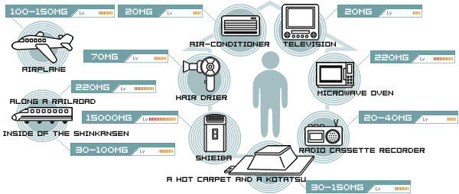
Instrument/Measurement Limitations
ATP Instrument Limitations:
photodiode, photomultiplier
electromagnetic interference
http://www.tecnoao-asia.com
Notes:
All measurements have limitations, and the instruments as well as the ATP method have reported limitations.
Limitations associated with the operation of the instrument itself can be associated with photodiode or the photomultiplier as well as the analytic capabilities of the software. One instrument that I reviewed indicated that there may be electromagnetic interference associated with EM emitting equipment as you can see, there are quite a few EM emitters that are commonplace
On caveat though, it that these limitations can be evaluated by calibration procedures, the use of blank, known samples or duplicate analysis. Additionally most instrument companies recommend yearly factory calibration of equipment. The technical experts that I have spoken too also recommend that the firm evaluate the use for their specific application.
I’d like to move on to talk a little more about the background of the study that I conducted…
For reference:
Limitations – “Antimicrobial disc assays demonstrated that in some cases the cleanser or sanitizer concentration was not effective against the bacteria, but enhanced or quenched the detection of bioluminescence signal, leading to fall-positive or false negative results” (madeline Velazquez, Journal of Food Prot. Vol. 60, No. 7, 1997 pg 799-803

Slide 13
Background
Maryland regulates 1387 manufactured food firms, of those 482 are prioritized as high-priority facilities
Unclear how HPF are employing these DRI/RT currently
How they are incorporating them into standard operating procedures, GMP, PC
Notes:
Maryland regulates 1387 firms that are designated as manufactured food firms, of those 482 are prioritized as high-priority facilities.
At this time it is unclear how many of MD HPF are employing DRI/RT instruments in their firms or how they are incorporated into their processing environments.
I have a brief discussion about ATP monitors and how they work in the next few slides. The use of ATP monitors is featured in this research.
Direct-reading instruments, such as monitors that measure adenosine triphosphate (ATP), a component of all living cells, have been used for over 20 years for the validation of sanitary conditions in the food industry (Valezquez, 1997). Multiple DRI/RTM instruments are commercially available to evaluate environmental sanitation and allergen control measurements. These instruments are produced by Accupoint, Hygiena, Neogen, 3M, BioControl, and Charm. Publicly available research was reviewed that describes the use of these instruments, generally in the dairy, meat, and brewing industries. (Sala, 2009) However, it is unclear exactly how these instruments are currently being used by the food manufacturing industry in Maryland high-priority firms.
ATP monitors employ the oxidation reaction of luciferase with ATP to produce photons of light that are then read and reported as relative light units (RLU) by a luminometer, light detector. Surfaces within a facility are swabbed, an enzyme is added to the swab and then the swab is placed into the instrument that reports a RLU reading or a text and/or colorimetric judgement indicator (ex. good green; yellow, caution; red, fail). The detection of ATP on a surface indicates the presence of living cells or organisms and high RLU measurements are interpreted as an indicator of an unclean surface or a surface with living cells. ATP monitors may also be used as a rapid test method indicating the presence of proteins for general allergen detection.

Slide 14
Problem Statement
The extent of the use of DRI/RT instruments by manufacturing firms in Maryland is largely unknown by the Maryland Department of Health.
Notes:
“Problem Statement”
More information on industry use of these instruments for risk control practices to validate hazard controls and trigger corrective actions will increase understanding for Maryland food regulators.
‘Let’s talk about the specific research questions that we had at MDH

Slide 15
Research Questions
What DRI are currently being used in Maryland high-priority firms?
What are the purposes that these instruments are being employed, sanitary standard operating procedures, hazard controls or preventive controls?
Notes:
Research questions for this study consist of determining what types of DRI are currently being used by MDHPF.
What purposes that the instruments are being used for, sSOPs, GMPs, allergen control, preventive controls?
How they are using the the instruments to make decisions, are some of the assumptions used to make corrections,

Slide 16
Research Questions (continued)
What training methods are used by firms for personnel using their specific equipment?
Are the firms aware of the limitations that are associated with these instruments for their application?
Notes:
What training methods are being used by firms to prepare their employees to use these instruments.
Additionally we were interested in the limitations associated with the instruments as these limitations may impact “go no-go” decisions that can impact food safety.
Next we’ll discuss the methodology that was used to evaluate these research questions.

Slide 17
Methodology
Survey - yes/no, & open-ended questions
Reviewed and tested, then revised
Administered via telephone with firm Quality Assurance/Food Safety representative
Data - Excel
Data reported using descriptive statistics
Further qualitative analysis of attribute data
Notes:
The methodology employed was the development of a survey. This survey consisted of yes/no as well as open-ended questions.
The survey was reviewed by MDH OFP staff and administered to selected industry partners and then revised based on question flow, natural response patterns as well as follow on questions or needed explanations.
I reviewed made all of the calls to firms, requested to speak with firm QA/FS representatives, scheduled interview times convenient to the participants and the survey was administered via phone. The time of administration was between 15-45 minutes based on Sections of the survey completed as well as follow on questions and further discussions.
Data was entered into an excel spreadsheet and descriptive statistics were calculated.
Open-ended questions were further evaluated and are also reported.
The next slide covers the study population was based on firms that were available via the MDH Office of Food Protection, Firm Inspection Database. At the time of this research , 482 High-priority food processing firms were identified and 50 firms were chosen to receive invitations.

Slide 18
Study Population
High-priority firms in Maryland
Ranged from specialty goods, bakeries, dairies, seafood, produce, meal kit, RTE foods
Quality Assurance, Quality Control, Food Safety Specialists
What instruments used by MDHPF
Notes:
The high-priority food processing firms Maryland ranged from speciality goods, (single products) to small to large bakeries, dairies, seafood producers, produce RTE preparation, sprouts, frozen foods, as well as production of meal kits, as well as other RTE foods.
Request was made at first contact to speak to the quality assurance, quality control or food safety specialist at the firm. That person varied from the owner to 1 of maybe 8 PCQI. In some cases for small firms, the term PCQI was not a familiar term. A few firms also were unsure of FSMA requirements and whether PC rules pertained to them.
We also wanted to determine the type of instruments that were being used at our firms.

Slide 19
Recruitment, Participation, and Survey Content
Firms contacted via email and follow-up phone call
(n=50)
Use DRI/RT – Continue Survey
(n=12)
Sec 2 – Type of Instruments
How used, Training
Triggering Limits and Corrective Actions (CA)
Sec 3 – Verification, calibration, limitations
Sec 1 – General Survey Firm Production Production Volume Types of Products Regulatory Agencies
FSMA Requirements
PCQI In-House
(n=18)
Dropped
(n=1)
No Response
(n=30)
Responded
(n=20)
Refused
(n=2)
Do Not Use DRI/RT
End Survey
(n=5)
Figure1. Recruitment, Participation and Survey Section Content
Notes:
This may seem to be a complicated slide, but I will break it down into components in the next few slides and walk you through the recruitment process, the participants, their group as well as the components and questions explored in the survey.

Slide 20
Recruitment
Firms contacted via email and follow-up phone call
(n=50)
18 Participants
No Response
(n=30)
Responded
(n=20)
Refused
(n=2)
Notes:
50 Firms were contacted via an email invitation and then at least one follow up call was conducted for each of those 50 firms.
Of the 50 firms, I received no response from 30 firms, of the 20 firms that responded, 2 refused to take the survey, one due to corporate guidelines.
18 participants, completed Section 1 of the survey that asked general questions about the firm, their production volume, products and process, regulatory agencies as well as FSMA requirements for their firms. One firm was dropped from analysis due to inability of the individual to answer further questions about the DRI/RT used by the firm.
5 of the 18 participants reported that they did not use DRI/RT and the survey was ended for them as Section 2 and 3 were questions specific to the use of DRI/RT in the firm.
12 Firms reported using DRI/RT and those firms completed the all 3 sections of the survey. Section 2 was comprised of questions that explored the use of the instrument in the firm, how it was used, triggering limits and corrective actions based on instrument results. Section 3 questions explored firm understanding of instrument limitations and how they were made aware of those .
The next few tables present overall percentages of the results of the specific question by the 2 groups, those firms that DO NOT use DRI/RT and those that do.

Slide 21
Participation and Survey Content
Sec 1 – General Survey Firm Production Production Volume Types of Products Regulatory Agencies
FSMA Requirements
PCQI In-House
(n=18)
Dropped
(n=1)
Use DRI/RT
Do Not Use DRI/RT
Notes:
18 participants, completed Section 1 of the survey that asked general questions about the firm, their production volume, products and process, regulatory agencies as well as FSMA requirements for their firms. One firm was dropped from analysis due to inability of the individual to answer further questions about the DRI/RT used by the firm giving 17 firms in total, who were then divided into 2 groups.
.

Slide 22
Participation and Survey Content
Use DRI/RT – Continue Survey
(n=12)
Sec 2 – Type of Instruments
How used, Training
Triggering Limits and Corrective Actions (CA)
Sec 3 – Verification, calibration, limitations
Do Not Use DRI/RT
End Survey
(n=5)
Notes:
Again, 17 firms in total, who all completed Section 1 of the survey, they were then divided into 2 groups, 5 who did not report using DRI at that point the survey was ended.
For the 12 Firms who did report using DRI/RT firms all 3 sections of the survey were completed with them. Section 2 was comprised of questions that explored the use of the instrument in the firm, how it was used, triggering limits and corrective actions based on instrument results. Section 3 questions explored firm understanding of instrument limitations and how they were made aware of those .
The next few tables present overall percentages of the results of the specific question by the 2 groups, those firms that DO NOT use DRI/RT and those that do.

Slide 23
Results- Table 1 a – Do Not Use DRI/RT
1a. MDHPF Who Do Not Use DRI/RT Section 1 - General Questions Only
Survey Criteria | % Firms (n=5)
Subject to Process PC | 40
Subject to Sanitation PC | 40
Subject to Supply-Chain PC | 40
Subject to Allergen PC | 40
PCQI In-House | 60
Food Safety Plan in Place | 60
Unsure of FSMA requirements | 60
Notes:
Table 1a contains the selected results of the of the firms that do not use DRI/RT and completed the Section 1 - General Questions, 40 percent reported being subject to FSMA Process, Sanitation, Supply-Chain and Allergen Preventive Controls. 60 percent reported having a PCQI in house, as well as having a food safety plan in place. Of those 5 firms, 3 reported being unsure about FSMA requirements for their firms.
Now we will move on to the firms that do use DRI/RT

Slide 24
Table 1b - MDHPF Who Do Use DRI/RT
Section 1 – General Business Characteristics | %* Firms (n=12)
Process/Sanitation/Allergen/Supply Chain PC | 92
PCQI In-house | 100
Food Safety Plan in Place | 100
Corrective Actions Plans in Place | 100
* Rounded to the nearest whole number
Notes:
Table 92% of the Firms that use DRI/RT report that they are subject to the process, sanitation, allergen and supply chains as designated in FSMA. 100% percent report having a PCQI person on staff and 100% report having a food safety plan in place. ‘
Additional information collected revealed that 8 firms reported daily use of ATP monitor – of those that reported between 4-70 per day
When asked about threshold Measurements of the ATP meters used, acceptable values were reported between 0-10,000 RLU. This range of values were based on different locations raw vs finished product areas and specific conditions associated with products, for example raw produce, raw milk as well as finished products.
I’d like to talk about some of the other information reported associated with the open-ended questions.

Slide 25
1b. Results, Section 2 - How Instrument is Used in Firm
SEC 2. How Instrument Used in Firm | %* Firms (n=12)
Use Only ATP DRI | 92
Use Allergen Rapid Tests | 75
Conduct In-house Microbial Analysis | 50
Use for GMPs only | 8
Use for Preventive Controls only | 8
Use for Both GMPs and Preventive Controls | 75
3rd Party Audit | 58
In-house Training Program | 100
3rd Party/Corporate Training Program | 33
* Rounded to the nearest whole number
Notes:
Table 92% of the Firms that use DRI/RT report that they are subject to the process, sanitation, allergen and supply chains as designated in FSMA.
100% percent report having a PCQI person on staff and 92% report having a food safety plan in place. ‘
92% report using an ATP monitor or Allergen Rapid Test Methods
Training is provided in-house for the use of the instruments and sampling methods by 100% of the firms. 33% of firms also report having a 3rd party or corporate training program that is conducted each year.
50% of firms conduct in-house microbial analysis, additionally all firms use a 3rd party lab for their microbial analysis of environmental samples and finished products.
When asked about knowledge of instrument limitations, 25% of those interviewed were aware of limitations.
Additional information collected revealed that 8 firms reported daily use of ATP monitor – of those that reported between 4-70 per day
When asked about threshold Measurements of the ATP meters used, acceptable values were reported between 0-10,000 RLU. This range of values were based on different locations raw vs finished product areas and specific conditions associated with products, for example raw produce, raw milk as well as finished products.
I’d like to talk about some of the other information reported associated with the open-ended questions.

Slide 26
1b. Results, Section 3 – QA Procedures/Limitations
SEC 3. - Quality Assurance Procedures and Limitations | %* Firms (n=12)
Yearly Calibration of Instrument | 67
Collect Blank, Duplicates, Positive Negative Controls | 33
Not Aware of Instrument Limitations | 75
* Rounded to the nearest whole number
Notes:
When asked about the calibration of instruments of those who reported, 67% said that the instruments were calibrated yearly. One manufacture actually sent new equipment yearly and had the other instruments returned. Of the 33% who reported some type of QA procedures, a few ran blanks and duplicate samples. It was also discussed a specific negative control and positive control program that was arranged by instrument supplier or as a 3rd party audit program.
Of greater concern thought, was when asked about knowledge or awareness of instrument limitations, 75% of those interviewed were NOT aware of any limitations.
I’d like to talk about some of the other information reported associated with the open-ended questions.

Slide 27
Other Results
Bakeries, produce, dairy, packaged meals, seafood
Single multi-use - 19 production lines
PCQI - 1-8 individuals
88% Report PCQI (unsure of FSMA designation of PCQI)
All firms conduct instrument training, effectiveness assessed by various methods
Notes:
As was reported earlier, there was a wide range of firms interviewed, bakeries, produce, dairy, packaged meals, seafood as well as speciality goods and single products.
The size of the firms varied from just the use of a single multi-use area to as many as 19 production lines. Of those firms that reported multiple production lines, the median was 9 production lines.
For the firms that reported a PCQI on staff they reported as few as 1 (usually the owner an sole operator) up to as many as 8 PCQI trained staff. 88% of Firms report having a Food Safety Plan currently in Place.

Slide 28
Other Findings
Different sanitation products and procedures used in firms
Seven firms audited or certified by 3rd party
6 Instrument brands reported
Review of instrument manuals,
1 reported sanitizer interference
1 reported electromagnetic interference from equipment
Notes:
Most firms reported using multiple sanitizing chemicals or methods within their firm. These were based many times on corporate or 3rd party guidelines, organic certification requirements or associated risk as determined by the product or process. One firm reported using a silver dioxide fogger as well as dry steam in some areas of the plant.
When considering the limitations of the ATP method as discussed before in the presence of residual sanitizer I reviewed the user manuals of the 6 instruments that were reported used by the MDHPF that were interviewed. Of the 6 instrument manuals, 1 manual had a section that discussed the interference, quenching or enhancement potential of sanitizer on the readings and 1 other manual discussed the potential of electromagnetic interference by equipment that may be used in the firm.
Conclusions of this study are discussed on the next slide

Slide 29
Conclusions
Used for verification of GMPs, sSOPs allergen and preventive controls
Triggering limits for corrective actions varied
Corrective actions vary based on characteristics of business
Notes:
DRI/RT were used for the verification of GMPs, sSOPs, allergen control as well as preventive controls in firms. DRI/RTs reported were ATP monitors, rapid microbial test kits, as well as electronic allergen monitoring, allergen test strips and lateral flow devices.
The triggering limits for corrective actions varied based on the product, the stage of production, as well as the instrument.
All firms reported corrective action plans for ATP levels, microbiology as well as allergen detection. Those varied based on individual firm guidelines, 3rd party guidelines or regulatory requirements.
We considering the corrective action plans, most described a process that included a deep cleaning of the area where a positive swab was collected or the piece of equipment sampled with a retesting procedure that varied based on type ATP, microbiology or allergen.
When questioned about the different sanitizing agents used in firm a wide variety of chemicals and methods were reported. We’ll talk about that on the next slide.

Slide 30
Conclusions (continued)
In-house training was conducted by all firms, 3 firms report having 3rd party training
75% of firms report NOT being aware of instrument limitations
Only 1 firm reported being informed of potential limitations
Limitations or misinterpretation of “clean or safe” adversely impacts the actual safety of the environment or product
Notes:
The threshold for triggering corrective actions were different based on the instrument used, specific acceptable levels within the specific food product and 3rd party audit requirements.
All firms using DRI/RT reported conducting in-house training by a PCQI. 3 firms have a yearly 3rd party training event. ‘
Effectiveness of the training was assessed by various methods, pre-post quizzes, field tests as well as direct observation.
When PCQI personnel were questioned about their interactions with the manufacturer manuals, and technical support of these DRI/RT technologies, the limitations related to the use of these technologies for verification or validation of sanitary conditions are not adequately explained. These limitations were discussed with the firms at the time of the interview.
When discussing the limitations of the DRI/RT methods, 75% of firms were NOT aware of the limitations of the instruments that they were using. Only 1 firms reported an instrument company that informed them of potential limitatons.
The misinterpretation or improper use of these technologies to designate a “clean or safe” environment for food production could adversely impact the actual safety of the produced food.

Slide 31
Recommendations
Food safety regulators should include a discussion of the use of these methods and the limitations of the instruments during document and procedural review of sSOPs, GMPS and HACCP controls as well as for the PC Inspection.
Instrument manufacturing firms should be encouraged to provide guidance for training and use of their instruments including a discussion of the instrument/method limitations in the user manual that is provided with the purchase of the instrument.

Slide 32
Recommendations (continued)
Instrument manufacturing firms should provide training and technical support for purchasers to evaluate the use of their instruments in the firm and identify inappropriate use or misinterpretation of results.
The questionnaire used in this study should be used by other regulatory agencies to evaluate the use of direct reading instruments and user understanding adding to the body of knowledge.

Slide 33
Recommendations (continued)
Further research is critically needed to assess firm understanding as well as inspector and regulator knowledge of the use of DRI/RT in food production firms.

Slide 34
Acknowledgements
I would like to thank the MDH, Dr. Clifford Mitchell, Dr. Alan W. Brench, Subha Chandar, Patricia Vauls and Kyle Shannon (IFPTI Cohort VI) for their support.
Particularly, I would like to thank my colleagues Amy Nard, Anthony Lattanzi and Dr. Robin Henderson.
I would also like to thank the amazing colleagues that I have gained during the IFPTI fellowship process.
Funding for this program was made possible, in part, by the Food and Drug Administration through grant 5U18FD005964-03; views expressed in written materials or publications and by speakers and moderators do not necessarily reflect the official policies of the Department of Health and Human Services; nor does any mention of trade names, commercial practices, or organization imply endorsement by the United States Government.
Notes:
I can’t thank the leadership at the Maryland Department of Health enough for allowing me to take part in this fellowship opportunity. This has been an invaluable experience and I would recommend applying for the next Cohort to anyone who wants to expand their understanding of an Integrated Food Safety System and work with a team of SME’s with a wide range of experiences and sage advice.
Their intellect, expertise and dedication to public health, food safety and the betterment of society is humbling. I am encouraged and hopeful, knowing that our future is in good hands.

Slide 35
Questions?
D’Ann L. Williams, DrPH, MS, LEHS dann.Williams@Maryland.gov 410-767-2633
Notes:
Slide 35: “Questions?”
Thank you for your attention, I can take any questions or comments at this time.

Slide 36
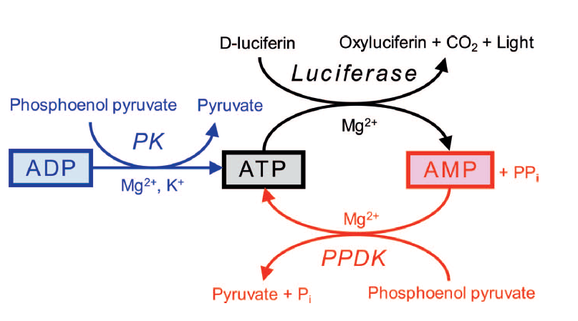
ATP – ADP – AMP Concepts
ATP degraded (dephosphorization) to ADP and AMP by heat, acids, alkalis, and enzymes
Source Bakke and Suzuki, J. Food Prot. Vol 81, No.5 pg 730
Notes:
Overall A3 – 2xs higher than just ATP
A3 method 3x higher than just ATP method in milk products (highly processed foods, butter, ice cream, cheese and coffee creamer >than 3xs
Raw meat – fish contain ADP
Eggs, processed meat, seafood, sausage, bacon, beef jerky, canned fish and dried fish- AMP
Grains, nuts, pasta, noodles, peanut butter, beer, mostly low responses and consist of AMP
Fruits and vegetables mostly AMP and ADP different based on species

Slide 37
Reliability – Quenching (+) and Enhancing (-)
Omidbakhsh N, Ahmadpour F, Kenny N (2014) How Reliable Are ATP Bioluminescence Meters in Assessing Decontamination of Environmental Surfaces in Healthcare Settings? PLoS ONE 9(6): e99951. doi:10.1371/journal.pone.0099951
Notes:
“The limitations of ATP luminometers clearly show that the units are not reliable in confirming proper removal of disease causing agents at healthcare settings. Inaccurate bioluminescence results causing false confidence on surface disinfection can ultimately jeopardize public health and rise infection control costs at hospitals and healthcare facilities.”
“By examining Table 1, it can be seen that healthcare disinfectants contain high levels of active ingredients. They also have other inert ingredients, which are usually not disclosed on their materials safety data sheets. Therefore swabbing a surface which has already been treated with a disinfectant has the potential to introduce high levels of residual chemicals to the swab and, subsequently, to the ATP measuring device. In food processing facilities, on the other hand, the chemical exposure will be significantly lower as FDA requirements (21 CFR 178.1005 & 1010 and similar guidelines) significantly limit the level of chemicals in food sanitizing and disinfecting solutions. This, results in much less chemical interaction, which could be the reason why not much chemical interaction is reported in ATP bioluminescence meters in these applications. It should be noted however that in this study, the disinfectant was directly applied to swab for the interaction test, while in real life situations, the disinfectant will be applied to the surface first, and in most part it will dry before swabbing. Therefore for volatile active ingredients such as alcohols or hydrogen peroxide, the actual chemical interaction may be less than the test results here, but for those non-volatile active ingredients, such as quaternary ammonium compounds or citric acid, the chemical interaction should be more or less the same if the surface is properly swabbed.”

Slide 38
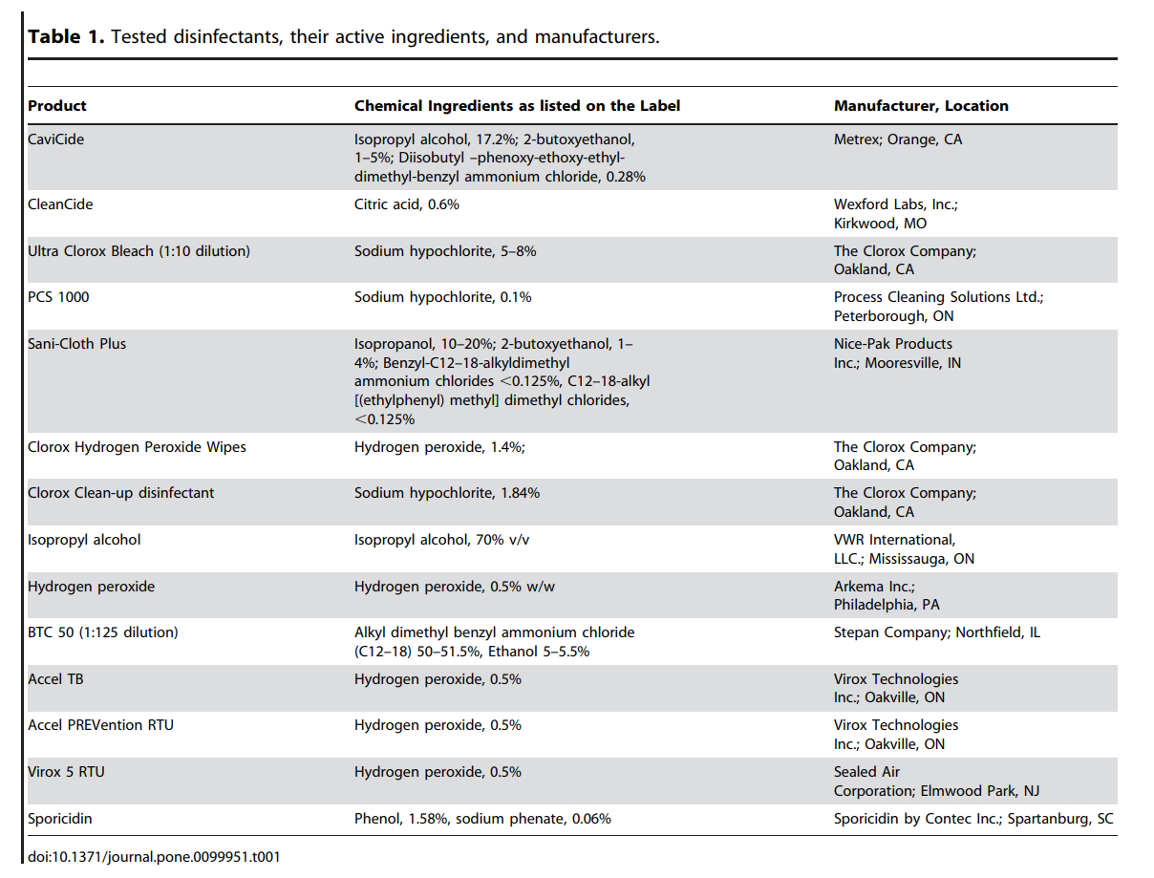
Notes:
Table 1 sanitizers addressed in the Omidbakhsh study How Reliable Are ATP Bioluminescence Meters in Assessing Decontamination of Environmental Surfaces in Healthcare Settings

Slide 39
ATP Luciferase Reaction
Adenosine triphosphate
Monitors report light intensity units RLU as indicator of protein concentration
Light
ThermoFisher - https://www.thermofisher.com/order/catalog/product/16176
Notes:
Adenosine triphosphate (ATP) is a molecule responsible for transferring energy within a cell. If ATP is detected on a surface, something living or (previously living) is present as well. The monitors report light intensity as an indicator of protein concentration or a living cell.
ATP sanitation verification systems measure the ATP collected from food contact surfaces or liquids as an indication of the cleanliness of the surface, or purity of the liquid,” said Neogen’s Erick Pardo. “They work by measuring the light created when ATP contacts a reagent in the system’s sampling devices. The higher the levels of food residue and microorganisms in a surface or water sample, the more ATP, and the more light produced.”

