Slide 1
Unique Device Identifier Implementation Presented by: Cornelia Rooks Senior Regulatory Specialist Registrar Corp 144 Research Drive Hampton, Virginia USA 23666

Slide 2
Medical Devices - Center for Devices and Radiological Health (CDRH)
An instrument, apparatus, implement, machine, contrivance, implant, in vitro reagent, or other similar or related article, including a component part, or accessory which is:
intended for use in the diagnosis of disease or other conditions, or in the cure, mitigation, treatment, or prevention of disease, in man or other animals, or
intended to affect the structure or any function of the body of man or other animals, and
- which does not achieve any of it's primary intended purposes through chemical action within or on the body of man or other animals and
- which is not dependent upon being metabolized for the achievement of any of its primary intended purposes.

Slide 3
Medical Devices
Class I: General Controls (Records and Files)
• Low risk (e.g., sunglasses, band-aids)
• Most exempt from 510(k)
Class II: General Controls and Special Controls
• Premarket Notification 510(k) (e.g., glucose monitoring kit, pregnancy test kits)
• Some exempt from 510(k)
Class III: General Controls and Premarket Approval (PMA)
• High risk (e.g., surgical laser, PSA tests)
• No exemptions

Slide 4
FDA Amendments Act (FDAA)2007 and FDA Safety and Innovation Act (FDASIA) of 2012
Not later than December 31, 2012, the Secretary shall issue proposed regulations establishing a unique device identification system for medical devices requiring the label of devices to bear a unique identifier, unless the Secretary requires an alternative placement or provides an exception for a particular device or type of device. The unique identifier shall adequately identify the device through distribution and use, and may include information on the lot or serial number.

Slide 5
FDA Amendments Act (FDAA)2007 and FDA Safety and Innovation Act (FDASIA) of 2012
The Secretary shall finalize the proposed regulations not later than 6 months after the close of the comment period and shall implement the final regulations with respect to devices that are implantable, life-saving, and life sustaining not later than 2 years after the regulations are finalized, taking into account patient access to medical devices and therapies.

Slide 6
Unique Device Identifier
FDA issued a final rule on September 24, 2013 which requires most medical devices to carry a Unique Device Identifier (UDI).
Label will have to bear the UDI.
Sometimes the device itself will have to bear the UDI.

Slide 7
Key Benefits of the UDI System
More robust postmarket surveillance system to support premarket clearance and approval.
More accurate reporting of adverse events.
More rapidly and precisely identify a device.
More effectively manage device recalls.
Enhance analysis of devices on the market.
Support a secure global distribution chain.

Slide 8
Establishment of UDI System
Four Distinct Steps:
Develop the unique device identifiers (UDI).
Place the UDI in human readable and/or AutoID on a device, its label, or both.
Create and maintain the UDI Database.
Adopt and Implement.

Slide 9
Unique Device Identifier
Implementation will be a phased-in approach with highest-risk medical devices first and exempting low-risk devices from some or all of the requirements.
UDI will be issued by an FDA-accredited agency and device information will be stored in a database.

Slide 10
W’s of UDI
Who
What
Where
When

Slide 11
Who: Labeler
The labeler is the person who causes a label to be applied to a device, or who causes the label to be modified, with the intent that the device will be introduced into interstate commerce without any subsequent replacement or modification of the label.

Slide 12
Labeler
In most instances, the labeler would be the device manufacturer, but the labeler may be a single-use device reprocessor, a convenience kit assembler,a repackager, or a relabeler.

Slide 13
Who is NOT a Labeler
The addition of the name of, and contact information for a person who distributes the device; without making any other changes to the label is not a modification for the purposes of determining whether a person is a labeler.

Slide 14
What: UDI
Device identifier (DI) - a mandatory, fixed portion of a UDI that identifies the labeler and the specific version or model of a device, and
Production identifier (PI) - a conditional, variable portion of a UDI that identifies one or more of the following when included on the label of a device:
the lot or batch number;
the serial number;
the expiration date;
the date manufactured;
the distinct identification code for a human cell, tissue, or cellular and tissue-based product (HCT/P) regulated as a device.

Slide 15
UDI System
A standardized system to create unique device identifiers (UDI).
FDA accredits the Issuing Agencies
Issuing Agencies develop unique labeler codes for use in UDIs, using ISO 15459
Labelers select Issuing Agencies to work with

Slide 16
Issuing Agencies
GS1 Princeton Pike Corporate Center 1009 Lenox Drive, Suite 202 Lawrenceville, NJ 08648
Health Industry Business Communications Council 2525 E. Arizona Biltmore Circle, Suite 127 Phoenix, AZ 85016
ICCBBA P.O. Box 11309 San Bernardino, CA 92423-1309

Slide 17
Where:
Labeler must place the UDI in human readable (Plain Text) and machine readable (AIDC) on label and packaging, and for certain devices, on the device itself.

Slide 18
UDI Application
Unique UDI applied to “base package” AND higher levels of packaging.
Default location is the label.
Human readable and encoded in a form of automatic identification technology.
Direct Marking (DM) for device intended to be used more than once and reprocessed before each use.

Slide 19
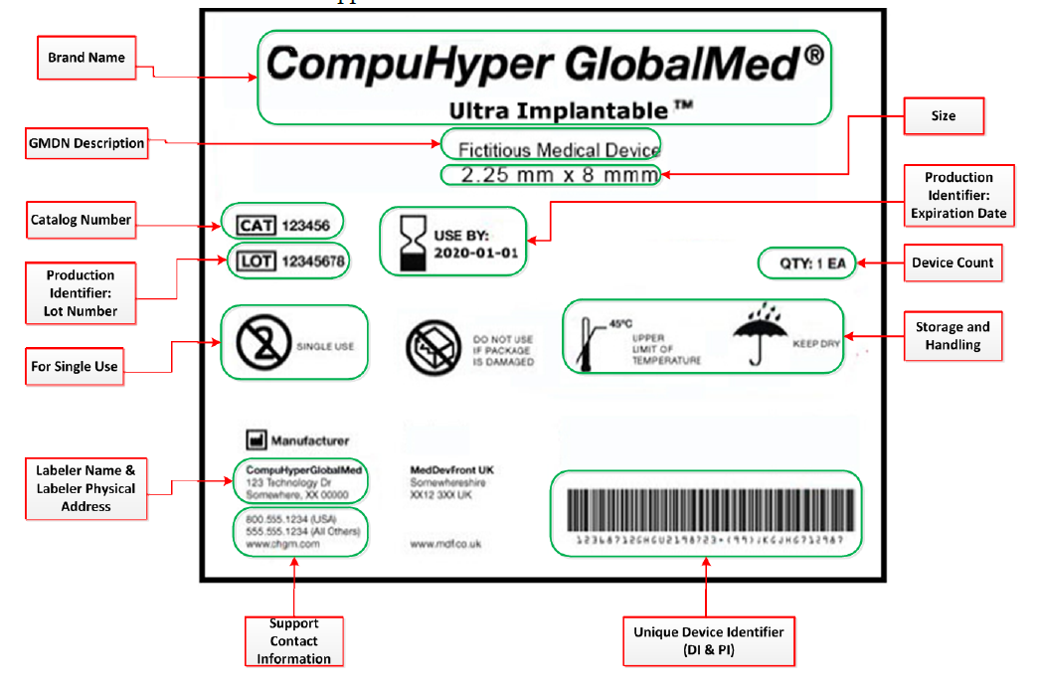
When a GUDID attribute appears on the medical device package/label, the values submitted to the GUDID should match the value on the label.

Slide 20
GUDID Database
FDA will create, maintain and use the UDI Database (GUDID)
GUDID includes a standard set of basic identifying elements for each device with a UDI.

Slide 21
GUDID Database
A publicly searchable database administered by the FDA, called the Global Unique Device Identification Database (GUDID) that will serve as a reference catalogue for every device with an identifier.
No identifying patient information will be stored in this device information center.

Slide 22
GUDID Guidance 6/11/14
Helps labelers prepare to submit information to the GUDID by describing key GUDID concepts such as accounts, user roles, the device identifier record life cycle, package configurations, and the GUDID data attributes and descriptions.

Slide 23
GUDID Database
The GUDID provides two options for submission of device identification information:
GUDID Web Interface – enables structured input of device information as one DI record at a time.
HL7 SPL submission – enables submission of device information as xml files.

Slide 24
GUDID Database
Submission of device information to GUDID requires establishment of a GUDID account, regardless of the submission option chosen –via Web Interface or via FDA ESG as HL7 SPL xml files.
GUDID provides two information retrieval options for published Device Identifier information:
1) Search and retrieval of device information via the web interface. (GUDID accounts are NOT required for search and retrieval of published information).
2) Download capability is planned for the future.
During the initial implementation, GUDID Public Search is temporarily disabled until a meaningful dataset of DI records have been created.

Slide 25
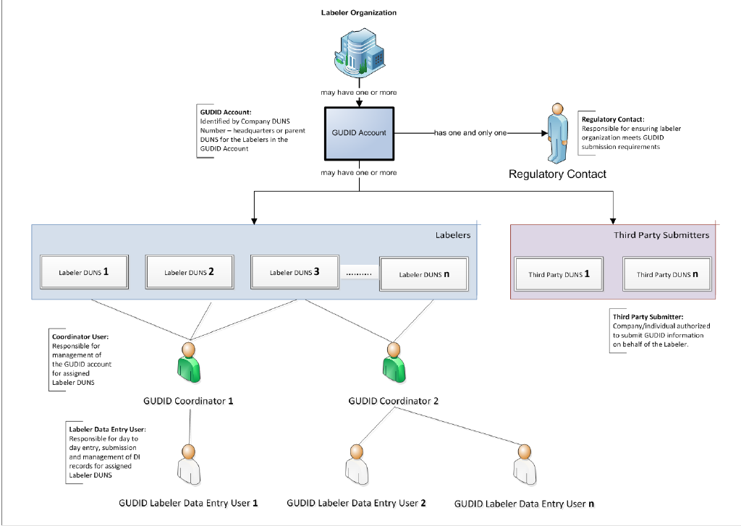
Note: GUDID utilizes DUNS numbers to enable identification of labeler organizations

Slide 26
When

Slide 27
General Exceptions
Finished device labeled and manufactured prior to compliance date.
GMP-exempt Class I devices.
Device used solely for research, teaching, or chemical analysis and not intended for clinical use.
Custom and investigational devices.
Class I Devices do not need to include Production Identifiers in UDI

Slide 28
General Exceptions
Individual single-use devices distributed in single packaging.
A combination product with NDC number is exempt I f combination components combined or mixed as a single entity.
A veterinary device not intended for use in man.
Device intended for export.
Exception for shipping container.

Slide 29
Requested Exceptions
A labeler may submit a request for an exception from or alternative to the requirement for the label of a device to bear a unique device identifier or other UDI requirement under 21 CFR 801 Subpart B for a specified device or a specified type of device.
Note: Extention
Request was due today!

Slide 30
National Health Related Items Code (NHRIC) and National Drug Code (NDC
Phased out over a time period that corresponds with the compliance dates for UDI requirements.
Any NHRIC or NDC numbers assigned to the device are rescinded and may no longer be provided on the device label or package.
If device is not required to bear UDI on label on the label, NHRIC or NDC will be rescinded and may no longer be on the device label or package after September 24, 2018.
A labeler may request continued use of an FDA labeler code under a system for the issuance of UDIs consistent with the framework

Slide 31
Need Assistance?
US Agent Services
Medical Devices
Electronic Establishment Registration and Device Listings
510(k) Administrative Review
Medical Device Master Files (MAF)
UDI Assistance
Export Certificates
Radiation-Emitting Devices
Electronic Product and Supplemental Reporting
Annual Reporting
Label Reviews
Certificates of Registration
Detention Assistance
Notes:
31
31

Slide 32
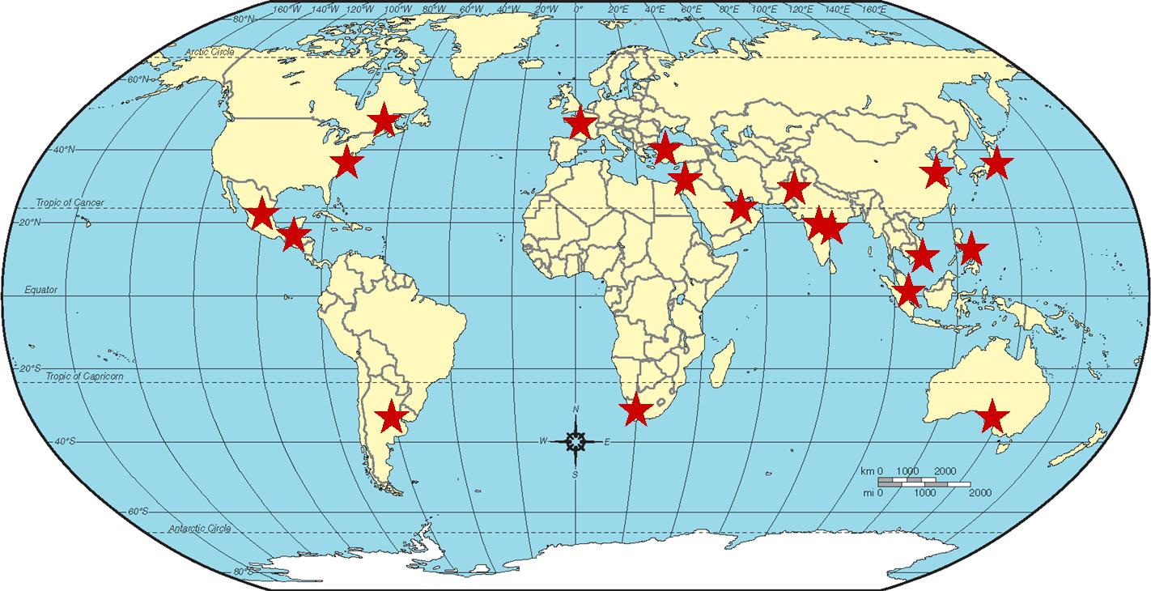
A Global Presence
24/7 “Live Help” on web site- www.registrarcorp.com
19 overseas offices.
Notes:
32
32

Slide 33
Questions and Answers
Registrar Corp Headquarters
144 Research Drive
Hampton, Virginia 23666
P: 757-224-0177
F: 757-224-0179
E: info@registrarcorp.com
W: www.registrarcorp.com
Notes:
33
33

