Slide 1
Aflatoxin Risk Management
Tim Herrman
Professor, State Chemist and Director
Notes:
I’ve been a member of AFDO since 2011 and attended my first annual meeting in Plano TX.
Today, I will speak on the topic of aflatoxin risk management. I am a risk manager for the state of Texas where I serve as director of the Texas Feed and Fertilizer Control Service which is the state government agency specifically tasked with managing aflatoxin risk in cereals and oilseeds as well as animal feed.

Slide 2
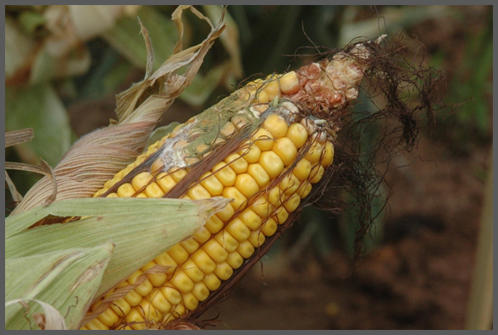
Notes:
Aflatoxin is a toxic fungal metabolite produced by two species of fungi, Aspergillus flavus and Aspergillus parasiticus. Toxin production can occur in the field or in storage.

Slide 3
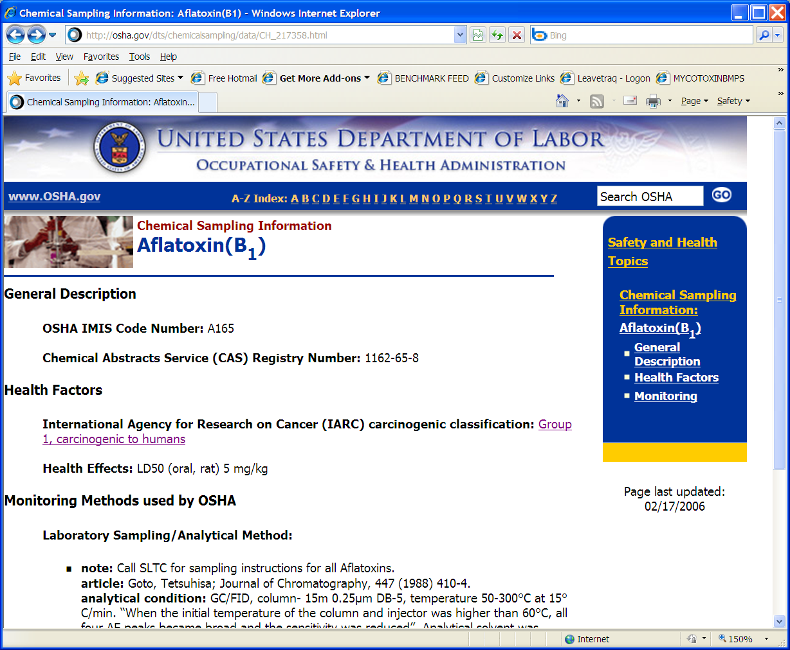
Notes:
Aflatoxin is a group I carcinogen as designated by the International Agency for Research on Cancer. Because of its toxicity, aflatoxin contamination is both a food safety and public health issue.
Quoting from a report by the Gates foundation: In high doses, aflatoxins can lead to serious illness including acute liver cirrhosis and death in both humans and animals. Chronic sub-lethal doses of aflatoxin are more insidious. Aflatoxin exposure is strongly linked to an increased risk of liver cancer with the rate of liver cancer reported to be up to 60 times higher in the aflatoxin hotspots. Two independent studies have linked aflatoxin to immune suppression, increased susceptibility to diseases (e.g. HIV and malaria), and possibly compromised vaccine efficacy. According to studies, young children remain particularly vulnerable, with aflatoxin exposure significantly inhibiting children's growth and development while seriously damaging children's immunity to everyday health issues.

Slide 4
FDA Aflatoxin Action Levels
ppb | Product Description
20 | Corn, peanut products, cottonseed meal, and other animal feeds and feed ingredients intended for dairy animals, for animal species or uses not specified above, or when the intended use is not known
20 | Corn, peanut products, and other animal feeds and feed ingredients, but excluding cottonseed meal, intended for immature animals
100 | Corn and peanut products intended for breeding beef cattle, breeding swine, or mature poultry
200 | Corn or peanut products intended for finishing swine of 100 pounds or greater
300 | Corn and peanut products intended for finishing (i.e., feedlot) beef cattle
Notes:
Action levels are non-regulatory limits provided by the FDA and voluntarily followed by industry. Due to the repeated and high levels of aflatoxin in Texas, the Texas State Chemist has provided regulatory limits and are found within Title 4 Chapter 61 of the Texas Administrative Code. Any cereal or oilseed is defined as feed if it exceeds the 20 ppb action level and falls under the regulatory authority of the Texas Feed and Fertilizer Control Service.

Slide 5
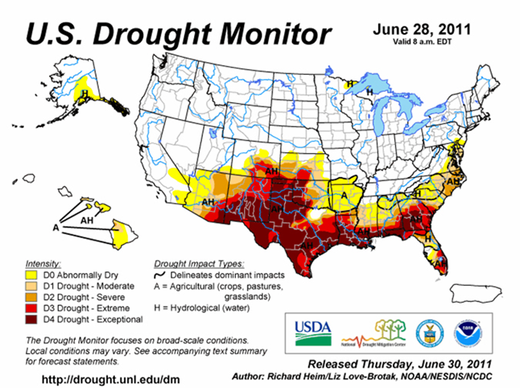
Notes:
Texas has long had to deal with the problem of drought and extreme heat, as depicted by this screen capture slide of a Texas A&M AgriLife Extension website. I’ve included a national map highlighting the 2011 Texas Drought as of June 2011 which became progressively worse though out the year.

Slide 6
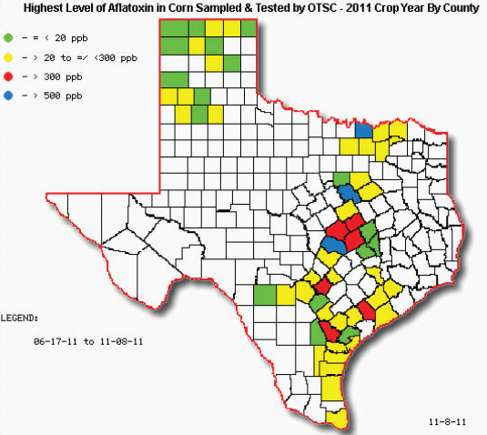
Notes:
Stress during the growing season, either by weather (abiotic) or biotic such as pests, predisposes the plant to fungal infection and production of aflatoxin. In Texas, this map illustrates the highest incidence of aflatoxin found in each county where corn was produced in 2011, with blue indicating that at least one incident of aflatoxin was found to exceed 500 ppb, which occurred in three counties. There were six counties where aflatoxin exceeded 300 ppb in at least one sample and 8 counties along the I35 corridor where aflatoxin was found to not exceed 20 ppb.

Slide 7
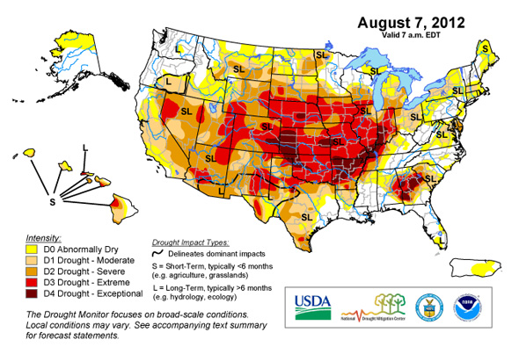
Notes:
The 2012 drought in the Midwest is depicted on this map for August 2012. The corn plants growth stage in August within the Midwest is nearly comparable to the corn growth stage in June for Texas, which was shown in an earlier slide for 2011.

Slide 8
http://otscweb.tamu.edu/Risk/Aflatoxin/Blending.aspx
Notes:
Eight Midwestern states sought and received a blending waiver from FDA during 2012. Our agency, the Office of the Texas State Chemist, posted information for all 8 states on their website, obtained through open records requests. Several states withheld the names of the companies that requested blending waivers and, in one state, regulatory officials were specifically instructed to not inform the public that they had received approval from FDA to permit blending corn free of aflatoxin with corn up to 500 ppb aflatoxin.
Texas is a major customer of Midwest corn. The state of TX requires approximately 30,000 railcars of corn for the dairy, broiler and pet food industry that contain less than 20 ppb aflatoxin.
Thus, it became essential to public health that our agency actively monitor and report aflatoxin incidence in the midwest corn crop, similar to what is done in Texas. This slide illustrates how our agency mapped aflatoxin incidence in two midwest states.

Slide 9
Notes:
At the end of this presentation I will present a few slides discuss Texas policy involving aflatoxin risk management.
However, in this slide I would like to illustrate how farm and environmental policy impacts crop production and the potential for increased incidence of aflatoxin. The renewable fuel standard leads to the channeling of over 5 billion bushels of corn into fuel ethanol production per year. In response to the increased demand for corn, there has been a reduction in crop rotation, that has also coincided with increased use of GM plantings. Crop rotation is an agronomic practice that helps in pest management by reducing inoculum of pathogens, such as Aspergillus that can infect the corn plant and produce aflatoxin.

Slide 10
Boryan et al. 2008
Notes:
Boryan, Craig and Willis from USDA/NASS performed an evaluation of single crop planting intensity and crop rotation patterns in NE, IA, and IL. This slide illustrates corn planting in four counties where 15% of the acres had been used to produce corn 5 years in succession in Delaware country, 6% in Hamilton, 13% in Debuque and 2% in Iowa.

Slide 11
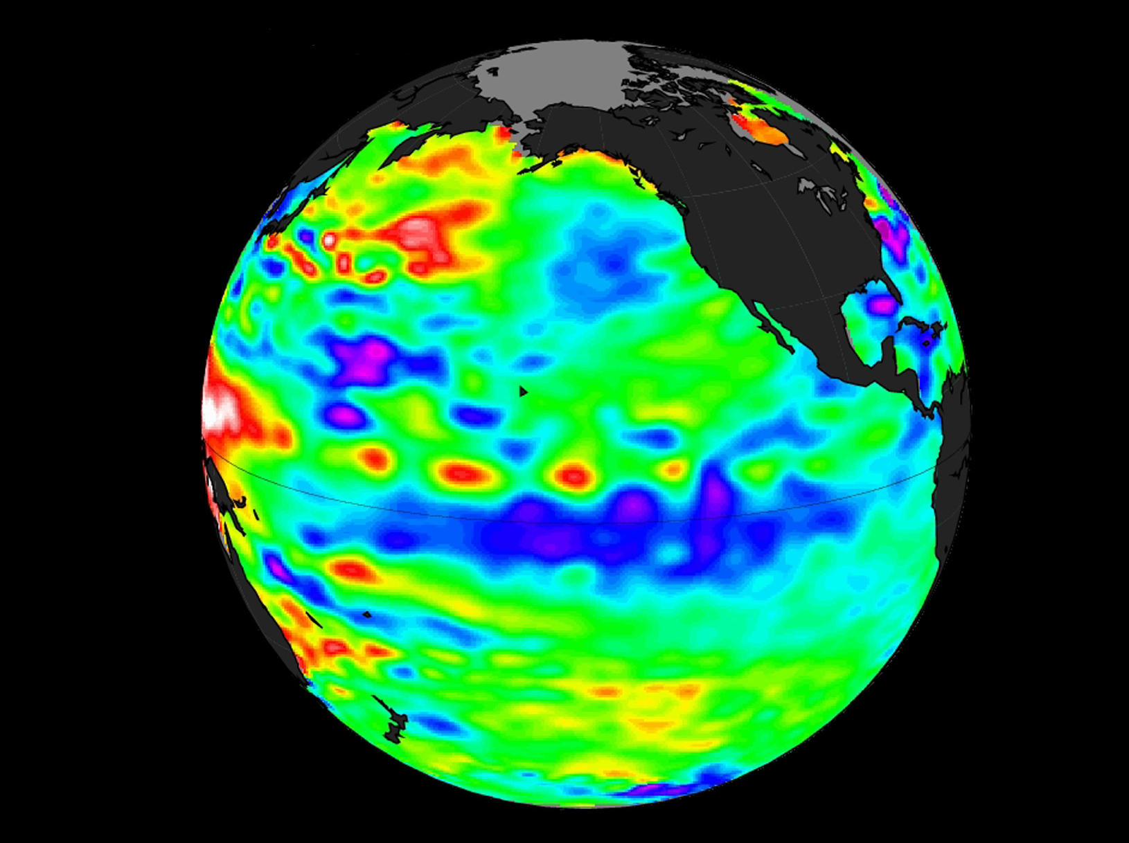
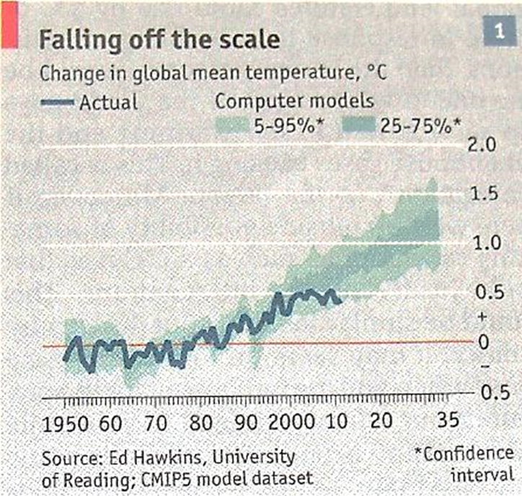
State Climatologist: Global surface temperatures likely to set a new record this year
2010 NASA/Jet Propulsion
Laboratory false-color image
Notes:
While Global temperatures have been relatively flat for the past several years, the factors causing global warming are still there, according to Texas A&M climatologist Neilson Gammon. The possibility of a more serious incidence of aflatoxin in the temperate growing regions of the US and world is predicted (e.g. Feedipedia, May 6, 2014) if global temperatures continue to rise and drought cycles continue. Combined with growing evidence of loss in resistance involving GM traits, it appears the current production practices in the US may not be sustainable and mycotoxin risk will increase.

Slide 12
Outline
Statistically derived risk-based plan of work
A good utilization of resources
Co-Regulation of aflatoxin risk as a preventive control
Greatly improved aflatoxin testing accuracy in the regulated community and increased confidence
Risk Assessment of the FDA blending waiver
A predictable level of milk contamination in Texas occurred in 2012 from Midwest corn
Policy Considerations
FDA should make permanent and nationwide the blending of 0 to 500 ppb aflatoxin contaminated corn
Use of aflatoxin binders
Notes:
It is against this backdrop I would like to discuss aflatoxin. First, I want to discuss how our agency develops its contaminant plan of work using aflatoxin as a model, hence, the topic of a statistically derived risk-based plan of work. Second, the application of preventive controls for aflatoxin risk using co-regulation and the overall impact in the state of Texas including improved aflatoxin testing accuracy and increased confidence in the market place involving regulator actions involving this toxin. Third, risk assessment is a tool by which we can predict and quantify risk. Our agency performed an aflatoxin risk assessment involving the FDA blending waiver to predict incidence of aflatoxin M1 in milk within Texas and compared our results with the Texas Department of State Health Services milk monitoring program. Fourth, I would like to revisit the topic of policy and discuss the idea of making the FDA blending waiver permanent and the use of aflatoxin binders.

Slide 13
Statistically derived risk-based plan of work: binomial probability statistics
$$\frac{p±\frac{z2∝/2}{2n} ±Z∝/2\sqrt{\frac{p(1−p)}{n}+\frac{z2∝/2}{4n2}} }{1±\frac{z2∝/2}{n} }$$
Wilson
interval:
Where
n: sample size = 3056
z$∝/2 :\left(1−\frac{∝}{2}\right)100th percentile of the standard normal distribution$
p: observed sample proportion = 0.206
Notes:
Our agency utilizes binomial probability statistics to calculate the confidence interval at a 95% significant level to estimate the number of samples required within our annual plan of work to accurately characterize the level of risk a particular contaminant poses to our state.
Binomial probability is Yes:No, similar to flipping a coin. In the case of a contaminant, we use the Wilson interval to estimate the upper and lower probability of contamination and we use these to estimate the number of samples to include in our POW. In this example, n is the total number of samples evaluated by our agency in the past three years, the Z statistic provides our level of significance, and the p value is the observed number of positive samples over the past three years.

Slide 14
Harvested Corn Mycotoxin Work Plan Estimated for a 95% Confidence Interval
$$\frac{0.206±\frac{1.962}{2n} ±1.96\sqrt{\frac{.206(1−.206)}{n}+\frac{1.962}{4n2}} }{1±\frac{1.962}{n} }$$
Wilson
interval:
Total Samples | Violation rate | Lower limit | Upper limit | CI length
3057 | 0.206 | 0.192 | 0.221 | 0.0287
Notes:
This slide illustrates how these values are entered into the equation and the lower and upper limits are calculated for our confidence interval.

Slide 15
Harvested Corn Mycotoxin Work Plan Estimated Sample Size
n = $\frac{1.96p\text{(}\text{1−}\text{p}\text{)}\text{N} }{\left(N−1\right)e2+1.96p(1−p)}$
Sample Size:
e$= Z∝/2\sqrt{\frac{p(1−p)}{n}}$
Acceptable error:
Analyte | N | Violation rate | Sample size, min | Sample size, max
Mycotoxin | 50,000 | 0.206 | 1133 | 1253
Notes:
These p values are use to estimate the number of samples, with a low number estimated to be 1133 and the max number to be 1253. We target a 95% level of significance, which means we are 95% confident that our violation rate is 0.206%.
N is 50,000 which is a conservative estimate of how many truck loads of corn are delivered during harvest in Texas and one could surmise from this slide that: if the incidence of loads where aflatoxin exceed 20 ppb is 0.206 (or 20%) we need to sample a little over 2% of the trucks in our regulatory risk management POW. As the violation rate drops, the number of required samples increases. A simple way of looking at this is, if 100% of the corn is contaminated by aflatoxin above 20 ppb, you only need to take one sample to establish the violation rate as a regulatory risk manager. As the probability decreases, you need to collect more and more samples to accurately estimate the risk associated with the contaminant.
While this may be an effective way of developing a POW, as regulatory risk managers we all would like to provide greater oversight than just 2% and we are not just interested in establishing a p value, we want to prevent the contaminate for impacting animal and human health. And that approach is consistent with the intension of FSMA.

Slide 16
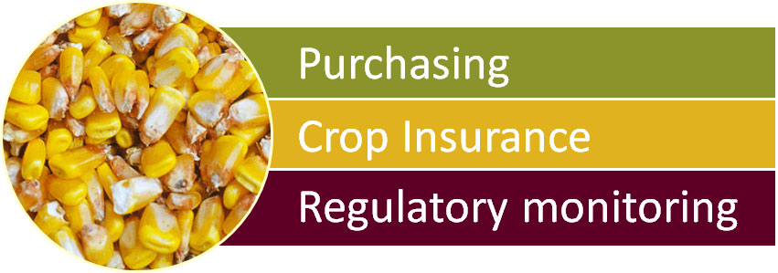
Co-Regulation of aflatoxin risk as a preventive control
Notes:
Our agency implemented a preventive approach to aflatoxin risk management four years ago. We call the program the “one sample strategy” to represent the idea that we will use one sample from every truck load during harvest for purchasing, crop insurance and regulatory monitoring. To achieve such an ambitious goal, we need to ensure correct sampling and testing procedures are implemented by trained individuals using validated aflatoxin testing platforms and verified performance by the qualified individuals performing these activities.

Slide 17
Aflatoxin Measurement Accuracy among 43 Grain Elevators in Texas
Aflatoxin Control | Average (ppb) | Low (ppb) | High (ppb) | Relative Standard Deviation
52 ppb | 57 | 8 | 310 | 98%
378 ppb | 267 | 4 | 660 | 50%
580 ppb | 410 | 4 | 970 | 60%
Notes:
In 2010, Texas experienced an extremely high level of aflatoxin contamination, combined with exceptionally high yields. Thus, a situation where there was a lot of aflatoxin contaminated corn and very little incentive for corn producers to collect crop insurance. This obviously led to a serious tension involving all parties, the producer, the grain elevator and the regulator. It also pushed our agency forward to try to bring some resolution to what had been a pernicious problem within the corn industry in Texas. We began our systematic approach to resolving this problem by testing the grain industry’s aflatoxin testing capability. As depicted in this slide, there was a wide range in testing capability. For the 52 ppb control, the 43 grain elevators that tested for aflatoxin produced values ranging between 8 and 310 with a rsd of 98%, for the 378 ppb control values ranging between 4 ppb and 660 ppb with a 50% rsd and for the 580 control, a low of 4 ppb and high of 970 ppb with a 60% rsd.
Prior work looking at variability in aflatoxin measurement indicates that sampling is the greatest source of variability, however, our work suggests that correct use of aflatoxin field tests to measure this contaminant is a major contributor to testing variability.

Slide 18
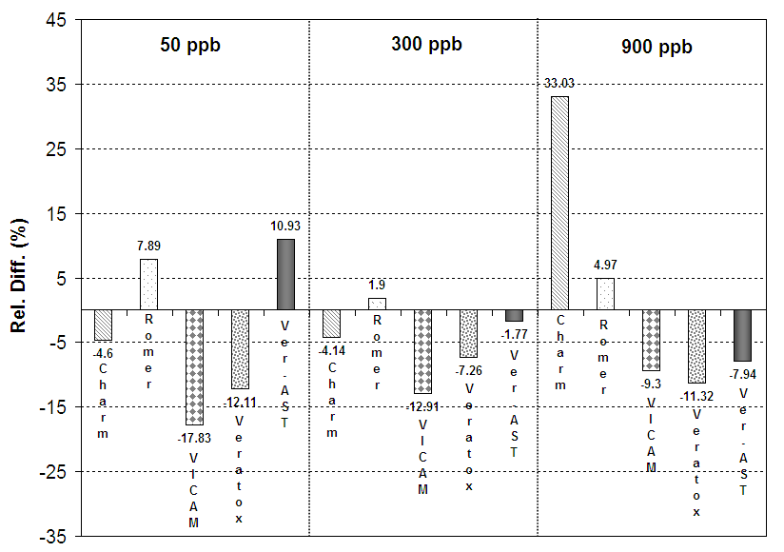
Performance of test kits on samples with different levels of mycotoxins
Notes:
This led us to our second question, are these test kits capable of measuring aflatoxin at levels experienced in Texas. Looking to the GIPSA as our guide, which is the agency within USDA that grades grain and approves test kits, we found that as of 2010, the agency only approved kits for measuring upto 100 ppb. Thus, a need existed for a competent authority to validate these kits at higher levels, as indicated on this slide. While a dilution scheme was used for all, two test kit manufacturers (Romer and Vicam) indicate their platforms can measure up to 1000 ppb without dilution. We found that all kits performed satisfactorily up to 300 ppb.

Slide 19
One Sample Strategy Components
Standardized methods
Standardized training
Verification of employee performance
Documented program outcomes
Monitoring & corrective actions
Reduced market and food safety risk
Monitoring & Corrective Actions
Approved
Equipment
Management & Recordkeeping
Training for Individual Employees
Proficiency Verification Process
Notes:
The previous two slides indicate the work we performed as an agency prior to my being called to meet with the head of the Texas House Appropriations committee to discuss the aflatoxin issue and its impact on producers in his district. In preparation for this meeting, I prepared a white paper that outlined a preventive approach to address the problems we observed during the 2010 harvest. To give you a sense of the tension that existed at the time, when I went to speak before producer meetings there was a need for law enforcement officers to be present to ensure things didn’t get out of hand.
The program we developed involved a systematic approach that included using approved equipment validated by our agency, training individuals in proper sampling and testing procedures, proficiency verification, a management and record keeping system and monitoring and corrective actions (where needed) by our field investigators. The overall objective was to reduce market and food safety risk. Because we implemented guidelines established by Grain Inspection, Packers & Stockyards (GIPSA) Aflatoxin Handbook and the USDA’s Risk Management Agency Loss Adjustment Manual where ever possible, we also sought to gain approval to use these test results for crop insurance, which we successfully obtained by harvest of 2011 and by 2012, received a permanent renewal approval.

Slide 20
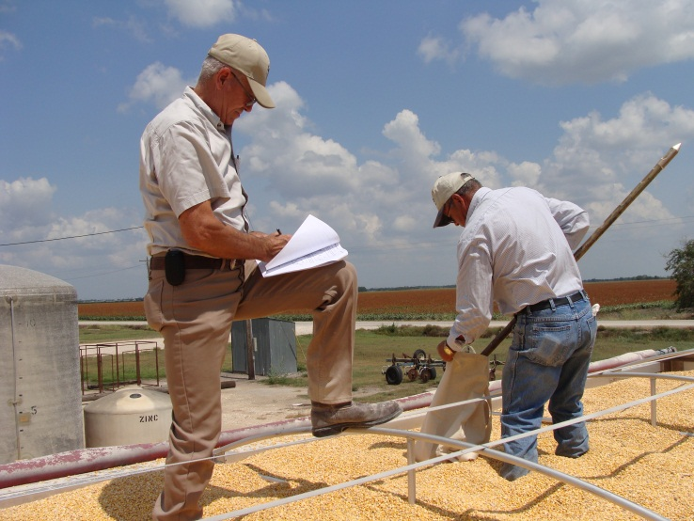
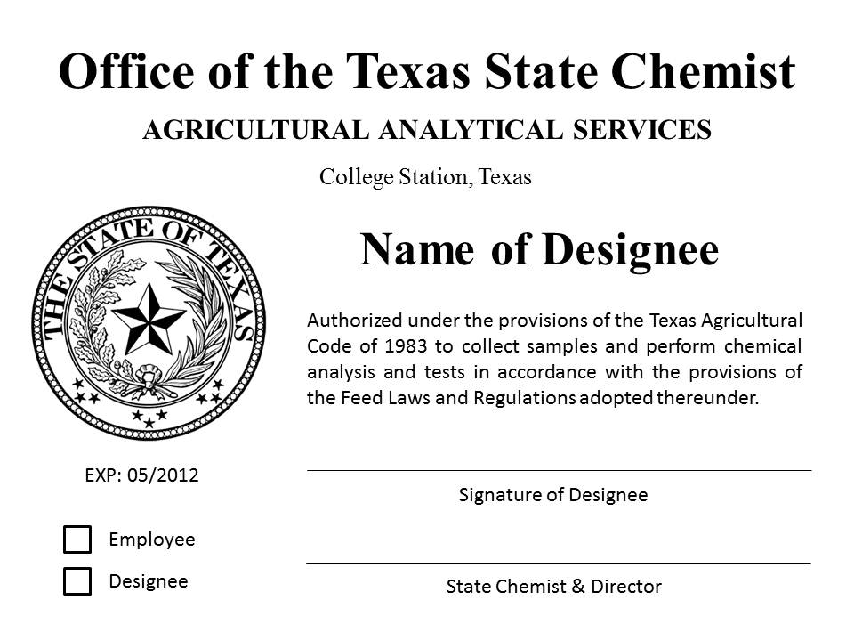
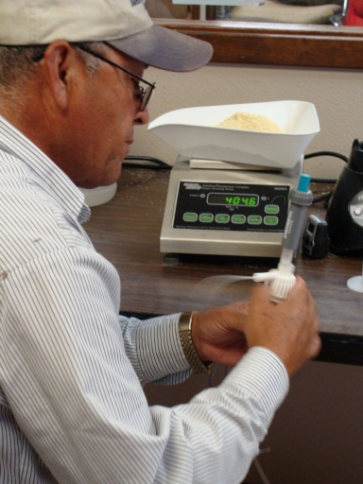
Approval Process
Sampling & Testing Plan
Training to review criteria
Background check
Proficiency evaluation
Approved as a designee of OTSC
Notes:
To initiate participation in the program, the firm submits a Sampling & Testing Plan to describe the firm’s equipment, personnel, and special methods. Our field investigators review training, we perform a background check and proficiency evaluation and if the employees passed, they become a designee of our agency to perform aflatoxin sample, grinding or testing.

Slide 21
Criteria: Sampling
Minimum 5-pound sample collected from each incoming truck or trailer
USDA representative sampling patterns
6’ spiral hand probe
PATTERN 1: 7 probes for trucks or trailers loaded with grain more than 4 feet deep
PATTERN 2: 9 probes for trucks or trailers loaded with grain less than 4 feet deep
X
2’
X
X
2’
X
X
X
X
2’
X
2’
X
2’
FRONT
REAR
FRONT
REAR
2’
X
X
X
X
X
X
X
2’
2’
Notes:
For sampling criteria, a prescribed probe pattern by USDA is used and a minimum of 5 pounds is collected, compared to the GIPSA method for truck of only 2 pounds, using a 6’ spiral hand probe.

Slide 22
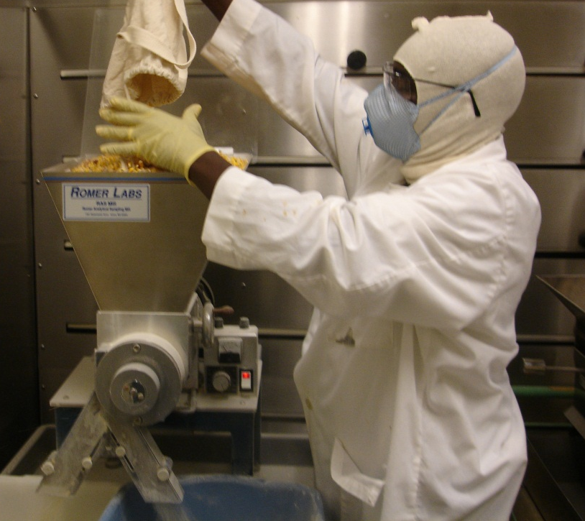
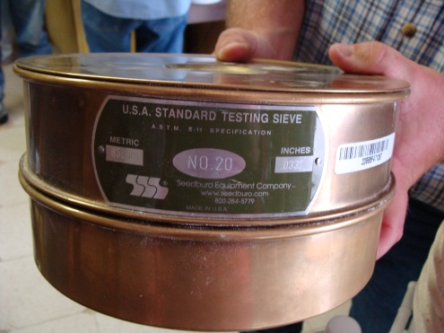
Criteria: Grinding
Grind the entire 5 lb. sample
Collect at least 500 grams of the ground sample
70% of the particles pass through a 20 mesh sieve after grinding
Notes:
To pass the grinding proficiency evaluation, employees must grind the corn so that 70% of the ground material passes through a 20 mesh sieve.

Slide 23
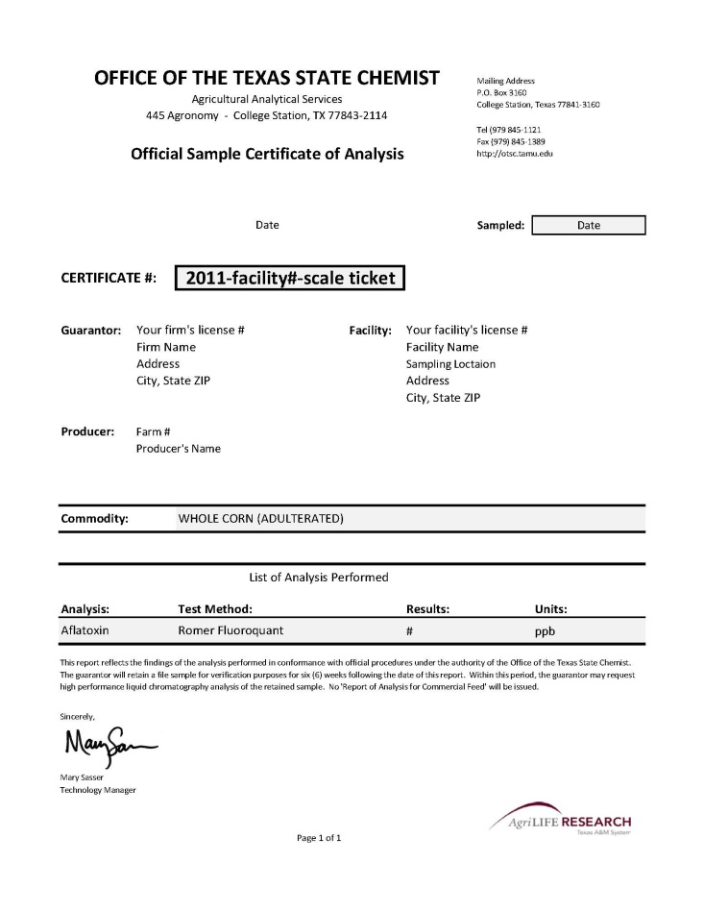
Certificate of Analysis
Elevator collects sample information in an Excel spreadsheet
Elevator prints certificates for incoming & submitted samples >20 ppb aflatoxin
Data is reported to OTSC & shared with RMA
Notes:
Final result are reported on a Certificate of Analysis. These certificates are only issued for insurance purposes and the elevator sends all test results to our office on a daily basis, and we send compiled to RMA throughout harvest season.

Slide 24
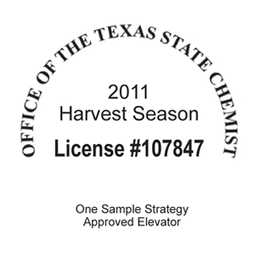
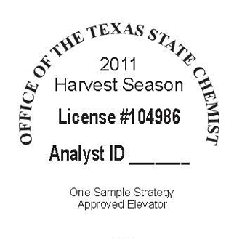
Outbound Seals
Full Participant | Outbound Participant
All incoming loads are sampled & grain is always segregated. Seal is attached to outbound documentation. | Some or all inbound and/or outbound loads are sampled. Seal is attached to printed outbound test results.
Notes:
Outbound seals are another important feature of the program, to identify grain that has already been tested by our designees and our investigators do not sample this grain as it moves through the market.

Slide 25
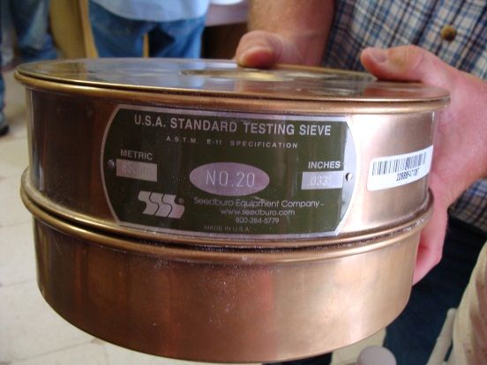
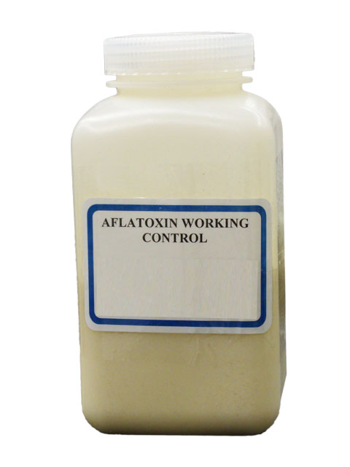
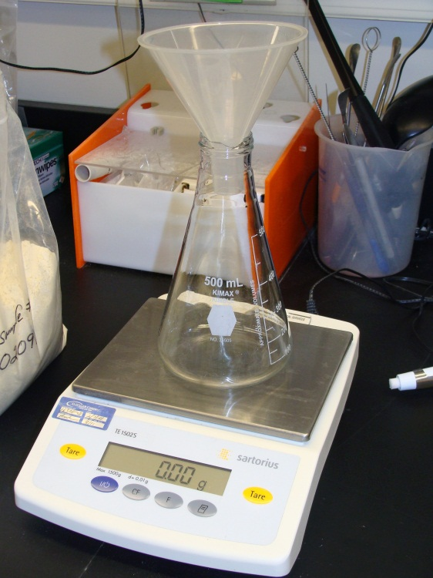
OTSC Monitoring
Employee performance
Equipment performance
Grinder check
Lab scale calibration record
OTSC control standard record
HPLC analysis of verificaton samples
Notes:
Monitoring these activities ensures program integrity. Our field investigators visit participating firms on a weekly basis during harvest season. And at each visit, the investigator observes employee performance, monitors equipment performance, reviews records, and collects retained file samples.
The samples collected by our investigators are sent to our lab for HPLC analysis and comparison with the elevator’s results.

Slide 26
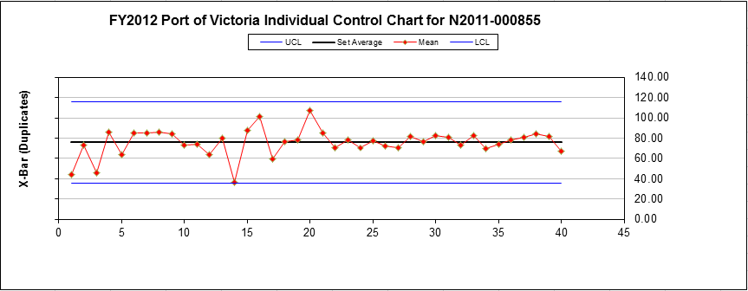
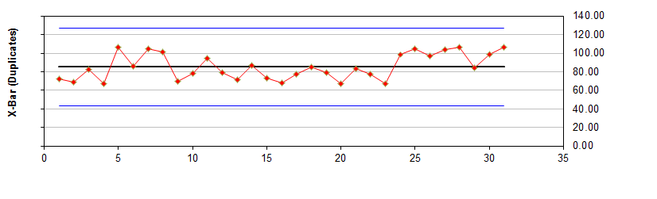
Control Chart
Company
A
80 ppb
Acceptable range: 60 - 100 ppb
Company B
Notes:
Participating firms run control samples daily and they are evaluated using Statistical Process Control Charts by our agency.

Slide 27
OTSC Corrective Actions
Oversee adjustment or repair of equipment
Oversee retraining of personnel
Report missing or non-compliant equipment
Report records that are missing, inaccurate, or appear to reflect poor performance
Suspend or remove an employee or firm
Notes:
If an investigator observes processes or employees who are not following program criteria, appropriate corrective actions such as these are taken.

Slide 28
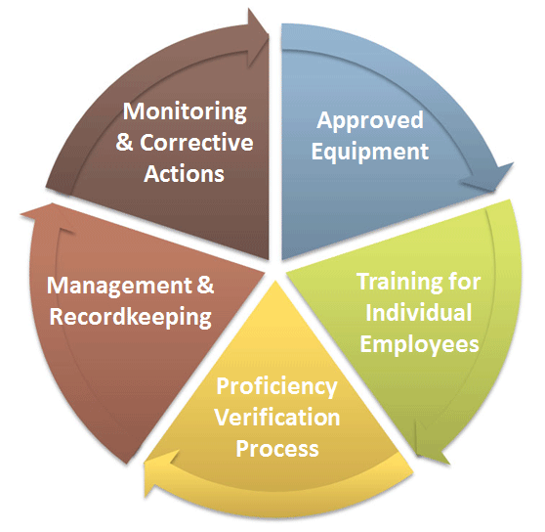
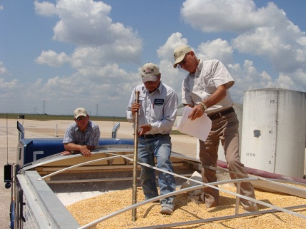
A Preventive Approach to Aflatoxin Risk Management
80 ppb
Acceptable range: 60 - 100 ppb
2013
Notes:
By 2013, we had 30 companies participating in the program with 170 designees and over 13000 measurements.

Slide 29
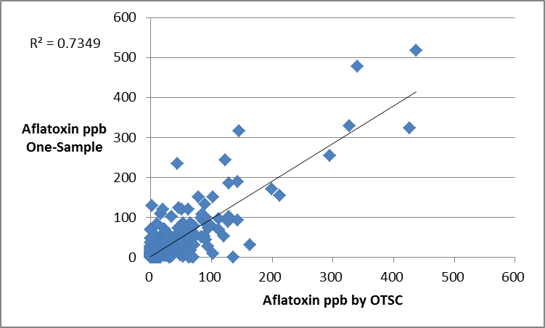
2013 Aflatoxin Verification Results
Notes:
Comparing designee results with our agency results is depicted on this slide. These a based on about 600 retained samples that we collected and analyzed by our agency. The coefficient of determination was 0.73 and found to be highly significant.

Slide 30
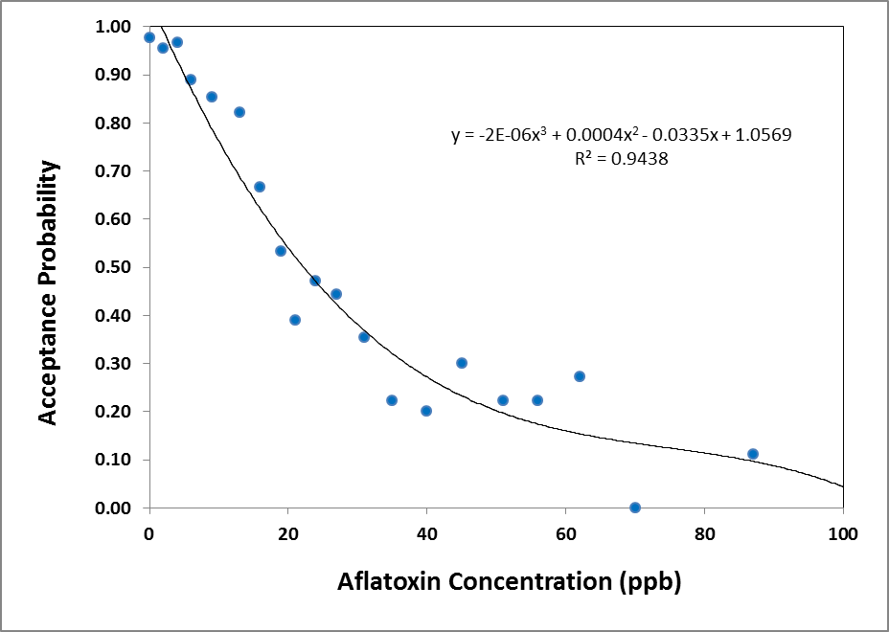
Performance curve comparing OTSC and One Sample Strategy verification results
Notes:
Another way to compare our agency results with those from the One Sample Strategy designees is through a performance curve. Is this figure, I’ve compared the acceptance probability by the firm (y axis) with the aflatoxin concentration (x-axis). This curve would be interpreted as follows: there is nearly 100% acceptance probability by the firm for samples that our agency tested and found to contain 0 ppb aflatoxin. About 80% probability of acceptance by the firm for those samples our agency measure at 15 ppb, about 50% probability of acceptance by the firm for those samples we measured at 20 ppb, etc. The performance curve can also represent the by types of risk or error in the system. For example, the area above the curve for measurements below 20 ppb is referred to as the sellers risk (type 1 error) or the likelihood of a false positive. The area below the curve for measurements above 20 ppb is referred to as the sellers risk (type II) or the likelihood of a false negative. The performance curve designated on this slide explains 94% of the variability represented by our 2013 data which was comprised of over 600 measurements. This looks similar to what is reported in the literature involving experimental data and represents the first such analysis involving actual aflatoxin measurements of grain moving through commerce.

Slide 31
Risk Analysis
There are "known knowns." There are things we know that we know. There are known unknowns. That is to say there are things that we now know we don't know. But there are also unknown unknowns. There are things we do not know we don't know.
Donald Rumsfeld, United States Secretary of Defense Press Conference at NATO Headquarters, Brussels, Belgium, June 6, 2002
Notes:
I would like to transition now to risk analysis as it relates to the FDA blending waiver policy of 2012 and a risk assessment of the practical implementation of this policy performed by our agency. By way of introduction, I’ve included a quote by Donald Rumsfeld regarding national security, involving things we know that we know, the known unknowns, and the unknown unknowns.

Slide 32
2012 Drought in the US corn belt and FDA Blending Provisions
The above‐referenced Blending Firm hereby agrees that it shall comply with following conditions when blending corn containing aflatoxin in concentrations of higher than 20 ppb (parts per billion) and less than 500 ppb with corn containing aflatoxin in concentrations of less than 20 ppb:
a. Corn contaminated with aflatoxin above 20 ppb may be blended with other corn to the extent that the resulting product is below the appropriate aflatoxin action level in corn used as or in animal feed. The blended corn will be shipped in interstate commerce or for use as or in feed for mature poultry, breeding swine, and finishing swine over 100 pounds, breeding cattle and finishing (feedlot) cattle as long as the aflatoxin levels are below the action levels set forth in FDA Guidance Document, Compliance Policy Guide‐ Section 683.100, “Action Levels for Aflatoxin in Animal Feeds.”
Notes:
The blended corn may be shipped in interstate commerce and action levels (which are not regulations) are contained within the FDA Guidance Document Compliance Policy Guide and were referred to in the aflatoxin blending waiver. The approval involved blending corn with as little as 0 ppb aflatoxin (uncontaminated) with corn containing greater than 20 ppb for shipment into interstate commerce.

Slide 33
b. Once the blending operation is completed, each batch of blended corn will be analyzed to determine its aflatoxin level. The analysis shall be performed using US Department of Agriculture Grain Inspection, Packers & Stockyards Administration (GIPSA) approved sampling and analysis protocols and testing procedures. Prior to the use of the blended corn, and before shipment in interstate commerce, the seller will certify that the aflatoxin level of the blended batch does not exceed the action level for the appropriate intended species.
c. The Seller of corn blended pursuant to this process will provide the purchaser with a copy of the analytical results generated from the process described in subparagraph “b”. In addition, the seller will obtain written assurance from the purchaser that blended corn will be used as or in feed for mature poultry, breeding swine, finishing swine over 100 pounds, breeding cattle and finishing (feedlot) cattle pursuant to the terms of Compliance Policy Guide‐Section 683.100.
d. The blended corn will be clearly identified and labeled for animal feed use only.
e. Corn containing aflatoxin levels greater than 500 ppb cannot be blended.
Notes:
Those blending the corn shall use GIPSA approved sampling and analysis protocols and testing procedures. As mentioned earlier, GIPSA has only approved test kits for measuring up to 100 ppb, and yet the blending waiver approved blending with corn containing greater than 500 ppb (this should have been known by FDA at the time of approving a blending waiver policy but wasn’t). The level of aflatoxin will be certified by the seller and a copy of the analytical results will accompany the shipments and end-users must provide a written assurance to the seller they only intend to use the corn in feed for mature poultry, breeding swine, finishing swine over 100 pounds, breeding cattle and finishing cattle. Based on our evaluation of grain elevator testing proficiency, we question their capability to certify results in the absence of a system similar to what I described earlier in the one sample strategy. For those relying upon GIPSA, they had not perform proficiency evaluation of their agency’s aflatoxin testing for the previous three years and didn’t do so until our agency complained about so of their “official results” in which they re-initiated proficiency testing in June 2013. Again, several items that should have been known prior to embarking on this policy and had FDA consulted the states, we would have provided them with some valuable insight.

Slide 34
Quantitative Risk Assessment
Notes:
Let me present a thumb nail sketch of the US corn situation in 2012. The same drought that produced aflatoxin reduced the corn crop from 13 billion bushels to approximately 11 billion bushels. If 2 billion bushels contained aflatoxin above 20 ppb where blending with 2 billion bushels of corn containing less that 20 ppb, and 5 billion bushels of corn containing were used by the fuel ethanol industry (all containing less than 20 ppb aflatoxin) that left a total corn crop of 2 billion bushels containing less than 20 ppb for the use by feed manufacturers making feed for dairy, immature poultry, pet food, etc. Thus, it came as no surprise to our agency that 21% of the grain we sampled from the 8 states with blending waivers contained more than 20 ppb aflatoxin and were not labeled as such.
We performed a risk assessment using these data as represented by the figure on this slide, which represents a
precision tree diagram created through the @Risk software to assess the risk associated with aflatoxin in Midwest corn to the Texas dairy industry. The upper branch of the tree models the Texas corn (96% of which was below 20 ppb aflatoxin). The bottom branch of the tree models the Midwest corn, using demand by the Texas dairy industry for 678 million bushels and the frequency of 21% for inbound corn containing aflatoxin greater than 20 ppb, which represents the actual detection level by our Agency based on >50 samples received from out-of-state. The exposure of high aflatoxin corn to the dairy industry was 4.7% and the likelihood of aflatoxin contaminated milk entering the human food supply was 0.5% based on this quantitative risk assessment.
The Texas Dept of State Health Services has a milk program that monitors aflatoxin contamination and based on the number of positives, it appears that their observed level of contamination was 0.6%, albeit a slightly different end point. Thus, we see the risk assessment was fairly close to predicted actual aflatoxin positive samples.

Slide 35
Aflatoxin Policy Considerations: What is Policy
Policy is a guiding principle leading to a course of action or specific program that is pursued by the government.
Agricultural and food policies embody the principles that guide government programs that influence production, the resources utilized in production, domestic and international markets for commodities and food products, food consumption and nutrition, food safety, and the conditions under which people live in rural America.
Notes:
Dealing with any contaminant involves both science and policy, thus, I would like to briefly mention some policy consideration. Policy is the guiding principle leading to a course of action or specific program that is pursued by the government. US food policy consider both the Food safety, food security, and food defense.

Slide 36
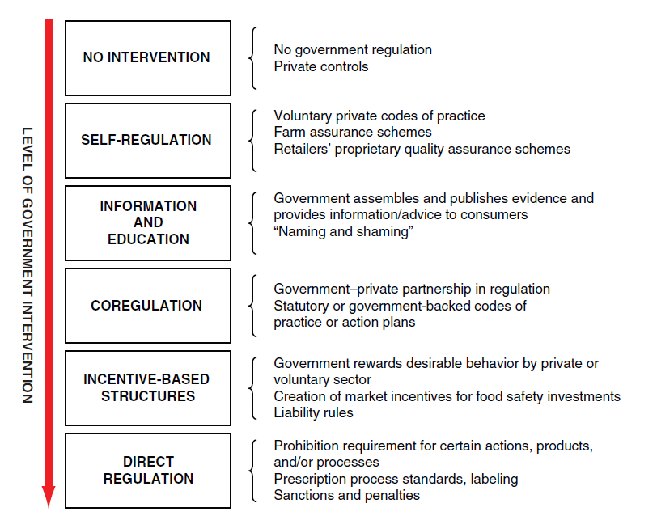
Generic List of Governance Options
National Research Council 2013; FIGURE 4-1. Options for assigning private-public responsibility to ensure food safety.
SOURCE: Adapted from Garcia-Martinez et al. (2007).
Notes:
Within the pursuit of policy, there is a decision to be made involving governance options ranging from direct regulation to no intervention, as represented on this slide. The agency I represent has selected a co-regulation strategy involving aflatoxin risk management for those who participate in the program and maintains a direct regulation for those firms that don’t.
A co-regulation, preventive approach to aflatoxin risk management requires increased corporate responsibility (accountability and recordkeeping) and additional work on our part to plan, administer, monitor and take corrective actions.

Slide 37
Proposed Policy for Blending
OTSC received the following request:
… the Food and Drug Administration (FDA) to implement a permanent nationwide policy that approves blending corn containing 0 ppb to 500 ppb aflatoxin.
We believe the FDA policy should be made permanent and supersede state authority to request this approval since it involves interstate commerce.
The policy should include requirements for testing and labeling of corn with aflatoxin that would be uniformly applied on a nationwide basis. This would provide purchasers greater assurance that they are buying properly tested, labeled, and blended grain. The ability to use all levels of corn, even those below 20 ppb, for blending will allow the purchasing sites the ability to blend aflatoxin contaminated corn more safely.
Notes:
Our stakeholders in Texas have been pleased with the approach adopted by our state and would like to see national adoption of the one-sample strategy for aflatoxin risk management as well as a national blending waiver approved by FDA, every year. They believe this would be a positive step to a uniform approach to aflatoxin risk management. It is worth mentioning that Texas has, by rule, an approved method for blending corn containing >20 ppb aflatoxin contaminated corn with < 500 ppb aflatoxin. As a state, we have not approved the deliberate adulteration of corn containing no aflatoxin with corn containing 20 ppb or more aflatoxin.

Slide 38
POLICY:
Texas Approved Aflatoxin Binders Through Rule Making:
(a) The provisions of this section apply to the use of aflatoxin binding agents in customer-formula feeds as defined in the Texas Agriculture Code §141.001(7). Labeling requirements for customer-formula feed set forth in §141.053 of the Texas Commercial Feed Control Act require the name and number of pounds of the binding agent to be included on the feed label, and the aflatoxin content to meet defined action levels as established in §61.61(a)(6) of this title, poisonous or deleterious substances.
Notes:
Our agency has also approved the use of aflatoxin binders. The policy doesn’t change the regulatory action levels in Texas, however, it does provide an additional option for managing aflatoxin risk. An approach similar to Texas has been taken by Brazil and is under review within Europe.

Slide 39
Acknowledgements
Andrew Buch, Research Specialist
Mary Sasser, Manager Field Operations
Susie Dai Assistance Research Professor
K.M. Lee, Associate Research Scientist
OTSC field investigators and laboratory,
Ben Jones Associate Director of Compliance
Notes:
Let me conclude by thanking all my colleagues at OTSC who have assisted in the implementation of the aflatoxin risk management program by our agency within the state of Texas including:

