Slide 1
Proposed Rule to Protect Food Against Intentional Adulteration
http://www.fda.gov/fsma

Slide 2
Proposed Regulations for Focused Mitigation Strategies to Protect Food Against Intentional Adulteration

Slide 3
Key Principles
Prevention of acts intended to cause widespread public health harm
Considers vulnerabilities and risks related to intentional adulteration
Risk-based and flexible

Slide 4
Key Terms and Phrases
Types of Intentional Adulteration
Acts intended to cause massive public health harm
Acts of disgruntled employees, consumers, or competitors
Economically motivated adulteration

Slide 5
Who is Covered?
Facilities that manufacture, process, pack or hold human food
In general, facilities required to register with FDA under sec. 415 of the FD&C Act
Applies to domestic and imported food
Some exemptions and modified requirements are being proposed

Slide 6
Exemptions
Manufacturing, processing, packing, or holding food for animals
Farms
Holding of food, except bulk liquid
Packing, repacking, labeling, or relabeling of food where the container that directly contacts the food remains intact
Alcoholic beverages at certain facilities (under specified conditions)

Slide 7
Modified Requirements
“Qualified” facilities:
Very small businesses (less than $10 million in total annual sales)
OR
Food sales averaging less than $500,000 per year during the last three years AND
Sales to qualified end users must exceed sales to others

Slide 8
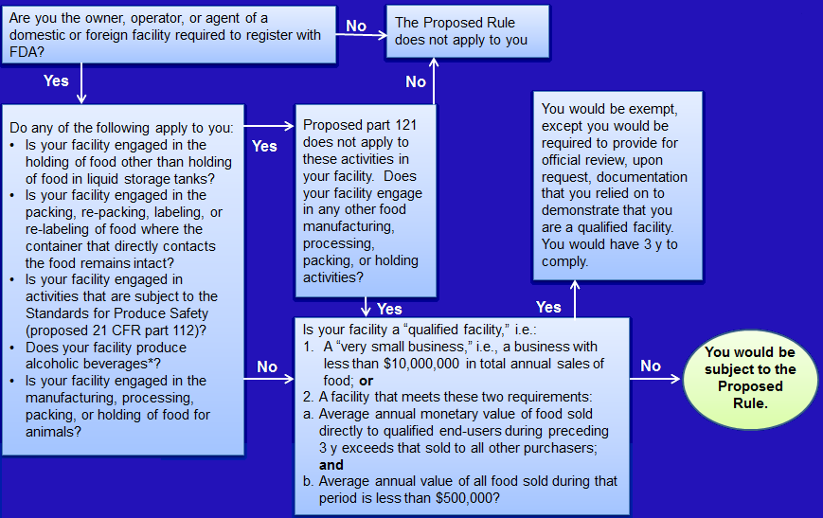
Proposed Coverage
*See proposed 121.5(e) for specific conditions

Slide 9
Effective and Compliance Dates
Effective date
60 days after the final rule is published
Compliance dates
Small Businesses – employing fewer than 500 persons would have two years after publication

Slide 10
Compliance Dates continued
Very Small Businesses – having less than $10 million in annual sales of food would have three years after publication to comply with modified requirements
Very small businesses are considered qualified facilities and subject to modified requirements
Other businesses –that do not qualify for exemptions would have one year after publication of the final rule to comply

Slide 11
How to Comment on the Proposed Rules
http://www.regulations.gov
Link to rules on http://www.fda.gov/fsma
Comment period closes on June 30, 2014
Comment periods on major FSMA proposals will be coordinated to enable comment on how the rules can best work together

