Slide 1
International Regulatory Capacity Building Global Curriculum Project

Slide 2
2012 Institute of Medicine Report
Ensuring Safe Food and Medical Products Through Stronger Regulatory Systems Abroad

Slide 3
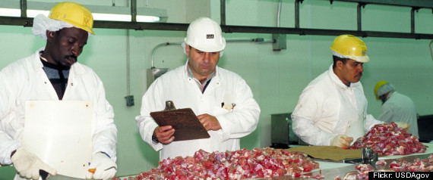
Core Elements of a Food Regulatory System
Product safety through GMPs, GAPS
Staff development and training
Monitoring products using laboratories
Inspection and surveillance throughout the supply chain
Risk assessment, analysis, and management
Emergency response

Slide 4
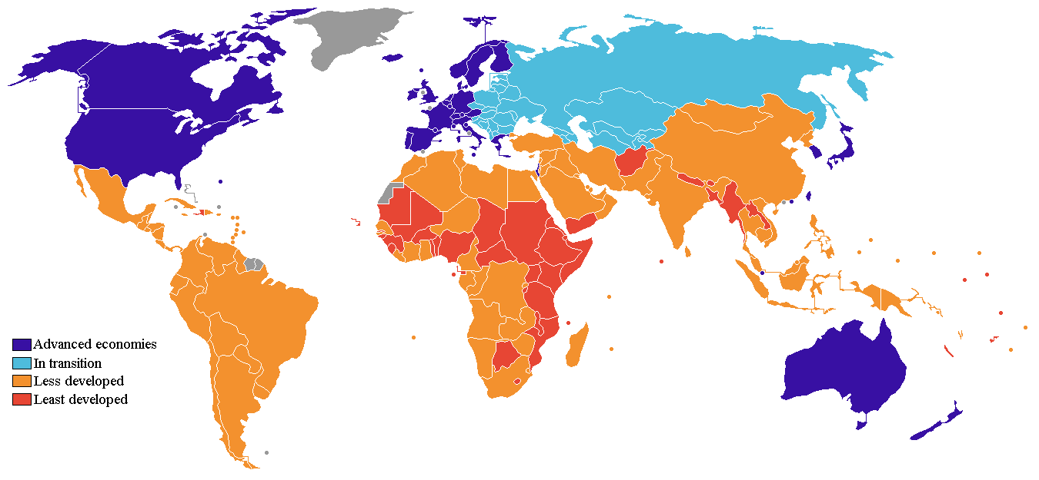

Slide 5
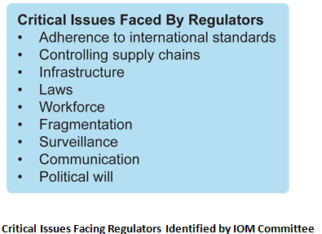

Slide 6
Nine Problems Facing Product Safety Systems in Developing Countries
Adherence to international standards
Supply chain problems
Infrastructure deficits
Lack of/ confusing regulatory laws
Neglected
Unequally applied
Non existent product liability laws

Slide 7
Nine Problems Facing Product Safety Systems in Developing Countries
Regulatory responsibilities scattered across agencies
Poor public health/ food safety surveillance systems
Poor communication
Within a regulatory authority
Across government agencies that share regulatory responsibilities
Between government and the regulated industry
Between government and the public
With counterpart agencies in other countries
8. Lack of accountability/ public will

Slide 8
9. Regulatory workforce
Insufficient
Retention problems, low pay
Lack of training / lack of
academic curricula
Poor morale
Corruption is a
cause and effect
Undue political influence
Fragmentation

Slide 9
IOM Recommendations
Adherence to International Standards
Controlling Supply Chains
Infrastructure Deficits
Strong Legal Foundation
Workforce
Fragmentation
Surveillance
Communication
Political Will
Enterprise Risk Management

Slide 10
FSMA International Regulatory Capacity Building
FDA Office of International Programs - led effort
Training is the first step
Build a global regulatory
curriculum
Needs/ gap analysis tools
Donor agencies assurance
World Bank –
Global Food Safety Partnership

Slide 11
Global Curriculum Project
FDA Office of International Programs

Slide 12
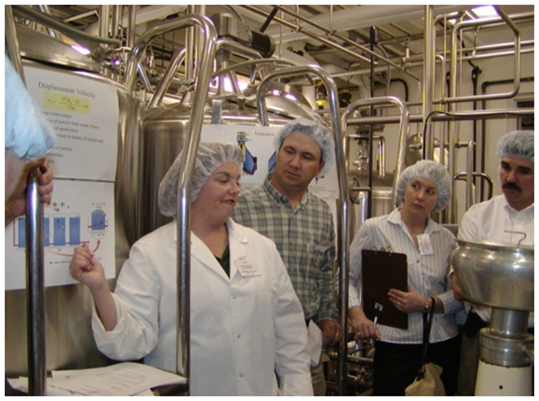
Global Curriculum Project Scope
Food & medical products
Training government
regulators

Slide 13
Global Curriculum Project - Phase I By October 2014
Define the minimal core competencies of a regulatory professional
Develop a curriculum framework for educating and training the regulatory workforce
Develop a gap assessment tool to be used by low-middle income countries

Slide 14
Competency-Based Curriculum Development
1
Create Competency Framework
2
Identify Competencies
3
Create Curriculum Framework
4
Develop Curricula

Slide 15
Categories of Minimal Competencies
Competencies
Core Professional 5
General Regulatory 11
Medical Products Technical 43
Food Technical 35

Slide 16
Activities
Expert Panel assembled
Competencies - first cut by panel
Validation using broad international group – survey open now: http://research.zarca.com/k/SsTTXYsVUTsPsPsP
Second cut by panel, curriculum framework, assessment tool – meeting in D.C. Sept. 2014

Slide 17
Phase II – Next Steps

Slide 18
