Slide 1
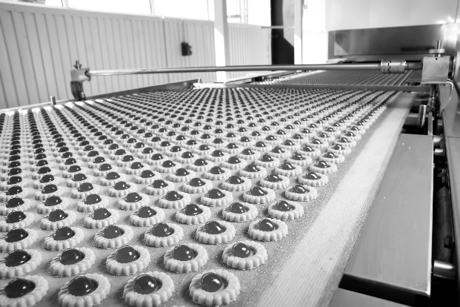
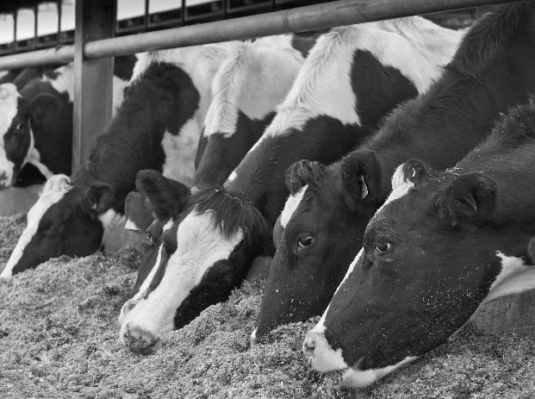
ifpti.org
IFPTI Fellowship Cohort V: Research Presentation
Jason Guzman
2015-2016
IFPTI Fellowship Cohort V: Research Presentation
Priya Nair
2015-2016
Notes:
Slide 1: “IFPTI Fellowship Cohort V: Research Presentation—Jason Guzman”
Instructions
Introduce yourself, if not already introduced.
Greet the participants: “Good morning/afternoon.”
Transition
(Click for next slide)

Slide 2
Factors Influencing Texas Health Department’s Enrollment in the Voluntary National Retail Food Regulatory Program Standards
Jason Guzman
IFPTI 2015-2016 Fellow
Texas Department of State Health Services
Public Sanitation and Retail Food Safety Group
Funding for this program was made possible, in part, by the Food and Drug Administration through grant 5U54FD004324-05; views expressed in written materials or publications and by speakers and moderators do not necessarily reflect the official policies of the Department of Health and Human Services; nor does any mention of trade names, commercial practices, or organization imply endorsement by the United States Government.
Notes:
Slide 2: “Factors Influencing Texas Health Department’s Enrollment in the Voluntary National Retail Food Regulatory Program Standards”
Instructions
Introduce the study topic.
Identify your agency, if you haven’t already done so.
Supporting Information
Not a formal hearing: Sell the project ‘Sell the sizzle not the steak’
Not to yell or raise my voice to regulators: I see a few division directors and managers…more then likely you know my manager…don’t wanna get myself in trouble.
Hopefully some of you have had the opportunity to sit in on some of the other fellows’ presentations…really some interesting studies…if you have not they are that rowdy bunch at the rear of the room…with signs and posters.
Transition
“Let’s talk about the background of the study.” (Click for next slide)

Slide 3
Background
National uniformity has been a ongoing debate for years (FDA, 2015)
The Voluntary National Retail Food Regulatory Program Standards (VNRFRPS):
Developed and designed by the FDA to help food regulatory programs
Has 9 Program Standards with the goal of reducing or eliminating the occurrence of foodborne illnesses and deaths from food at the retail level
Notes:
Slide 3: “Background”
Instructions
Discuss each bullet on the screen.
Transition
“Now let’s review the Problem Statement.” (Click for next slide)

Slide 4
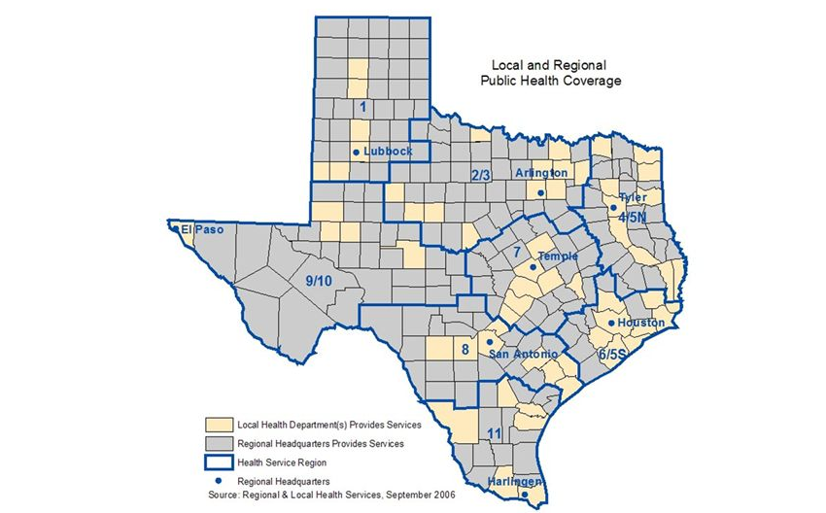
Background (continued)
Texas is a ‘home rule state’:
262 independent jurisdictions.
From 2001 to present enrollment of 65 (25%)
Texas State and Local Health Jurisdictions
Image source: Department of State Health Services, March 2012, Retrieved from http://slideplayer.com/slide/759578/
Notes:
Slide 4: “Background”
Instructions
Discuss each bullet on the screen.
Use supporting information as needed.
Supporting Information
Not everyone knows what a home rule state is. Give a bit of an explanation, but you may want to have a sentence that state’s clearly the TX definition of “home rule state” because that’s a key aspect (perhaps the root) of “the problem.”
Home rule: TX idea to create less gov’t, but in turn created more smaller local gov’t
Rule: Administer programs as needed as not to conflict with state statue.
Problem for Regulatory and Industry Partners.
Transition
“Now let’s review the Problem Statement.” (Click for next slide)

Slide 5
Problem Statement
No current published research describes the influences that bring about or hinder adoption of the Retail Program Standards by Texas local health departments.
Notes:
Slide 5: “Problem Statement”
Instructions
Discuss each bullet on the screen.
Transition
“Let’s review the research questions.” (Click for next slide)

Slide 6
Research Questions
What do Texas local health departments perceive as the benefits of enrollment in the Retail Program Standards?
What do Texas local health departments perceive as the barriers to entry into the Retail Program Standards?
What barriers have local health departments in Texas encountered after enrolling in the Retail Program Standards?
What are the characteristics associated with the local health departments enrolled and those not enrolled in the Retail Program Standards?
Notes:
Slide 6: “Research Questions”
Instructions
Summarize…do not read questions word for word.
Use supporting information to facilitate a discussion.
Supporting Information
What are the characteristics:
Is there a characteristic between the two departments that has influenced programs?
Transition
“Let’s talk about the methodology used in the study.” (Click for next slide)

Slide 7
Methodology
Qualitative data:
10 question survey via electronic mail
Email lists:
FDA Voluntary National Retail Food Regulatory Standards
Local Public Health Organizations listing on the Texas Department of State Health Services
Study population:
Food Safety Inspection Officers (FSIO) employed by local health departments
Both enrolled and non-enrolled in VNRFRPS
Data collection/analysis:
Excel spreadsheet data collection
Notes:
Slide 7: “Methodology”
Instructions
Discuss each bullet on the screen.
Use supporting information to facilitate a discussion.
Supporting Information
10 question online surveys open ended questions regarding the improvement and barriers of enrolled local health depts.; I wanted their thoughts.
Email list created using the FDA Voluntary National Retail Food Regulatory Standards and Local Public Health Organizations listing on the Texas Department of State Health Services webpage. Can be found on our webpage.
Study Population: Food Safety Inspection Officers (FSIO) employed by local health departments, both enrolled and non-enrolled in Voluntary National Retail Food Regulatory.
Transition
“Let’s discuss the results.” (Click for next slide)

Slide 8
Results
Total of 16 responses
13 enrolled
3 non-enrolled
Data separated into groups based on population
Large: 200,000 and above (8)
Medium: 100,000 – 200,000 (5)
Small: 100,000 or less (3)
Notes:
Slide 8: “Results”
Instructions
Discuss each bullet on the screen.
Supporting Information
Departments served populations ranging from 2,889 to 1,436,697.
Population information was created using 2014 census data.
Used to create some more characterization / description for comparison of this small survey group.
“Joke”: Of course the guy from Texas is going to put things into sizes. I am already looking forward to my health that participated in the survey to get back to me and having that conversation..
Transition
“Let’s look at additional results from the study.” (Click for next slide)

Slide 9
Results (continued)
Larger health departments complete more Standards compared to small health departments that only complete one or less.
5 of the 13 (38.5%) identified Standard 2 – Training and Standardization as the most difficult to complete.
10 of the 13 (76.9%) enrolled local health departments had no formal training program.
Notes:
Slide 9: “Results (continued)”
Instructions
Discuss each bullet on the screen.
Supporting Information
Larger Health departments complete more Standards compared to small health departments that only complete 1 or less.
Instead pointing to "hands on"/ "on the job" training, attendance of food safety courses provided in the area, shadowing of experienced inspectors, and completing joint inspections as their training before being released into the field to complete routine inspections.
Transition
“Let’s look at the results as it relates to the purpose for enrollment.” (Click for next slide)

Slide 10
Results (continued)
Notes:
Slide 10: “Results (continued)”
Instructions
Discuss the graph on the screen using the supporting information below.
Supporting Information
Purpose of enrollment:
Creating uniformity in inspections 38.5
Improved public safety policies and procedures 30.8
Promoting training 15.4
Unknown 7.7
Introduction by another agency 7.7
Transition
“Let’s look at results as it relates to improvements.” (Click for next slide)

Slide 11
Results (continued)
Notes:
Slide 11: “Results (continued)”
Instructions
Discuss the graph on the screen using the supporting information below.
Supporting Information
Improvements:
Training Programs 53.8
policy and procedures – risk based inspection 15.4
foodborne illness/ food defense preparedness and response 15.4
No change 15.4
Transition
“Let’s look at results as it relates to barriers.” (Click for next slide)

Slide 12
Results (continued)
Notes:
Slide 12: “Results (continued)”
Instructions
Discuss the graph on the screen using the supporting information below.
Supporting Information
Retail Program Barriers:
lack of funding and reduced staff 53.8%
standardize a training officer within their departments 23.1%
lengthy auditing process 15.4%
No neighboring Jurisdiction 7.7%
Non-enrolled—2 or 3 health depts.—see funding and manpower. (66,.7%)
Transition
“Let’s look at some final thoughts regarding the Retail Program Standards.” (Click for next slide)

Slide 13
Results (continued)
Thoughts regarding the Retail Program Standards:
Enrolled
Assistance from Federal and State level health departments
Support of the Training Standardization Officer
Non-enrolled
No assistance needed
Notes:
Slide 13: “Results (continued)”
Instructions
Discuss each bullet on the screen.
Use supporting information to facilitate a discussion.
Supporting Information
Really like the thoughts from the non-enrolled health departments…I was a little taken aback but I thought it was a good measure of what we have to confront.
The surveyed health departments varied in their comments but the main thoughts focused on:
Enrolled health departments requested better communication and assistance from FDA and state partners, conference calls or webinars that could discuss specific issues and eliminate travel cost and time spent away from the office, and a course or workshop that focuses on a specific standards to aid in completion.
Other comments focused around the standardization officer and recommending a quick reference guide that is clear and concise to what the requirements of the position would entail.
Transition
“Let’s look at the conclusions.” (Click for next slide)

Slide 14
Conclusions
Improvement
Training programs
Creation of policy and procedures
Foodborne illness/food defense preparedness and response
Barriers
Lack of budgeting and reduced staff
Training Standardization Officer
Auditing process
Trouble partnering with another agency
Notes:
Slide 14: “Conclusions”
Instructions
Discuss each bullet on the screen.
Transition
“Now let’s look at the recommendations.” (Click for next slide)

Slide 15
Recommendations
Dedicated website to the Retail Program Standards in Texas created to:
Share Texas-specific information and advice regarding the Retail Program Standards.
Encourage communication among the 262 local health departments regarding opportunities and overcoming barriers to implementation of the Retail Program Standards.
Identify funding and resources for enrollees.
Provide technical information on topics such as auditing and self-assessment.
Notes:
Slide 15: “Recommendations”
Instructions
Discuss each bullet on the screen.
Supporting Information
Is a FDA program but can we as a state department create guidance documents that simplify the process: audit, Standardizing officer.
Simplify the auditing process or the responsibilities of the
Create educational webinars.
Transition
“Now I would like to acknowledge a few people.” (Click for next slide)

Slide 16
Acknowledgements
Texas Department of State Health Services (DSHS) management:
Mr. Jon Huss, Section Director
Dr. Rod Moline, Unit Manager
Mr. Christopher Sparks, Public Sanitation and Retail Food Safety Manager
DSHS Public Sanitation and Retail Food Safety Team
Mr. Cameron Smoak, Fellowship Mentor
Paul Dezendorf, Research Subject Matter Expert
IFPTI Fellows
IFPTI staff
Notes:
Slide 16: “Acknowledgements”
Instructions
Acknowledge the individuals/organizations listed on the screen.
Transition
“Next we’ll take a few minutes for questions you may have.” (Click for next slide)

Slide 17
Questions?
Image source: http://www.lhtech.us/FAQs.php
Jason Guzman
Jason.Guzman@dshs.state.tx.us
Notes:
Slide 17: “Questions?”
Instructions
Ask for questions and respond appropriately.
Use additional information slide as needed to respond to questions.
Clicking once will take you to a blank slide as a short pause before the Additional Information slide.
Transition
(Click for next slide, if desired, or two clicks to go to the Additional Information slide)

Slide 18
Notes:
Slide 18: “Blank Slide”
Instructions
This slide is here as a short pause; the next slide is the Additional Information slide.
Transition
(Click for next slide)

Slide 19
Additional Information
Texas has updated to the FDA 2013 Model Food Code
VNRFRPS Standard 1 has been updated for any health department in Retail Program Standards
Small survey
Lead to more surveys (specific)
Notes:
Slide 19: “Additional Information”
Instructions
Discuss each bullet on the screen.
Transition
(Click to exit presentation)

