Slide 1


PARTNERS IN
DEFENDING
THE
FOOD SUPPLY
Erika Nelson
National Center of Food Protection and Defense

Slide 2

VISION:
Defending the safety of the
food system
through
Research and education
MISSION:
REDUCE THE LIKELIHOOD OF AN ATTACK
IMPROVE THE NATION’S ABILITY TO RESPOND EFFECTIVELY
REDUCE THE CONSEQUENCES OF AN ATTACK
NATIONAL CENTER FOR FOOD PROTECTION AND DEFENSE

Slide 3


Thank you for 10 years!
NATIONAL CENTER FOR FOOD PROTECTION AND DEFENSE
Notes:
This month we celebrate 10 years of defending the food supply through research and education
Over 100 research projects have been completed
A multitude of academic courses have been delivered on food defense exposing our next generation of professionals to the concept
We have built a network of partners
Together we have deployed tools, like FoodSHIELD to improve the efficiency of our effort

Slide 4
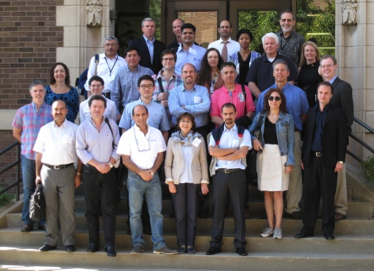

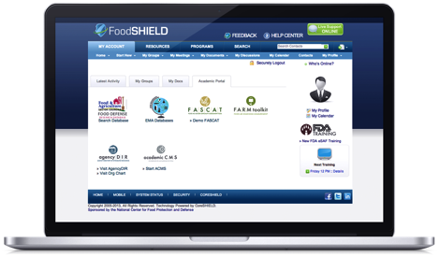
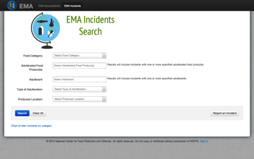
NCFPD PRODUCT LINES
INFORMATION TECHNOLOGY
IT development to transition research to end-users and maintain CoreSHIELD operations
FoodSHIELD
Laboratory Portals
EMA Database
Risk Assessments
Supply Chain Documentation
Horizon Scanning
SERVICE DELIVERY
Delivery of service to advance the profession through though leadership and service projects
Exercises
Consultation
Preparedness
Thought Leadership
RESEARCH
Research organized and led by internal and external PIs according to themes
Exploratory, Basic, and Applied Research by Themes
Agent Detection
Supply Chains
Modeling
Risk Analysis
Information Sharing
EDUCATION
Education and training for students & professionals both domestic and international
Credit and Non-Credit Offerings Delivered Through
Classrooms
Online Courses
Seminars
Collaborative Exchanges
SUPPORT SERVICES
HR, Finance, Admin, Communication, Marketing
NATIONAL CENTER FOR FOOD PROTECTION AND DEFENSE
Notes:
This year we re-organized the Center to reflect business lines. This has allowed us to be more focused on our core business lines executing the work and strategizing the future efforts.

Slide 5

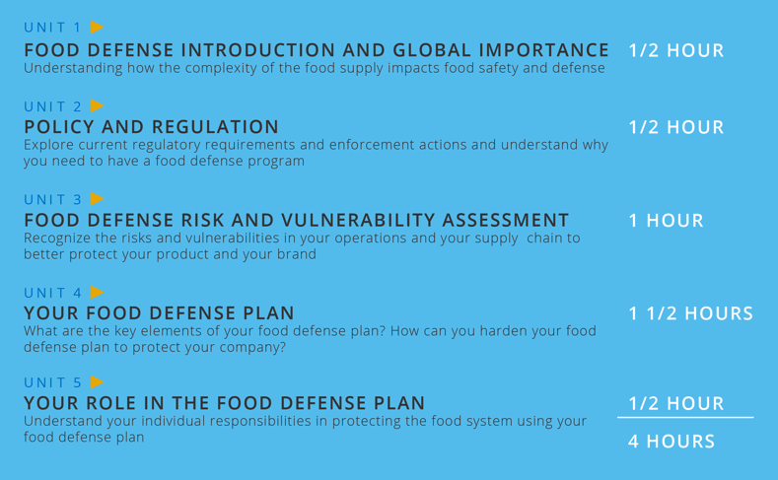

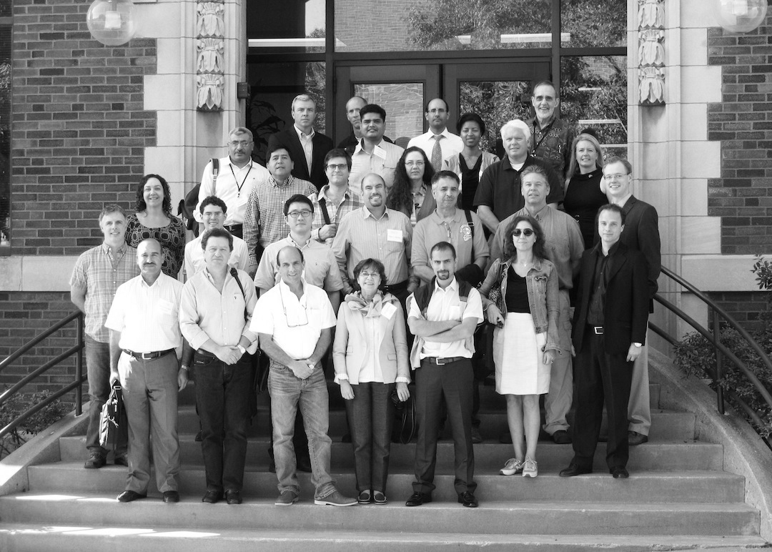
EDUCATION
Collaborative Exchange (3-5 Days) // In Person Certificate (4 Hours) // Academic Credit Courses (Academic Certificate Coming)
NATIONAL CENTER FOR FOOD PROTECTION AND DEFENSE

Slide 6

NCFPD TOOLS
AND
CAPABILITIES
NATIONAL CENTER FOR FOOD PROTECTION AND DEFENSE

Slide 7
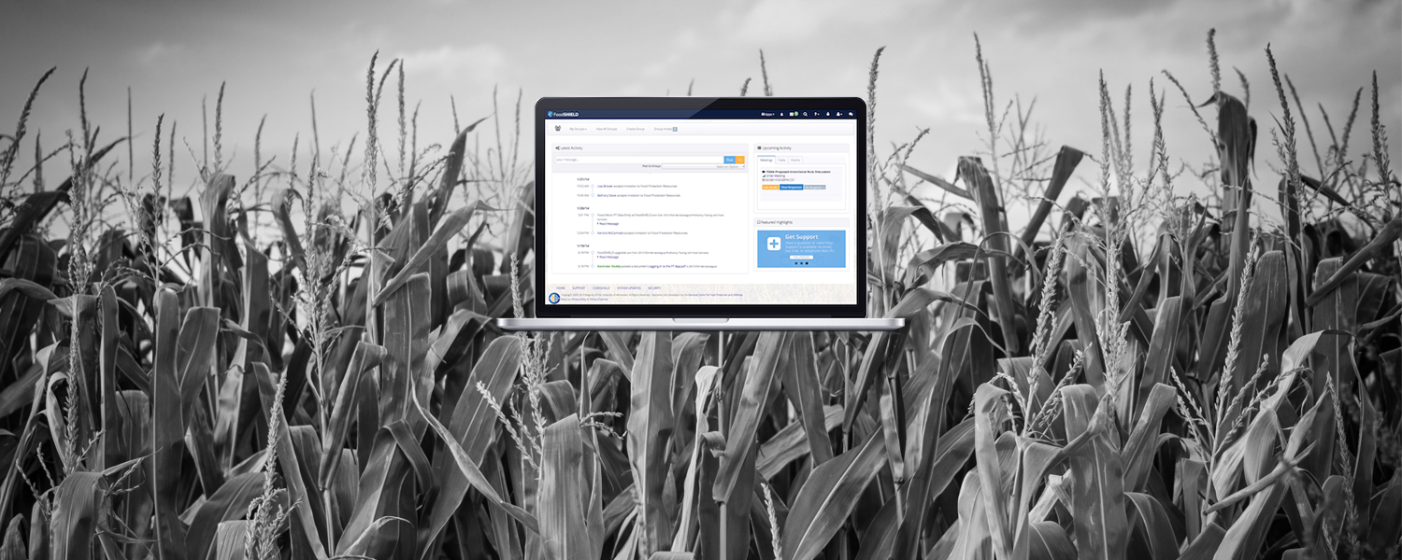

FoodSHIELD
NATIONAL CENTER FOR FOOD PROTECTION AND DEFENSE

Slide 8
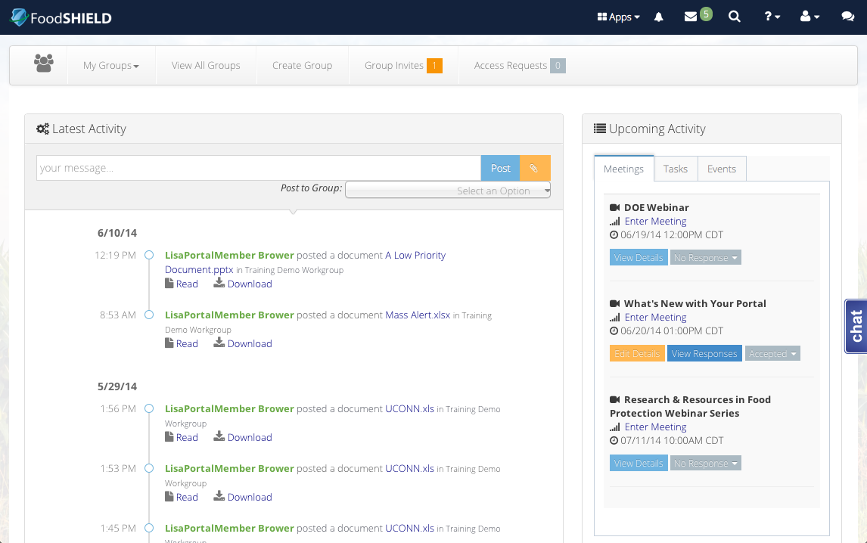

Workgroup Dashboard
NATIONAL CENTER FOR FOOD PROTECTION AND DEFENSE
Notes:
Customize your portal homepage to best match your workflow. If you’ve got work to do and you want to get straight to it, choose Workgroups. With the Workgroups homepage, you will see an overview of all workgroup activity and scheduled upcoming meetings and tasks.

Slide 9
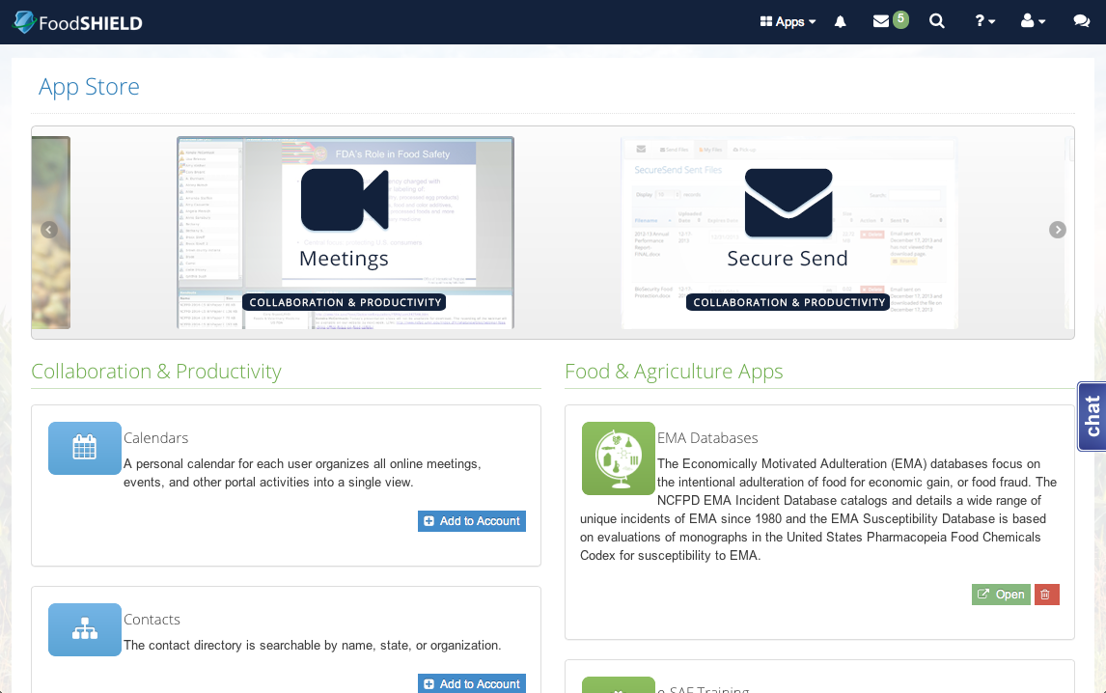
Applications Dashboard
NATIONAL CENTER FOR FOOD PROTECTION AND DEFENSE
Notes:
If you want help guiding your work, start with the Applications homepage. You will find simple access to your existing applications, and discover new ones in the portal App Store.

Slide 10
Control Center
NATIONAL CENTER FOR FOOD PROTECTION AND DEFENSE
Notes:
If you want help guiding your work, start with the Applications homepage. You will find simple access to your existing applications, and discover new ones in the portal App Store.

Slide 11
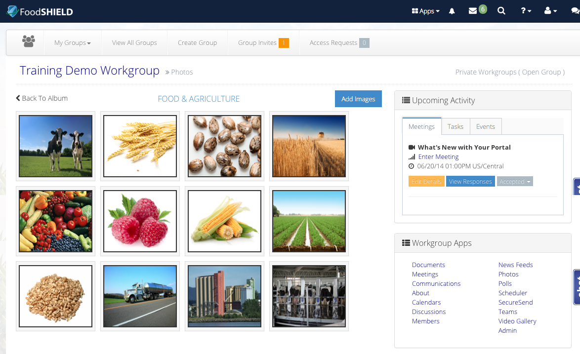
New Workgroup Apps
NATIONAL CENTER FOR FOOD PROTECTION AND DEFENSE
Notes:
Photos App
Create albums and share images

Slide 12
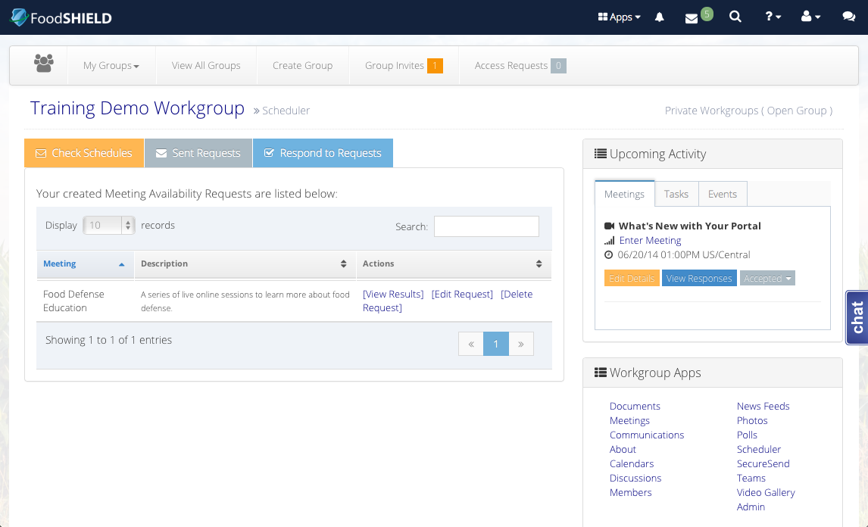
New Workgroup Apps
NATIONAL CENTER FOR FOOD PROTECTION AND DEFENSE
Notes:
Scheduler App
With today's fast-paced work environment, it can be challenging to find that one time where everyone is free for a meeting. Complete this onerous task quickly and easily with our meeting availability tool. It securely allows Doodle-like scheduling capability to simplify meeting time decisions by polling remote users and viewing aggregate responses to choose the best meeting time.

Slide 13
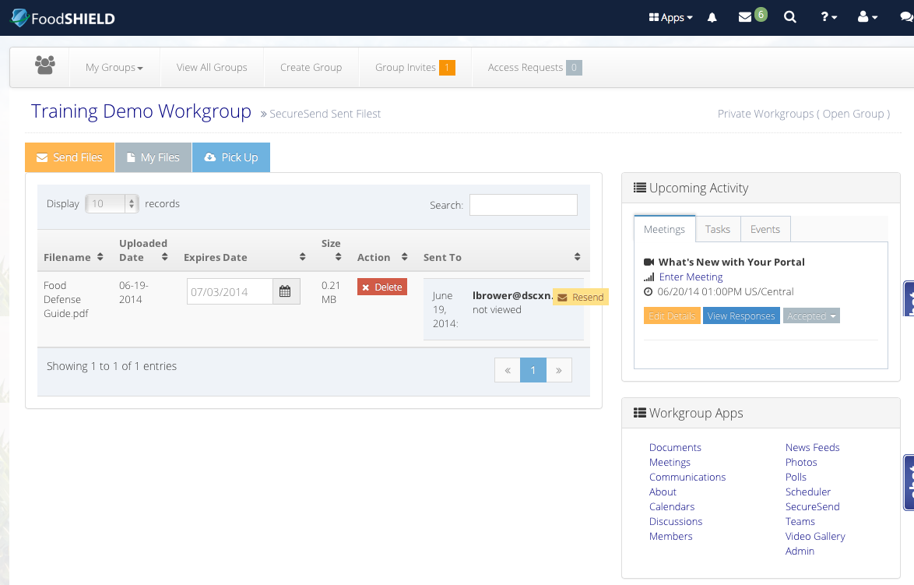
New Workgroup Apps
NATIONAL CENTER FOR FOOD PROTECTION AND DEFENSE
Notes:
SecureSend App
Do you get frustrated when you email a large file only to have it come back as undeliverable or file size too large to send? Use SecureSend to send large files to portal members and non-members.

Slide 14
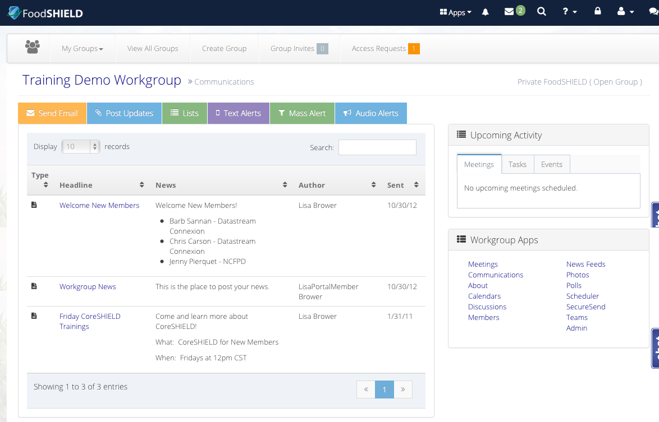
New Workgroup Apps
NATIONAL CENTER FOR FOOD PROTECTION AND DEFENSE
Notes:
The new Communications app….now with Alerts! The Alerts utilities are coming soon (could be launched week of AFDO). Ask Ted for launch update.
The Communications app is the central hub for all workgroup communication. Group members can deliver critical and non-critical messages via email, text, and audio to other group members.
Send Email - A utility used to deliver messages by email to group members, portal members, and non-portal members.
Post Updates - A utility used to post messages to a workgroup's message board.
Lists - A tool for creating and managing email distribution lists.
Texts Alerts - A utility used to deliver messages to cell phones in the form of SMS text messages. Text messages can be sent immediately or scheduled for a date and time of your choosing. Text-to-Audio is available for those members unable to receive text messages. The audio will be sent to a member's voicemail.
Mass Alerts - A utility used to deliver critical messages to a large audience in the form of text or email messages. A spreadsheet template is available for use in compiling a list of recipients and their contact information.
Audio Alerts - A utility used to deliver messages by audio to recipients' phones or voicemail systems. This utility allows you to record your message or attach a pre-recorded message by providing the recording URL. Only workgroup administrators have access to this utility.
? Use SecureSend to send large files to portal members and non-members.

Slide 15


FOOD AND AGRICULTURE READINESS MEASUREMENT (FARM) TOOLKIT
NATIONAL CENTER FOR FOOD PROTECTION AND DEFENSE

Slide 16

Three Objectives
1. Survey: Determine state government capabilities through a series of questions on prevention, preparedness, response, mitigation, and recovery in the event of a food emergency.
2. Benchmark: Based on state responses, the tool generates individual assessments, measurements, and a report for the state.
3. Improve: FARM Toolkit supplies states with customized resource suggestions to improve their response.
NATIONAL CENTER FOR FOOD PROTECTION AND DEFENSE

Slide 17
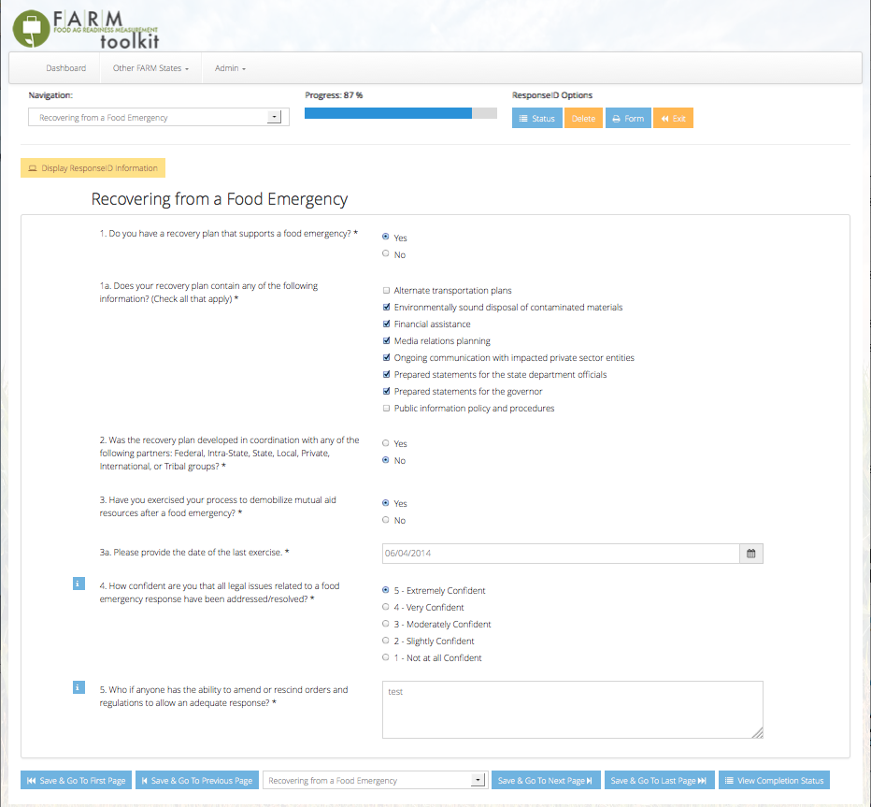
Objective #1 - Survey
  Easy to use web-based data collection tool.
  Aligns with the Presidential Policy Directive-8 (PPD-8) and NASDA’s Food Emergency Response Plan (FERP).
  Gains insight on each state’s emergency response prevention, preparedness, response, mitigation, and recovery.
NATIONAL CENTER FOR FOOD PROTECTION AND DEFENSE

Slide 18
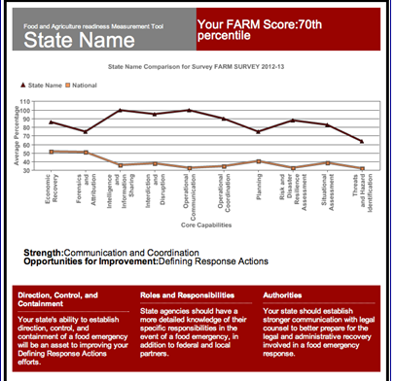
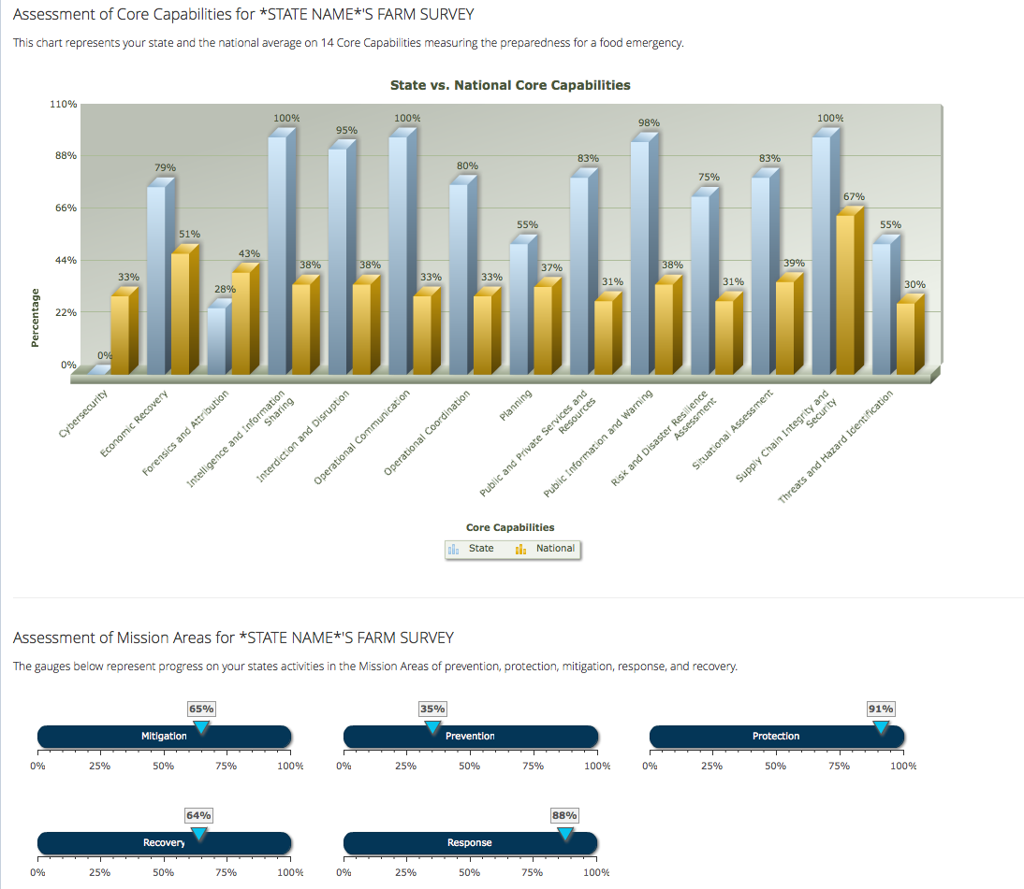
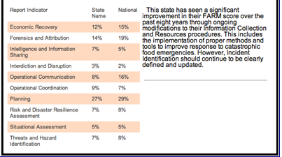
Objective #2 - Benchmark
  Graphic displays of results and comparisons between state, regional, and national results.
  Individualized one-page report summary to provide practical feedback and easily distributable information.
NATIONAL CENTER FOR FOOD PROTECTION AND DEFENSE

Slide 19
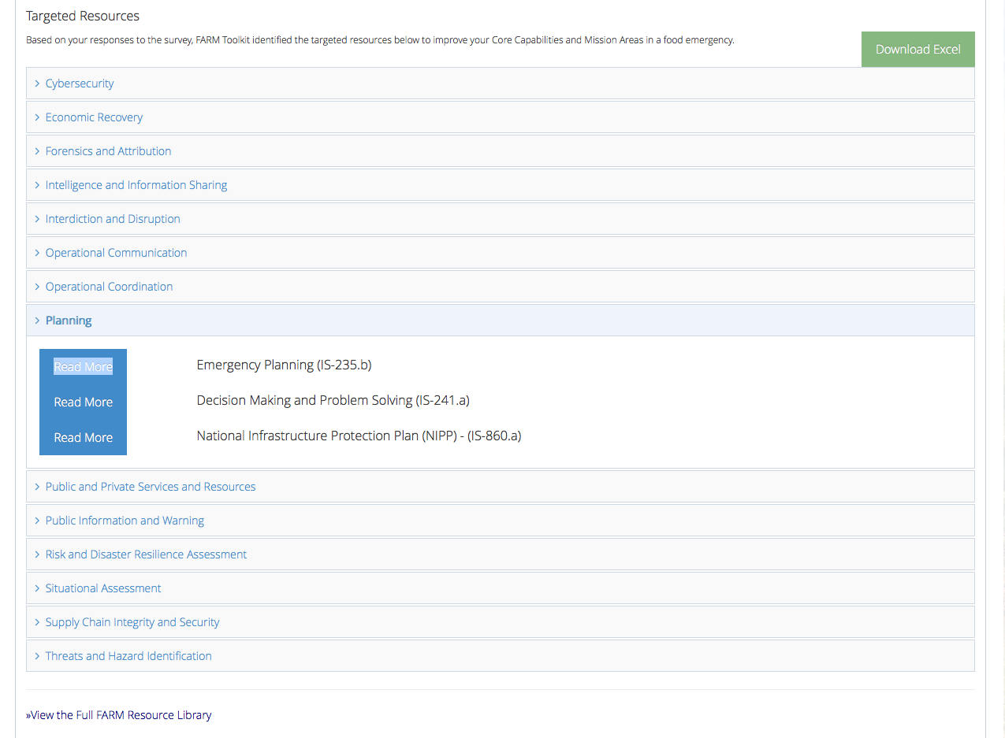
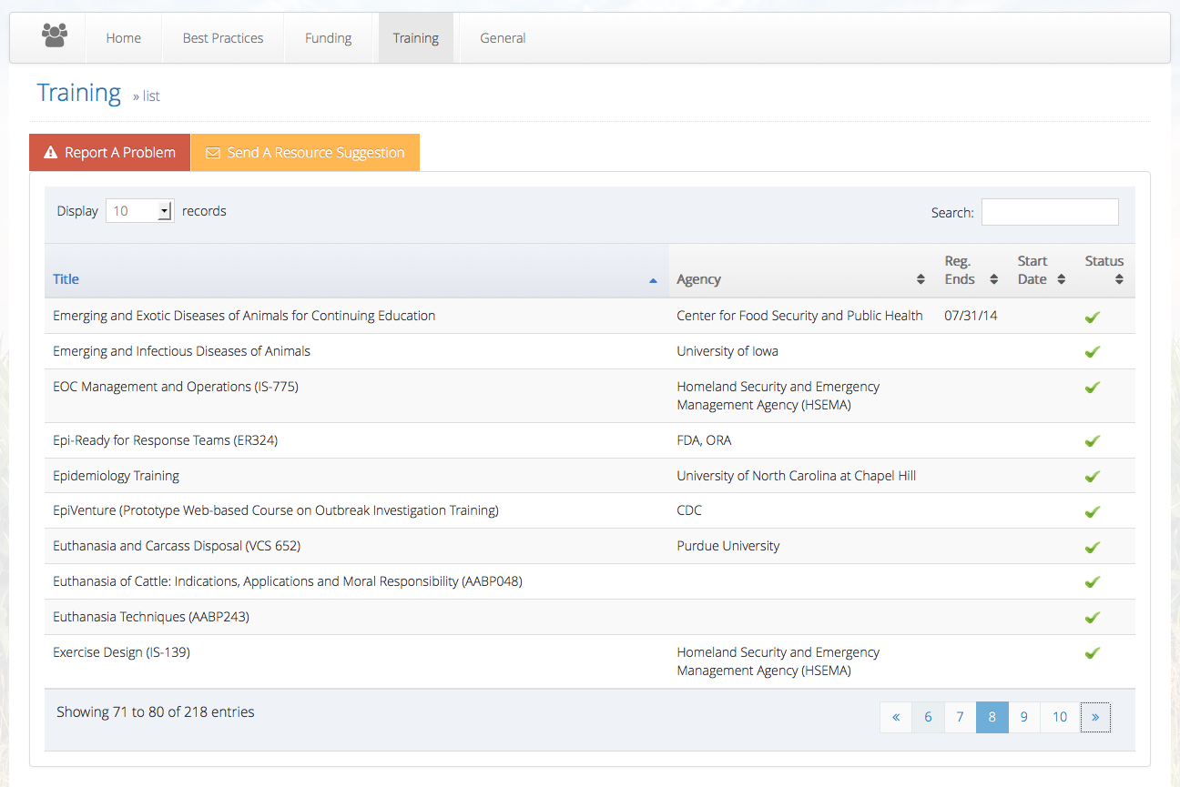
Objective #3 - Improve
  Individualized resource suggestions categorized by Core Capability.
  Full resource library access of Funding, Training, Best Practices, and General Resources.
NATIONAL CENTER FOR FOOD PROTECTION AND DEFENSE

Slide 20
Participation
NCFPD is actively seeking state participation!
Capable of TRAVELING, HOSTING, or ASSISTING VIA WEBINAR
Most effective state participation entails:
  Two hour commitment
  Representation from any agency that would be involved in Food Emergency
Contact: Bethany Stave,
NCFPD Program Specialist
stave015@umn.edu
NATIONAL CENTER FOR FOOD PROTECTION AND DEFENSE

Slide 21
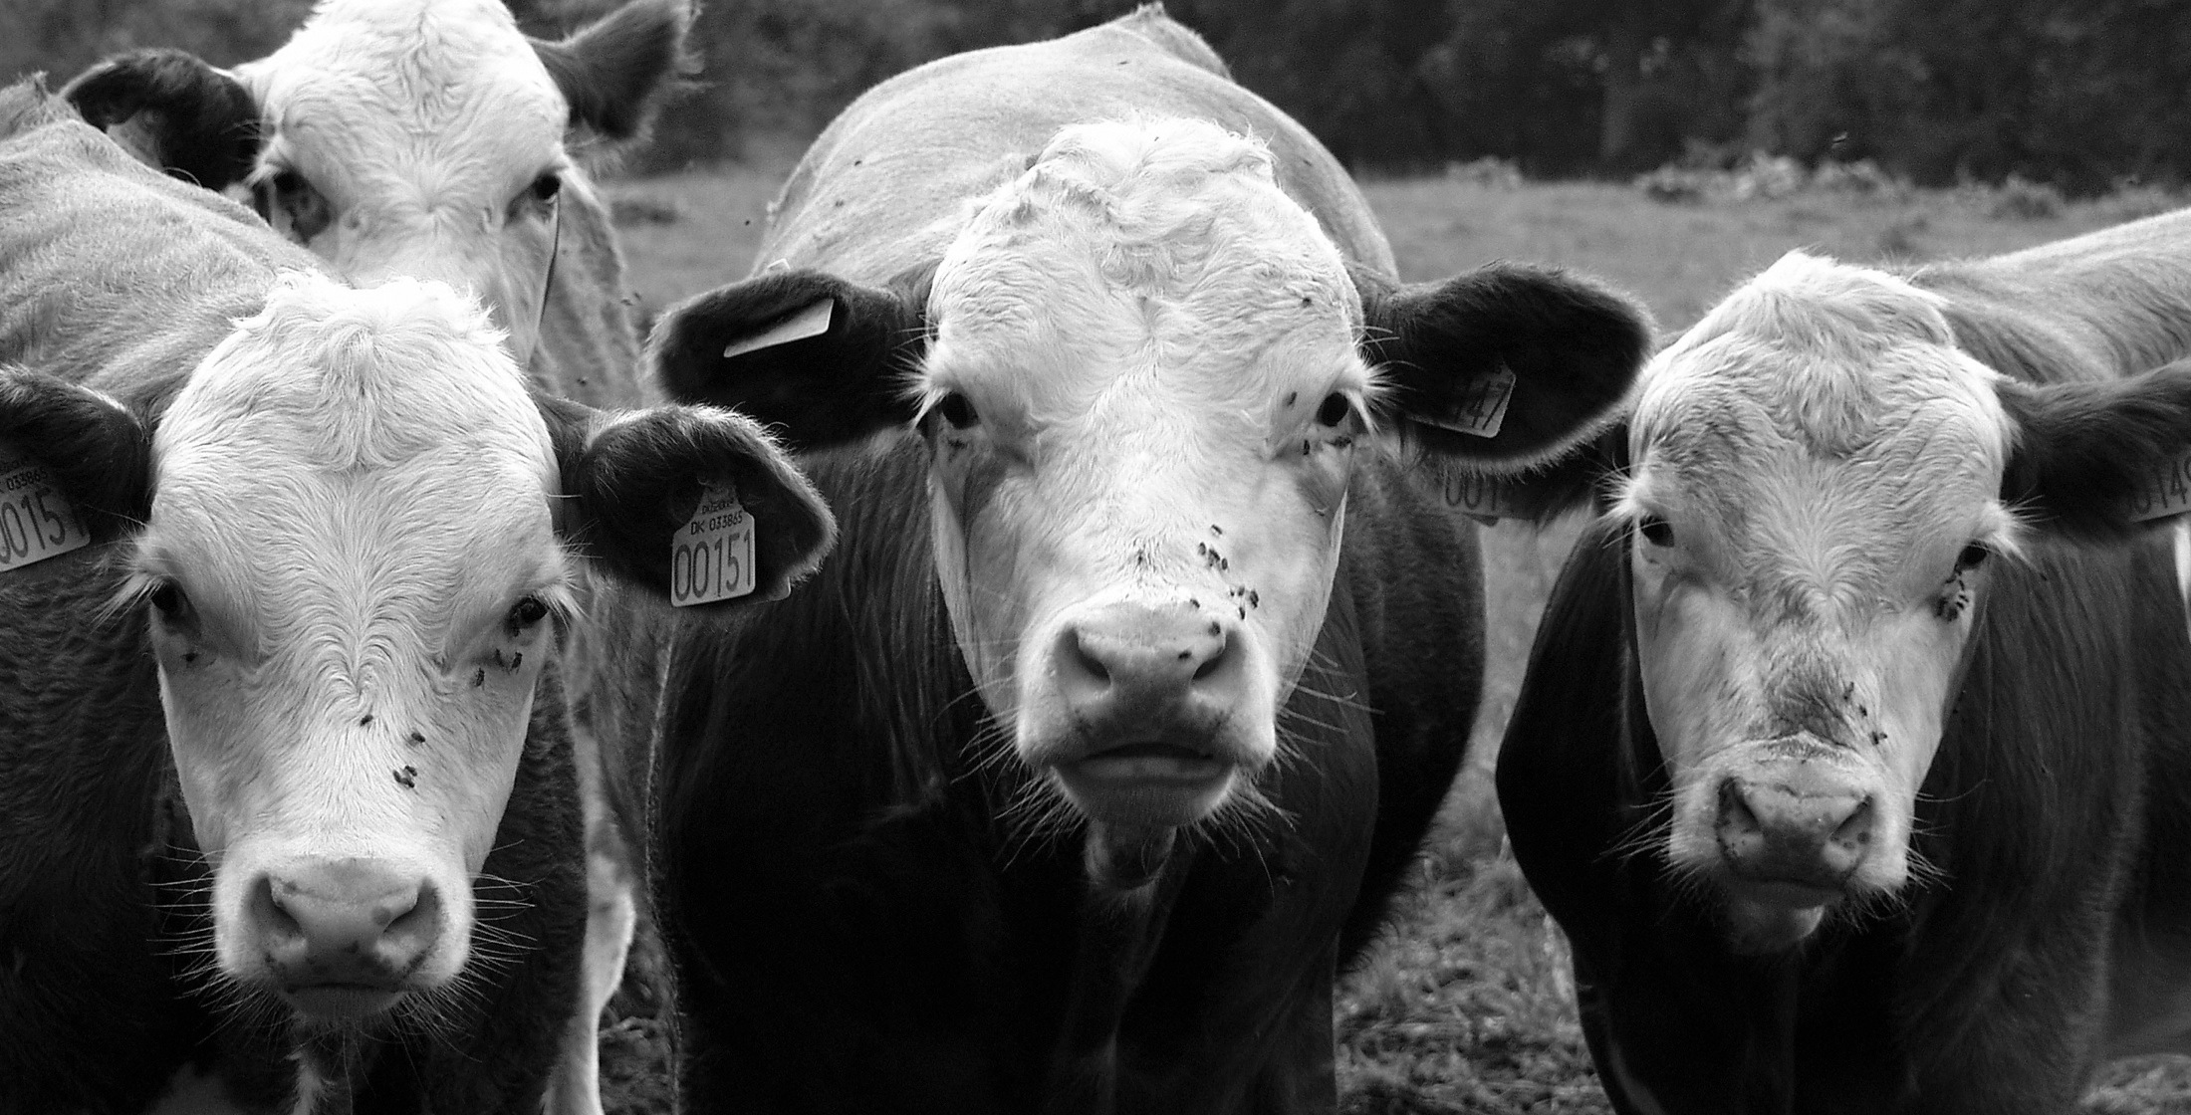

Animal Emergency FRAME
NATIONAL CENTER FOR FOOD PROTECTION AND DEFENSE

Slide 22

Animal Emergency FRAME
Training is organized by position type in the Incident Command System
NATIONAL CENTER FOR FOOD PROTECTION AND DEFENSE

Slide 23
Animal Emergency FRAME
Individuals can access their training, document experience, and access information on tools they will use in emergency response
NATIONAL CENTER FOR FOOD PROTECTION AND DEFENSE

Slide 24
FRAME Status
Will beta-test tool in Fall 2014
  States
  AVMA teams
  USDA
NATIONAL CENTER FOR FOOD PROTECTION AND DEFENSE

Slide 25


Slide 26

RESEARCH FUNDING PRIORITY AREAS
  Bio and Chem Agent Behavior
  Risk Analysis
  Event Modeling
  Supply Chain Security
  Information Sharing
  Cyber Security
Oct: Request for White Papers
Dec: Invitation for Full Proposals
Feb: Selection of research projects
NATIONAL CENTER FOR FOOD PROTECTION AND DEFENSE

Slide 27


























































































































ERIKA@UMN.EDU
STATE/LOCAL AGENCIES

