Slide 1
Sanitation Success –Wet or Dry!
Warren Stone, MBA
Senior Director, Science Policy
Grocery Manufacturers Association

Slide 2
What makes an effective, comprehensive sanitation program, wet or dry?

Slide 3
“Sanitize means to adequately treat cleaned food-contact surfaces by a process that is effective in destroying vegetative cells of microorganisms of public health significance, and in substantially reducing numbers of other undesirable microorganisms, but without adversely affecting the product or its safety for the consumer.”
Proposed 21 CFR 117.3

Slide 4
Benefits of Sanitary Design
A well-designed piece of equipment (or facility) can be cleaned more effectively and in less time
Well designed facilities serve to keep hazards out
Sanitary design can add bottom line value while supporting food safety and quality
  Supporting the organization’s objectives in reducing the amount of labor required to clean the equipment and/or facility.
Sanitary design principles can also be a driver of multi-year operational efficiency gains!

Slide 5
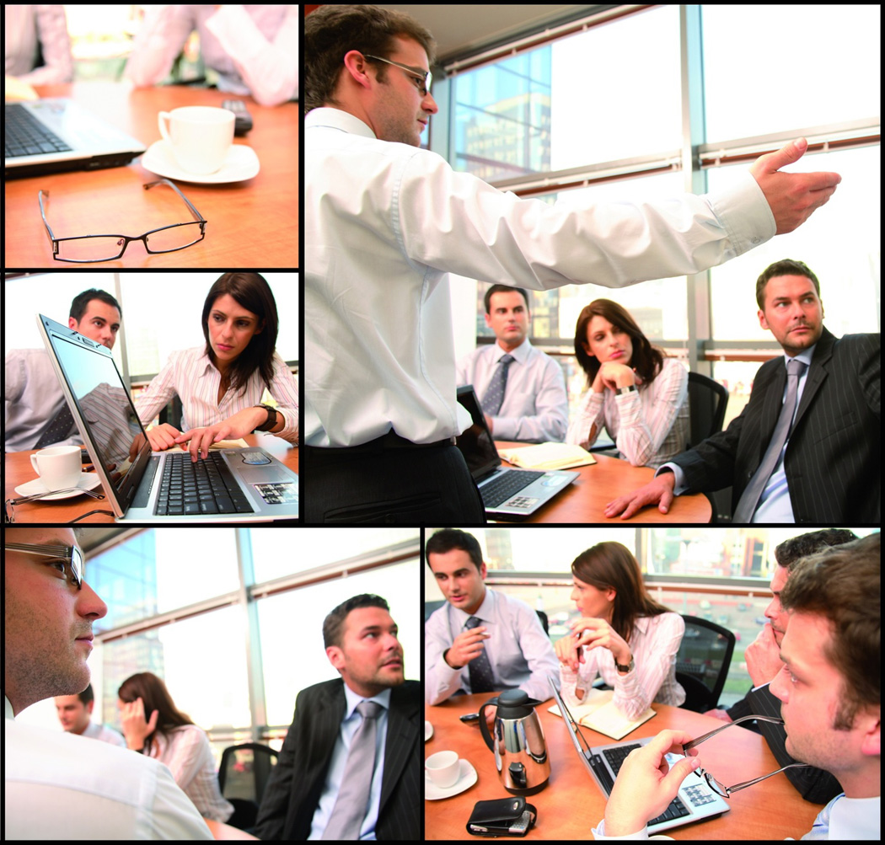

Do your homework!

Slide 6
Sanitation success
Conduct a Cleaning Needs Analysis
  HACCP based risk assessment
  Hazards (allergens, pathogens, FM, pests)
  Quality change-over (flavor, color)
  Knowledge of products / process
      Is it dry or wet process?
Apply Cleaning Method / Frequency
  Choose appropriate cleaning method (dry, wet)
  Frequency of cleaning

Slide 7
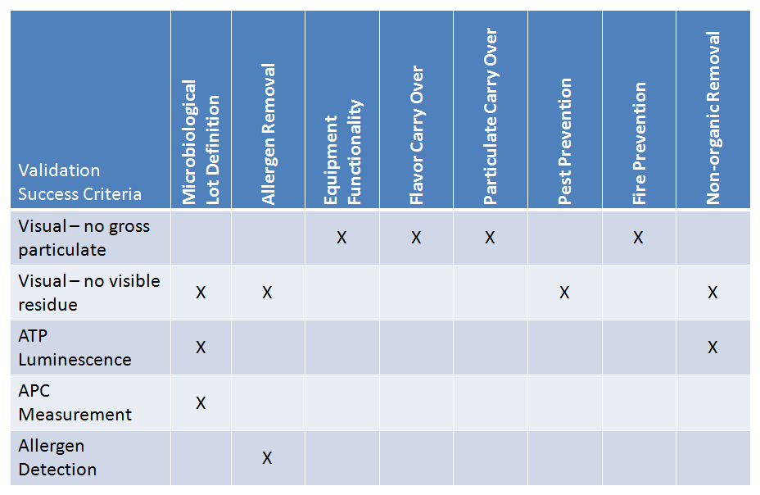
Determine Sanitation Objectives
Notes:
How do you determine success in cleaning

Slide 8
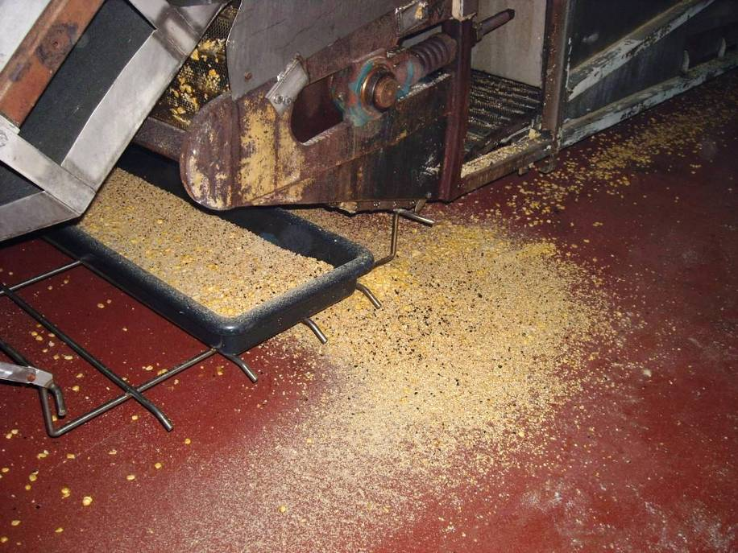
Pre-Sanitation Readiness -
Maintain Good Housekeeping
It is critically important to make sure that good housekeeping practices are maintained throughout the production run and that spills and messes are cleaned up when they happen. When good housekeeping is not followed the first hour or more of the sanitation process is wasted making up for poor housekeeping practices instead of focusing on the value added tasks of the sanitation process.

Slide 9
The 7-Step Cleaning Process
Provides direction for sanitation employees to assure an effective cleaning process.
Identifies the correct steps in the right order
Provides in sync process design to eliminate re-contamination or cross contamination issues
Provides direction for entire room clean
Identifies ‘KEY’ critical steps
Excellent training and auditing tool

Slide 10
Wet vs. dry principals
7 Principals of wet cleaning
Dry Clean
Pre-rinse
Soap and Scrub
Rinse and Inspect
Assemble
Pre-operational inspection
Sanitize
7 Principals of dry cleaning
Pre-Sanitation preparation
Secure and dismantle
Dry Clean
Detail cleaning
Post sanitation inspection and reassembly
Pre-operational inspection
Final inspection and documentation

Slide 11
Develop a Cleaning Plan
Disassemble equipment
  Complete visual inspection of all product contact. surfaces (zone 1 & 2 areas). This may require teardown of equipment.
  Identify hard to clean areas, document (with pictures) and incorporate into cleaning plan.
  Develop a pre-operational check list based on finding.

Slide 12
Develop a cleaning plan
Determine method for successful removal of allergen / allergens if a dry process.
  Dry paper towel
  Alcohol wipes
  Limited application of detergent solution on paper wiper and similar rinse and then dry
  Removal of equipment to a wet clean area for cleaning
  Vacuum cleaning
  Dry ice blasting
  Push through (sugar, salt, product)
Document your plan in detail

Slide 13
Develop a cleaning plan
Determine method for successful removal of allergen / allergens if a wet process.
  Clean in place (CIP) system
  Disassemble and remove equipment to a wash room for cleaning
  Use “clean out of place” wash systems (COP)
  Foam with chlorinated detergents and apply mechanical action
Document your plan in detail

Slide 14
You have a plan – Validate it!
When??
  At start up of a line where a allergen change over is planned
  Whenever there is a new product added to the production line
  Whenever there is a new process or a change in the process or equipment
  Whenever there is a change in the product
  On a predetermined schedule (e.g. every year)
SSOP validation may become a FSMA preventive controls requirement

Slide 15
Validate effectiveness
Execute the plan
Complete visual inspection
  A complete visual inspection of all product contact surfaces (Zone 1 areas). May require the teardown of equipment.
  Document that HTC areas are visually clean.
  Document that the line is clean using the pre-op check list.
Test for indicator analyte using multiple test sites
  Allergenic protein
  Indicator microbial organism
  ATP
Repeat up to three times with acceptable results

Slide 16
Validation safeguards – do it right
Testing details, where appropriate and necessary:
  Use “aseptic like” techniques.
  Use rinsate in a wet process.
  Document all details of the sanitation procedure used.
  Detail, detail, detail.
  For allergens, evaluate different matrixes for successful removal of the same allergenic protein (remove tree nut residue from dark, white and milk chocolate).
  Have a predetermined plan in the event you get a positive result.

Slide 17
Verification
If your SSOP is a CCP, product can not be released until all CCP’s have been verified and documented.
Are you doing what you say you’re doing?
  Visual inspection of equipment on pre-identified pieces of equipment including hard to clean areas.
  Verify the sanitation plan has been followed (time, temperatures, methods of cleaning, chemical concentrations amount of flush material, etc.)
  Complete and sign any pre-op documentation.
  Records review
  Calibration of instruments (lab equipment, thermometers).

Slide 18
Dry Cleaning - War on Water
Best practices – Minimize the use of water
History, studies and literature tell us:
  From a microbial standpoint, unnecessary water is like gasoline for a fire!
  Bacteria need time, food and water to quickly multiply.
  “Moisture control is critically important in preventing Salmonella contamination in low-moisture products (ICMSF, 2005b).”
  “Water in the dry processing environment is one of the most significant risk factors for Salmonella contamination because the presence of water allows the pathogen to grow in the environment, where normally the lack of moisture would prevent this (Podolak, JFP, 2010).”
  A Low Moisture Food Manufacture:
  CAN and MUST CONTROL WATER
Time
Food
Water

Slide 19
Facts Not Fiction
Wet cleaning of equipment that was not designed for wet cleaning causes critical issues
Introducing water into environments that were not designed for the introduction of water creates issues .
Microorganisms need water to grow.
Environmental sustainability is not maintained when water is wasted.
One GMA member: wet clean up - 2,410,836 gallons, dry clean up - 1,024,032.
Notes:
.

Slide 20
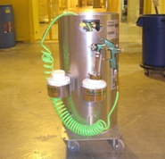
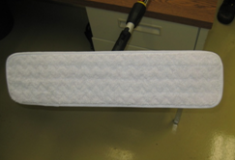
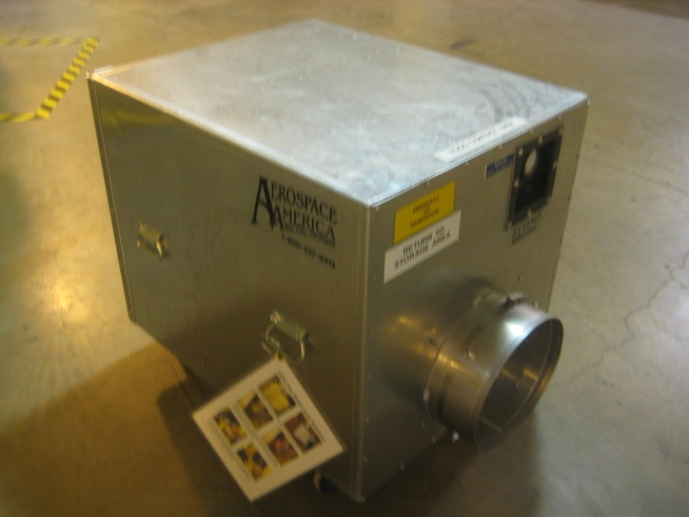
Develop a plan to eliminate obstacles
Tools-WOW & Sanitation
  CO₂ Sanitizer Delivery
  HEPA blowers
  Ergonomic tools fabricated
  Swiffters
  Ladders & lifts

Slide 21
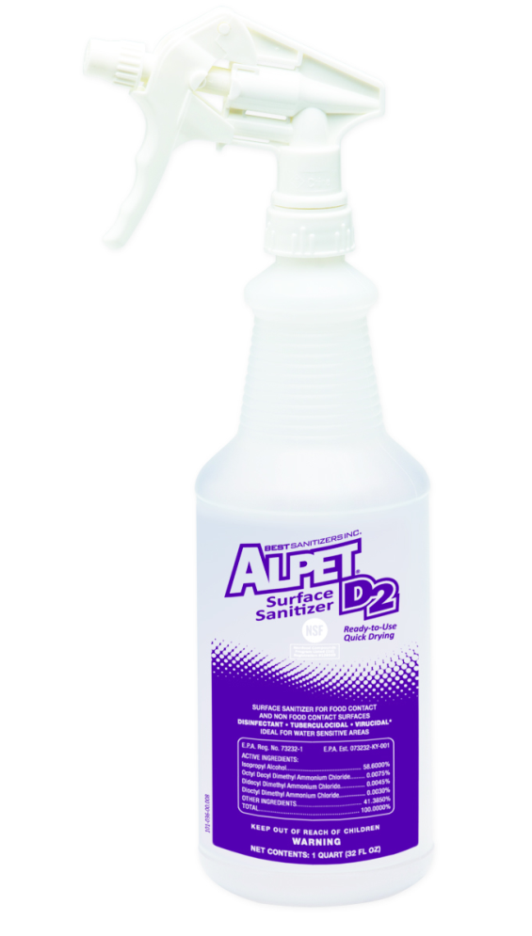
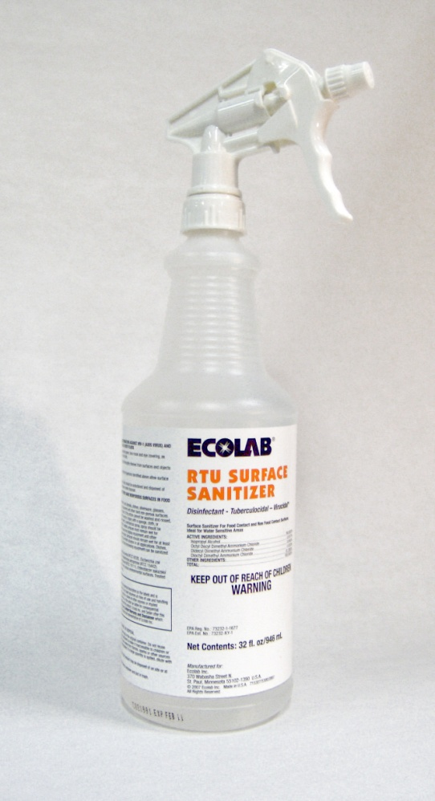
Isopropyl alcohol / and QAC Sanitizer
Ready-to-use sanitizer
58.6% IPA, 150 ppm QAC
Fast drying, reduced moisture presence
EPA-registered
  5 log-reduction, 1 min
Flammability…dispensing & storage

Slide 22
Develop Tracking Metrics
Total cleaning water consumption per line or area
Microbiological, allergen, etc. monitoring
Track internal adverse water events with direct correlation to wet washing
Auditing new SSOP
  Pinpoint behavior changes needed for success
  Audit each change over

Slide 23
Water Accumulation Controlled
The drier your facility, the easier it will be to control microbial growth
Even in a wet facility, water flow needs to be managed to control risk

Slide 24
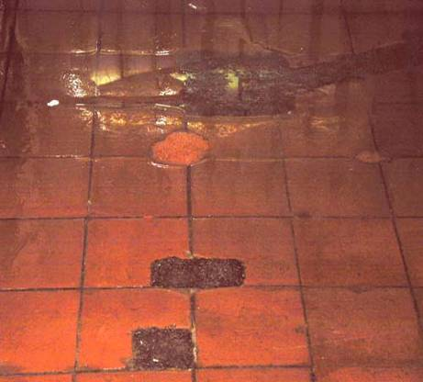
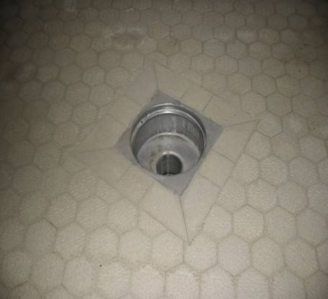
… requires designs that facilitate free draining of any moisture that is introduced into the facility environment.
Pooling water is a sign of trouble.
Ponding water
From This
To This More
Poor repairs
Design
Sanitary Design

Slide 25

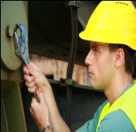
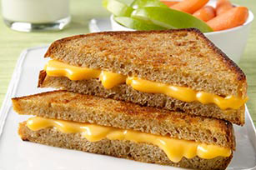
A Sanitation Centric integrated “Safe Food” Supply Chain
Concept
Design
Review
Install
Operate
Clean
Safe Food
Product sensitivity
Wet or dry clean
Allergens
New or old design
Meet with Vendors
Capture learning’s
Allergens / label requirements
Compliant
Equipment design
Cleaning methods
Utilities
Facility design
Regulatory requirements
Pest mangmnt
Pathogen monitoring
Process control
Facility design check list
Equipment design list
HACCP points
Allergen management
Sanitation procedures
Other items
  Trash flow
  RTE Raw separation
GMPs followed
Separation from other processes
Raw from RTE
Observe risk areas
Monitor environment
Inspect
Sanitary Operational performance
In process monitoring
Employee concerns
Easy for employees to do it right things
Validate procedures
Monitor time to clean
Microbial monitoring
Continuous improvement

Slide 26
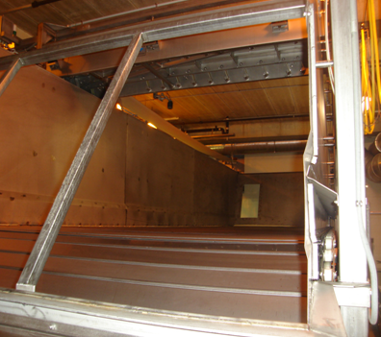
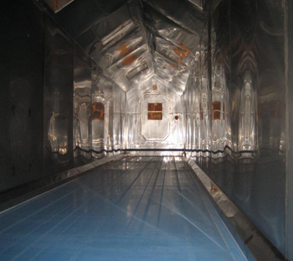
Sanitary Design
Notes:
Old BSU vs. New BSU, new BSU has not been wet washed in 4yrs, only Alcohol based sanitizers

Slide 27
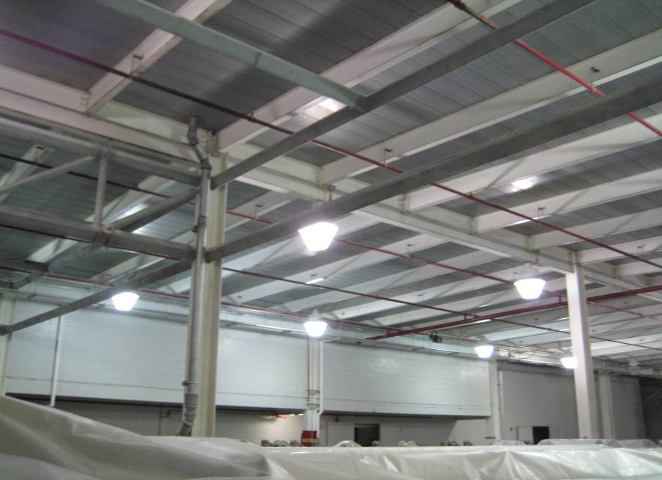

Slide 28
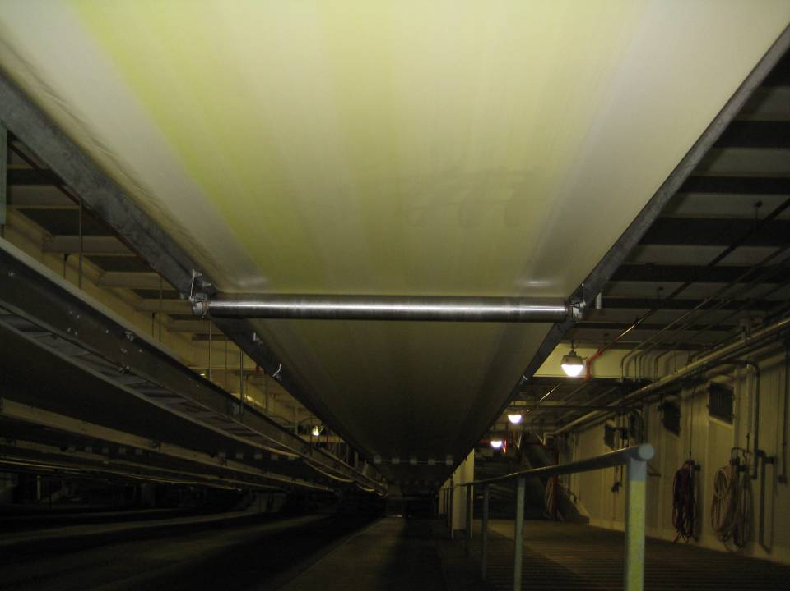
Couple of examples of dry cleaned belts

Slide 29
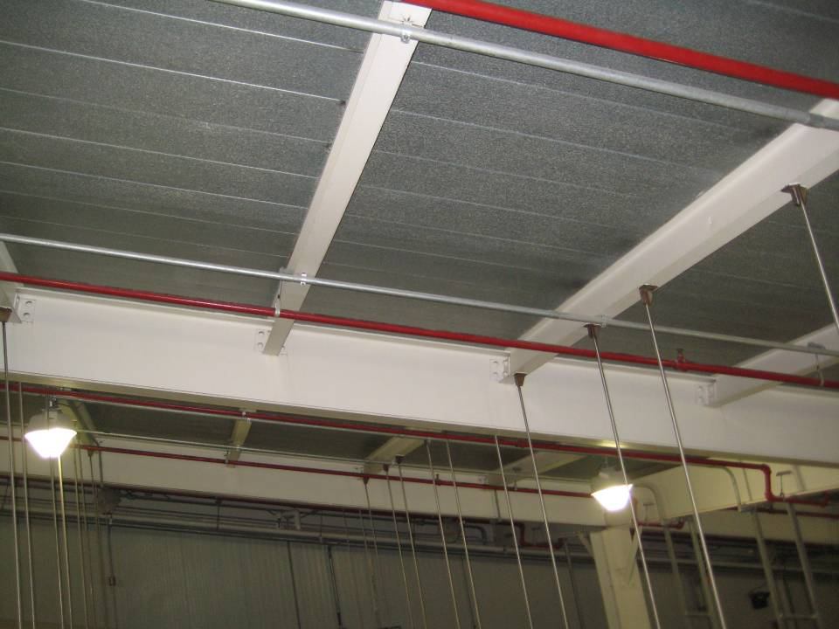
Ski Slope overheads

Slide 30
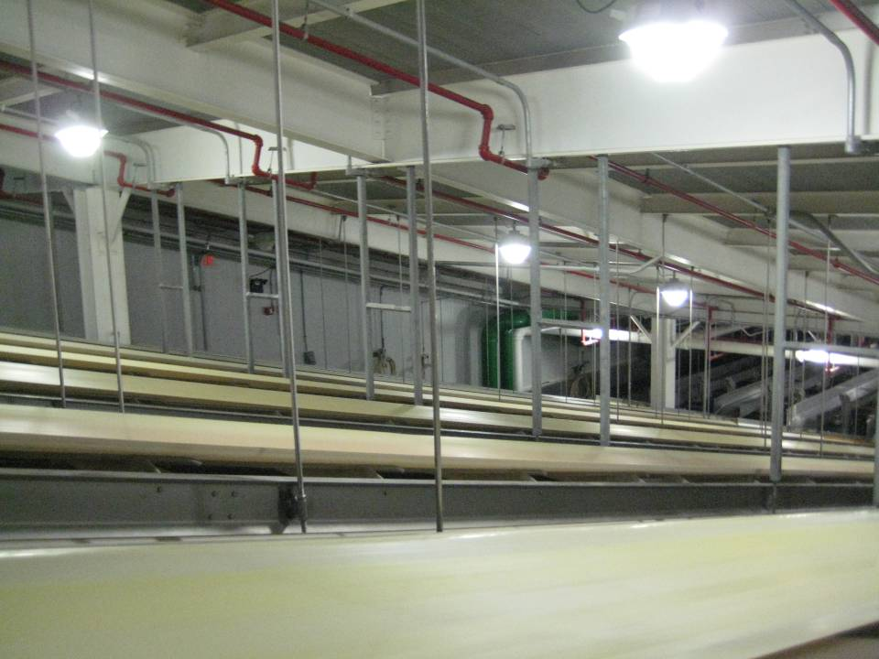

Slide 31
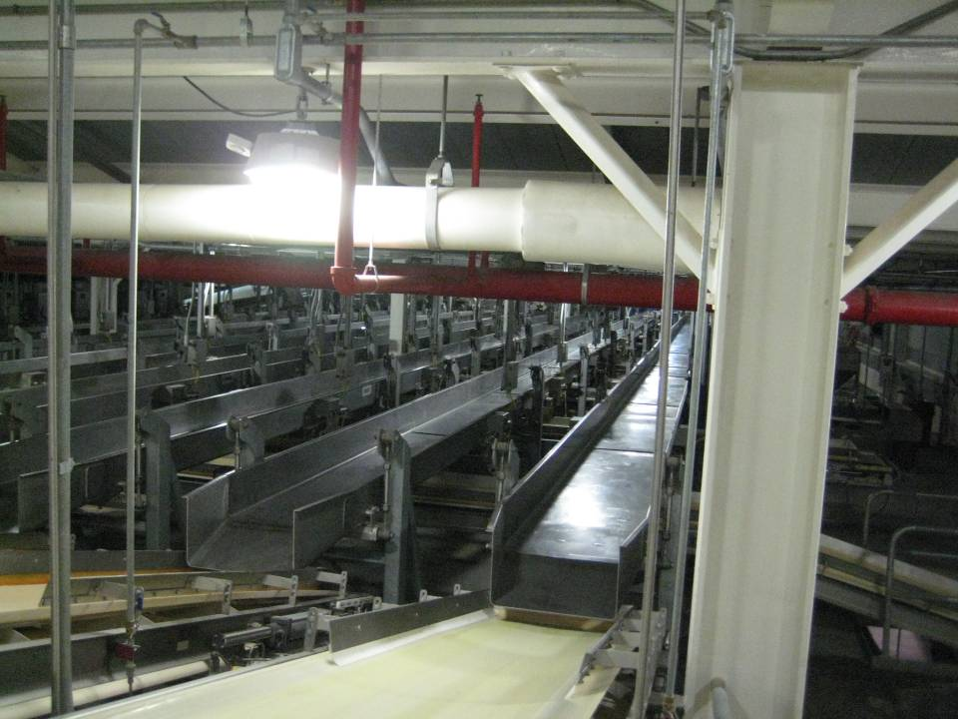
Drag Level slip-sticks

Slide 32
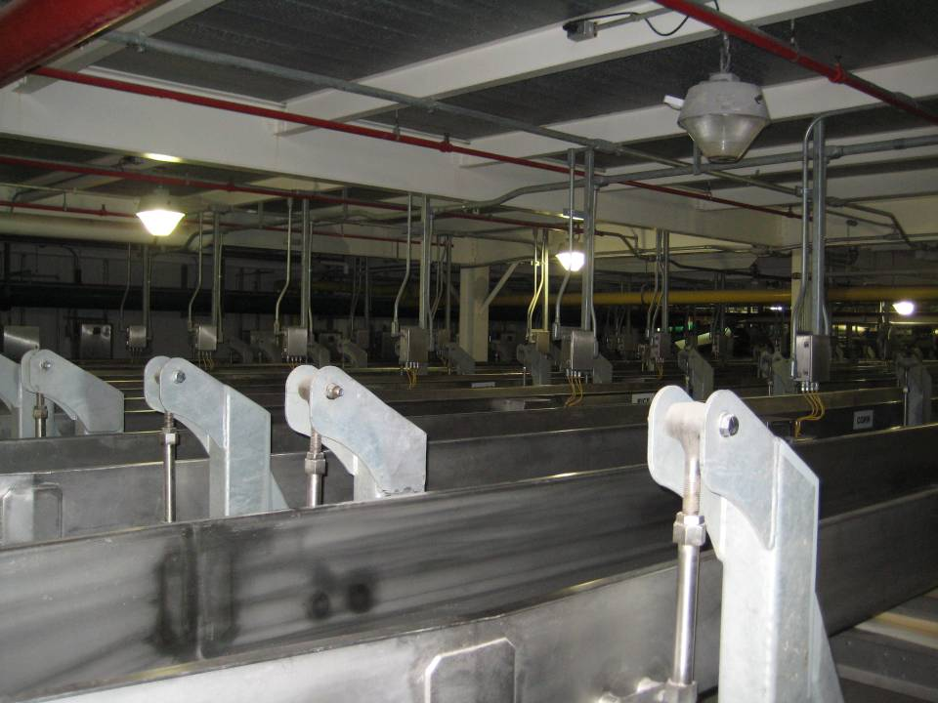
Drag Level overheads and outside of slip-sticks

Slide 33
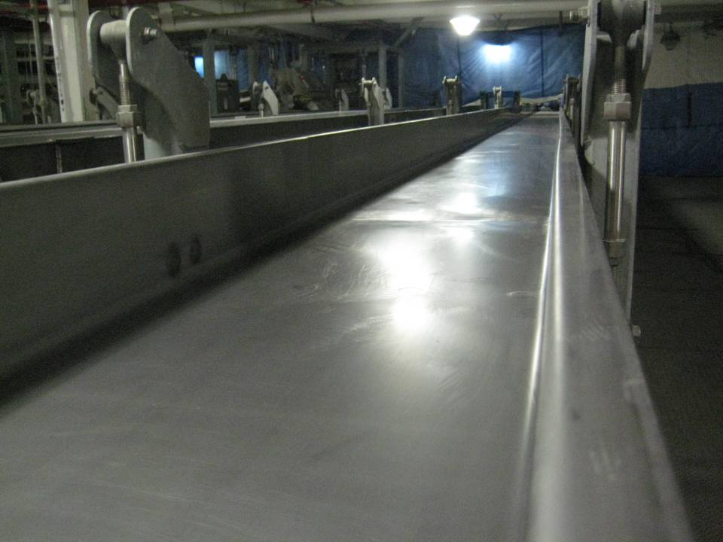
Slip-sticks after hand sanitizing with Alcohol

Slide 34
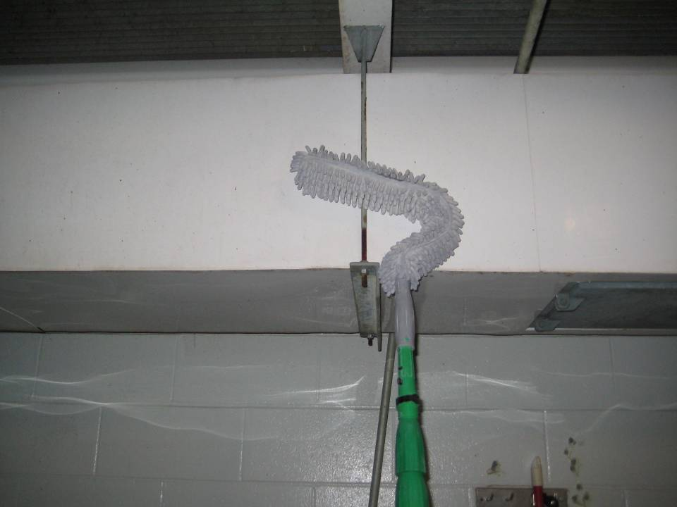
Tools used for overheads

Slide 35
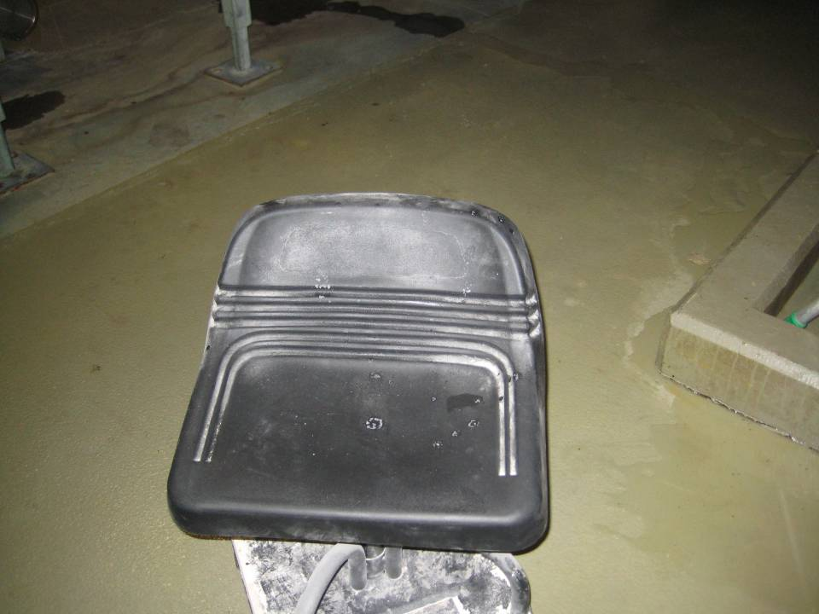
Rolling Stools purchased to clean under slip-sticks and belts.

Slide 36
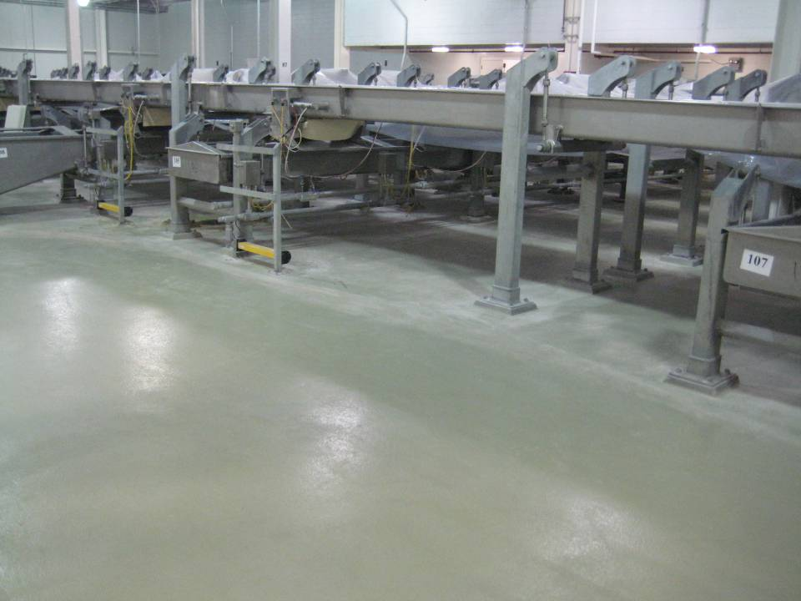
Mezzanine Level Floors

Slide 37
What makes an effective, comprehensive sanitation program, wet or dry?

Slide 38
Any Questions??

