Slide 1

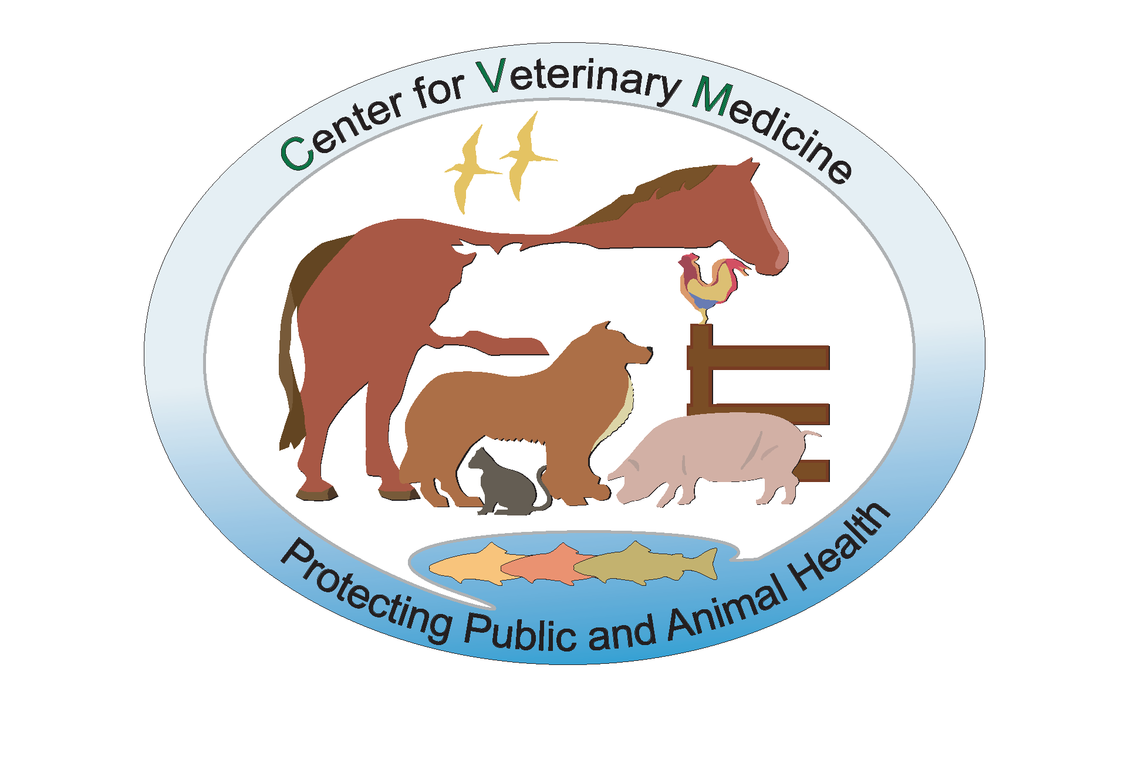
Understanding Mycotoxins Impact on Food and Feed: CVM’s Data and Approaches
Michael H. Henry, Ph.D.
Division of Animal Feeds
Office of Surveillance & Compliance
Center for Veterinary Medicine
Food and Drug Administration
Phone: (240) 453-6861
E-mail: mike.henry@@fda.hhs.gov

Slide 2
Introduction
CVM and Regulations
Mycotoxins
  Aflatoxins, Fumonisins, Vomitoxin (DON), Ochratoxins, and Zearalenone
        Occurrence
        Health Effects
Mycotoxin Surveillance Program and Data
Summary

Slide 3
CVM and Regulations
CVM and Responsibilities
  The Center for Veterinary Medicine (CVM) is a consumer protection organization. We foster public and animal health by approving safe and effective products for animals and by enforcing other applicable provisions of the Federal Food, Drug, and Cosmetic Act and other authorities.
  Within CVM, the Division of Animal Feeds is responsible for ensuring that food for companion animals and feed for food-producing animals are safe and wholesome.
  The feed industry plays a critical role in the production of safe wholesome meat, milk, fish, and eggs ($50 -100 Billion).

Slide 4
CVM and Regulations
CVM Authority
Federal Food, Drug, and Cosmetic Act
  SEC. 402. [21 U.S.C. 342] A food shall be deemed to be adulterated
    (a)(1) If it bears or contains any poisonous or deleterious substance which may render it injurious to health; …
  SEC. 406. [21 U.S.C. 346] TOLERANCES FOR POISONOUS INGREDIENTS IN FOOD
    When any poisonous or deleterious substance cannot be avoided by good manufacturing practice, the Secretary shall promulgate regulations limiting the quantity therein or thereon to such extent as he finds necessary for the protection of public health

Slide 5
CVM and Regulations
Regulatory Limits
Tolerances: represent limits above which the product is adulterated as a matter of law. FDA can take legal action to remove products from the market without having to prove them unsafe.
Action Levels: represent limits at or above which FDA may take legal action to remove products from the market.
Guidance or advisory levels are recommended maximum levels that FDA considers adequate to protect human and animal health.

Slide 6
Mycotoxins
Secondary metabolites of fungi (molds)
Organic chemicals (C, N, O, & H)
There are more than 300 known mycotoxins
Mycotoxins that have grabbed most attention worldwide:
  Aflatoxins, ochratoxin A, and zearalenone
  Trichothecenes and fumonisins,
  Ergot alkaloids
Stable and persistent

Slide 7
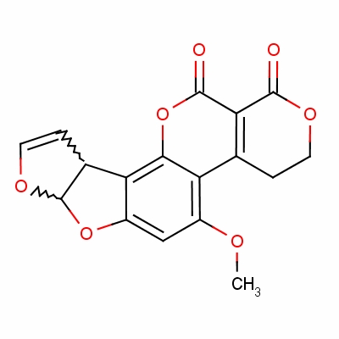
Aflatoxins
Produced by Aspergillus sp.
  A. flavus and A. parasiticus)
Common feed substrates:
  Corn, cottonseed, peanuts, and sorghum.
Four major aflatoxins in feed: B1, B2, G1 & G2
M1 in milk of humans and animals
High levels of aflatoxins associated with:
  above-average temperature
  below-average rainfall

Slide 8
Aflatoxins
In Animals and Humans:
Major target organs
  Liver and kidneys
Young animals more susceptible than adults
Monogastric animals more susceptible than ruminants
Acute aflatoxicosis can be fatal

Slide 9
Aflatoxins
In Animals and Humans:
Carcinogenicity
  Liver cancer is a serious consequence of long-term exposure to aflatoxins.
  Hepatitis B infection may exacerbate the effects of aflatoxin exposure
Decreased immune and reproductive function.
Fetus/young chronically exposed may experience growth failure.

Slide 10
Aflatoxins
Action levels
  Establish for Dairy cattle based on M1 in milk
    20 ppb in feed and feed ingredients
  In other classes of animals
    Safety of animals and residues in tissues
  Available Literature
    1960 to 1987

Slide 11
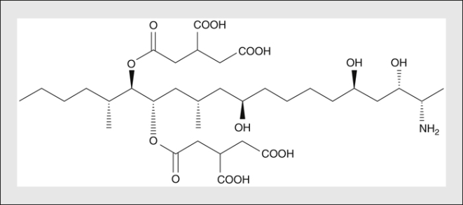
Fumonisins
Produced by Fusarium sp. (F. verticillioides)
Found worldwide
  mainly in corn and particularly corn screenings
High levels associated with:
  hot and dry weather
  followed by periods of high humidity
Three major fumonisins in feed
  B₁, B₂ & B₃ = total fumonisins

Slide 12
Fumonisins
Target organs
  Liver, brains, lungs
Suspected carcinogens
Associated with Esophageal cancer in humans
Most susceptible species
  Equine, Swine,
  Dogs and Cats

Slide 13
Fumonisins
Equine:
  Leukoencephalomalacia (ELEM)
Swine:
  Liver damage, pulmonary edema
Cattle and Sheep:
  Mild liver damage, moderate feed refusal
Poultry
  Reduce growth, mild liver damage
Guidance levels:
  based on animal safety

Slide 14
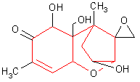
Vomitoxin (DON)
Produced by members of genus Fusarium (especially F. graminearum)
Commonly found on wheat, barley, rye, and oats
Reported most frequently in cool, temperate regions (northern U.S. and Canada)
Member of the trichothecene family of mycotoxins (include T-2 and HT-2 toxins)

Slide 15
Vomitoxin (DON)
Target organs
  Liver, brains, lungs, and immune system
  Vaccine failures
Most susceptible species
  Swine, dogs, and cats
In Humans
  Associated with alimentary toxic aleukia (ATA)
  Gastrointestinal issues
Advisory levels:- based on safety of animals

Slide 16
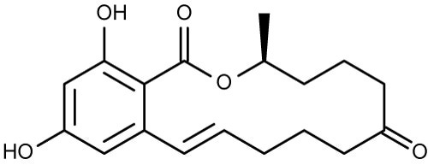
Zearalenone
Produced by Fusarium sp. (primarily F. graminearum)
Common substrates are corn, wheat, barley, and occasionally in oats
Production favored by high humidity and low temperatures
Most susceptible species
  Swine, dogs, and cats

Slide 17
Zearalenone (ZEA)
Target organs
    Binds to the estrogen receptor (ER)
    Reproductive and immune system
In Humans ZEA is associated with:
    Endometrial tumors
    Precocious puberty
    Male sterility
In Animals
    Reduce reproductive performance

Slide 18
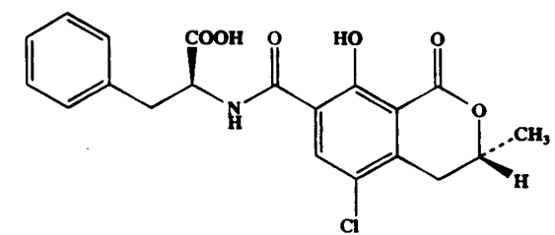
Ochratoxin A
Produced by Penicillium sp. (P. viridicatum) and possible (Aspergillus ochraceus)
Highest levels usually found in cereal grains (corn, barley, wheat and rye)
Produced mainly under poor storage conditions
At least nine ochratoxins identified
  Ochratoxin A is the most common
  Greatest toxicological significance

Slide 19
Ochratoxin A
Target organs
  Renal, hepatic, and immune system
  A suspected carcinogen
Effects in Animals
  Swine: reduces growth rate and nephropathy
  Poultry: poor weight gain, feed conversion, egg production, egg shell quality, and nephrotoxicity
  Dogs and cats: anorexia, weight loss, vomiting, bloody diarrhea, and nephropathy

Slide 20
Ochratoxin A
Effects in Humans
  Associated Endemic nephropathy
    Kidney damage incidence
    binding to plasma proteins
  Found in breast milk
    Source of exposure for infants

Slide 21
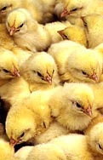

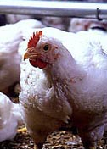
Mycotoxins are Potential Hazards to both Humans and Livestock

Slide 22
Mycotoxin Surveillance Program and Data
Feed Surveillance Program
  Program - reliable mycotoxins data on feed commodities to address risk assessment and feed safety issues.
  This includes planning and directing operational activities for the program
  Collecting and summarizing program data for comprehensive written and oral reports
  Managing program information databases
  Coordinating sampling and testing procedures with participating federal laboratories

Slide 23
Mycotoxin Surveillance Program and Data
CVM’s Mycotoxin Surveillance Program.
  Aflatoxins in corn, corn and peanut products, and complete feed
  Fumonisins in corn, corn products and feed
  Vomitoxin (deoxynivalenol) barley, wheat and swine feed
  Zearalenone in swine feed and pet food
  Ochratoxin A in oats

Slide 24
Mycotoxin Surveillance Program and Data
Sampling: Must ensure that the mycotoxins in the analytical sample is truly representative of the consignment.
A few kernels of corn with 100 ppm aflatoxins can result in 1 kg sample exceeding the 20 ppb action level (kernel is approximately 0.25 grams).
Minimum of 10 subsamples should be collected

Slide 25
Mycotoxin Surveillance Program and Data
Extraction and Analysis
Extraction and clean-up of the extract solutions (immunoaffinity columns, C18, XAD)
Analytical methods used are based on TLC, HPLC, ELISA, or Mass Spectrometry, ELISA )
Method must provide sensitive and selective results for a wide range of feed ingredients and animal feeds which are complex matrix.

Slide 26
Mycotoxin Surveillance Program Data (1994 to 2012)
Mycotoxins | # of Samples | Positive samples |  | Above guidance
 |  | No | % | No. | % of positive
Aflatoxin | 4757 | 623 | 13.1 | 181 | 29.0
Fumonisin | 1184 | 652 | 55.1 | 72 | 11.0
Vomitoxin | 475 | 234 | 49.3 | 24 | 10.3
Zearalenone | 580 | 78 | 13.4 | 71 | 100*
Ochratoxin A | 207 | 21 | 10.1 | 19 | 100*
* No established guidance levels

Slide 27
Mycotoxins in Corn Samples
(1994 to 2012)
Mycotoxins | #Samples | Positive | Min | Max
Aflatoxins (ppb) | 2007 | 374 (18.6) | 0.07 | 1067
Fumonisins (ppm) | 941 | 532 (56.5) | 0.1 | 53.1
Vomitoxin (DON) (ppm) | 13 | 2 (15.4) | 0.5 | 0.6
Zearalenone (ppb) | 300 | 26 (8.7) | 7.4 | 463.8
Ochratoxin A (ppb) | 28 | 0 0

Slide 28
Aflatoxins in corn 1994 to 2012

Slide 29
Aflatoxins in corn 1994 to 2012
1998: Crop contamination
  Aflatoxin contamination of maize (corn) in the south-eastern U.S. led to rejection rates of corn of up to 50%.
  Aflatoxin contamination reached 1500 ppb
2006-2007: Crop contamination
  Drought conditions and moisture stress led to aflatoxin on corn in Missouri/Kansas – rejection of harvested corn by buyers
2011: Corn contamination: South/Midwest
  Reduce feed availability and increase food and feed prices

Slide 30
Mycotoxins in Barley 1994 to 2012
Mycotoxins | # of Samples | Positive Samples | Range
 |  |  | Min | Max
Aflatoxins (ppb) | 107 | 0 0 | 0 | 0
Vomitoxin (DON) (ppm) | 25 | 7 (28%) | .028 | 4.43
Zearalenone (ppb) | 4 | 2 (50%) | 117 | 987
Ochratoxin A (ppb) | 23 | 4 (17.5%) | 1.2 | 15.9

Slide 31
Mycotoxins in Wheat 1994 to 2012
Mycotoxins | # of Samples | Positive Samples | Range
 |  |  | Min | Max
Aflatoxins (ppb) | 107 | 0 0 | 0 | 0
Vomitoxin (DON) (ppm) | 25 | 7 (28%) | .028 | 4.43
Zearalenone (ppb) | 4 | 2 (50%) | 117 | 987
Ochratoxin A (ppb) | 23 | 4 (17.5%) | 1.2 | 15.9

Slide 32
Mycotoxin Surveillance Program and Data
Issues
Residues of mycotoxins concentrated in feed products obtained during human food and ethanol production
  Vomitoxin in distiller's and brewer’s grains in 2011 (revised advisory levels)
  Peanut meal form oil extraction
Methods to analyze for mycotoxins in these co-products.
Unpredictability of mycotoxin occurrences

Slide 33
Regulatory Approaches and Control Strategies
Use Existing Memorandum with USDA & FDA
  Aflatoxin in peanuts and corn
  Residues in meat, milk, and eggs
Establish cooperative agreements with States
  Mycotoxins contaminated feeds
  Aflatoxins in milk and milk products

Slide 34
Regulatory Approaches and Control Strategies
Feed Safety System
  Above guidance levels for aflatoxins, fumonisins, and vomitoxin are reportable
  Zearalenone at 250 ppb in swine feed –safety issue
Livestock and Pet Safety Reporting System
  Consumers and pet owners can report adverse e vents

Slide 35
Regulatory Approaches and Control Strategies
Recent Cases
Case #1 Aflatoxins in Dog Food, 2007
  Recalled due to elevated aflatoxin levels in corn
  > 50 ppb in complete dog food cause death and injuries
  Feed destroyed to prevent use in other species.

Slide 36
Regulatory Approaches and Control Strategies
Recent Cases
Case #2 Aflatoxins in Peanuts, 2009
  178,561 lb of raw shelled peanuts containing 37 ppb aflatoxins
  Used to produce oil for human consumption
  Peanut meal not allowed to be used in dairy feeds

Slide 37
Summary
Mycotoxins can be found in human food and animal feed
Mycotoxins are potential health hazards
Residues in food can compromise immune system and affect drug effectiveness
Prevention is the only effective and safe method to eliminate risk

Slide 38
Thank You

Slide 39
Acknowledgements
CVM Office of Surveillance and Compliance

