Slide 1
A Purposeful Engagement: FDA’s International Food Safety Capacity-Building Plan
Association of Food & Drug Officials
118th AFDO Annual Educational Conference
June 22 – 25, 2014
Cathleen McInerney Barnes
U.S. Food & Drug Administration
Center for Food Safety & Applied Nutrition
International Affairs Staff
Notes:
Allow me to introduce myself:
I’ve been with FDA for just over a year, having spent most of my professional life at EPA, and much of that doing international pesticide work. So I’m here primarily to learn more about the food safety world and it’s many advocates and regulators.
My base is with the International Affairs Staff at CFSAN. The Staff is technically part of the Center Director’s Staff, but we have a great deal of interaction with FDA’s Office of International Programs.
We are divided into three teams:
Public Health & Trade – covers work related to the World Trade Organization (WTO), any trade agreement negotiations that have a food component (TTIP – Transatlantic Trade & Investment Partnership; TPP – Trans-Pacific Partnership, etc.)
Bilateral Coordination – includes the newly formed Partnership with Mexico; issues that relate to specific countries – such as import detentions – and it also includes our work with Codex. This team coordinates the international work related to many of the FSMA rules.
Strategic Partnerships & Metrics – my team, which includes my work devoted to capacity building.

Slide 2
International Food Safety Capacity Building Plan (ICB)
My presentation will cover:
  FSMA basis of the ICB
  Note several Goals & Objectives* of particular interest
  Activities underway or under development
  The ICB as an example of purposeful engagement
Notes:
Out of respect for our limited time, most are summarized; information on how to download a copy is provided at the end.

Slide 3
Food Safety Modernization Act (FSMA)
FSMA Section 305
  “… FDA shall develop a comprehensive plan to expand the technical, scientific, and regulatory food safety capacity of foreign governments, and their respective food industries, from which foods are exported to the United States….”
Capacity building is one of the non-regulatory tools FDA has available to help strengthen its efforts in preventing food safety problems in the global supply chain.
Notes:
Section 305 of FSMA, titled “Building Capacity of Foreign Governments with Respect to Food Safety,” directs FDA “to develop a comprehensive plan to increase the technical, scientific, and regulatory food safety capacity of foreign governments, and their respective food industries, from which foods are exported to the United States.”
Although this mandate provided by Congress is new, this type of work is not. Historically, and by virtue of law, FDA’s mandate was limited to the domestic regulatory agenda. FDA played a supporting, technical role in the international arena – typically as part of a group from JIFSAN (one of our closest partners) traveling overseas to conduct food safety training programs on Good Agricultural Practices or Good Aquaculture Practices or to provide hands-on laboratory training, for example. -- FDA has been providing technical assistance for many years -- usually in response to a request from another government or international organization.
But the international capacity-building plan mandated by FSMA allows us to take this work to a new level – and rather than simply reacting to requests – which can easily disrupt the best laid resource management plans – we want to take this mandate and figure out how we can be more proactive about the work – to strategically align the activities with the goals and objectives.

Slide 4
FSMA Section 305
The plan shall include, as appropriate:
  Recommendations for bilateral and multilateral arrangements and agreements, including provisions to provide for responsibility of exporting countries to ensure the safety of food
  Provisions for secure electronic data sharing
  Provisions for mutual recognition of inspection reports
  Training of foreign governments and food producers on United States requirements for safe food
  Recommendations on whether/how to harmonize requirements under Codex Alimentarius
  Provisions for multilateral acceptance of lab methods and testing/detection techniques
Plus: evidence based decision making, partnerships & assessment analysis
Notes:
Congress identified six elements (listed in the slide) in Section 305 of FSMA and each is addressed in the Plan.
FDA interpreted the phrase “as appropriate” to mean that the agency has flexibility in determining the extent to which each element is addressed in this Plan. Therefore, FDA used its policy and subject matter expertise to determine the feasibility of, and emphasis given to, each of the six elements.
Of course, all of it is dependent on the availability of resources – a caveat that is simply a fact of life.
Furthermore, Congress directed that the Plan be “comprehensive,” a charge that FDA interprets to mean that the Plan may place emphasis on other than the six elements listed in the legislation – thus, evidence-based decision making, working through partnerships, and conducting assessment analyses have been integrated into the plan.

Slide 5
FDA’s Guiding Principles
  Ownership
  Alignment
  Leverage
  Manage for results
  Mutual Accountability
  Sustainability
Notes:
To provide food safety technical assistance and undertake capacity-building efforts in countries that export food to the United States, FDA is guided by the following overarching principles:
Ownership: Partnering countries will take active leadership over the development of their food safety strategies and policies. FDA will consult with the food safety authorities of partnering countries about the needs and approaches they identify so that partnering countries maintain a sense of ownership over the strategies and policies that are adopted.
• Alignment: FDA will work in coordination with national development strategies, institutions, and food producers of potential partner countries. FDA will work with organizations in partner countries that have similar goals (such as public health and food safety).
• Leverage: FDA will coordinate its efforts with other countries and organizations so duplication of work is reduced and resources will be used productively.
• Managing for results: As FDA designs and evaluates capacity-building programs, the agency will use a performance management approach to focus capacity-building efforts on results that are linked to public health outcomes.
• Mutual Accountability: FDA and its partners are accountable for their respective efforts. In addition, mechanisms will be established to ensure work progresses according to the pre-determined plan. All parties will participate in setting goals and will work together toward accomplishing those goals.
• Sustainability: To help ensure the sustainability of capacity-building programs developed pursuant to this Plan, FDA will seek the “buy in” and clear commitments from partnering countries. In addition, FDA will encourage and support partners in their efforts to create and maintain the structures necessary to sustain food safety programs.

Slide 6
Paris Principles
Just for comparison, note the Principles of the Paris Declaration of 2005* Ownership: Developing countries set their own strategies for poverty reduction, improve their institutions and tackle corruption. 2. Alignment: Donor countries align behind these objectives and use local systems. 3. Harmonization: Donor countries coordinate, simplify procedures and share information to avoid duplication. 4. Results: Developing countries and donors shift focus to development results and results get measured. 5. Mutual accountability: Donors and partners are accountable for development results. * http://www.oecd.org/dac/effectiveness/parisdeclarationandaccraagendaforaction.
Notes:
JUST FOR REFERENCE….
The only real difference perhaps seems to be harmonization – which may simply be more appropriate for multiple countries to sign onto, whereas FDA’s focus was setting one country’s agenda for international CB work.

Slide 7

FDA’s International Food Safety Capacity Building Plan (ICB): Overview
Establishes a strategic framework to direct FDA in its international food safety capacity-building efforts
Basic tools:
  “risk analytics”
  “performances measures”
Main message:
  Work smarter
  Demonstrate results
Notes:
Part of being strategic is to clearly establish priorities and be transparent about the criteria used to set those priorities – thus the plan employs “risk analytics” and “performances measures” -- this is also very much consistent with much of the work of key international organizations to base work on national self-assessments as well as metrics & evaluation.
Personally, it would be easy to get lost in the language and concepts of “Monitoring and Evaluation” -- what makes it real for me is what I take to be the main message: FDA needs to work smarter, and demonstrate results
At the time the plan was published – February 2013 -- FDA anticipated that the strategic framework for the agency over the next five years, with periodic interim assessments and an in-depth evaluation after five years.
It is a challenge, and the process of turning this strategic plan into an operational reality is underway.
measure the impact
of our efforts to be sure FDA is
using its resources wisely.

Slide 8
FSMA ICB Plan….
While the good news is that FSMA mandated a comprehensive and appropriate plan to guide FDA’s capacity building work, the not-surprising news is that it did not include a separate appropriations for a program.
Thus, the “work smarter” mandate….

Slide 9
Implementation of the Plan…
.…is a work in progress…
  Engages partners
  Evaluates programs
  Prioritizes decision making
  Pursues CB internationally
(emphasis on partners very intentional & purposeful)
Notes:
There are many action items noted in the Plan that are already underway and achievable. We are developing a more detailed operational document from this framework to further guide how FDA will engage partners, evaluate its programs, prioritize decision making and otherwise pursue capacity-building efforts.
Keep in mind the “FSMA Plus” -- evidence based decision making, partnerships & assessment analysis

Slide 10
ICB: Goals & Objectives
Goal 2: Increase effectiveness through evidence-based decision making
  Objective 2.1 – Enhance intelligence regarding food safety risks
  Objective 2.2 – Utilize food safety assessments
  Objective 2.3 – Design for effectiveness
So, what does this mean?

Slide 11
ICB: Supporting Activities
(CONT.)
FDA has embraced ROM -- that is,
Results Oriented Management
A results-based approach being implemented - using a comprehensive performance measurement system to track the performance and progress of activities.
Shifts focus from what’s being done (managing activities)
Towards a more balanced focus that emphasizes the level of progress achieved towards the intended results (managing for results)
Notes:
….which leads me to ROM – an important tool for us but for me personally, a work in progress ….

Slide 12
EXAMPLE: Imports Safety Results Framework*
Protect Public from
Unsafe Imported Foods**
1. Better Prevention of Food Safety Problems in the Foreign Supply Chain
2. Entry of Unsafe Food Reduced
3. Prevent Consumption of Unsafe Imported Foods Once in U.S.
Result 1: Increased Use of Best Practices by Industry in Priority Countries and Commodities
Result 2: Increased Use of Practices in Compliance with Regulated Standards by Industry in Priority Countries and Commodities
(Etc.)
(Etc.)
Compliance Activities
Result 3: Better Execution of Compliance Activities by FDA
Result 4: Better Execution of Compliance Activities by Partner Country Gov. and NGO’s
FDA’s Capacity Building Activities & Effective Leveraging of Bi-lateral and Multi-lateral Organizations
* This slide only shows the top level of the results framework. The results identified for the right side of the framework (i.e., ones not applicable to capacity building) have been excluded from this figure for simplicity sake.
**’Imported foods’ refers to those regulated by FDA.
Notes:
Given the nature of capacity building, it was appropriate to frame the capacity building activities within the larger Imports Safety Results Framework and more specifically, within the safety of the foreign supply chain (located on the left side). The capacity building efforts aim to improve the safety of the foreign supply chain and provide the foundation for the ‘Imports Prevention Results Framework’. The following four results were identified as being both necessary and sufficient to achieve “Better Prevention of Food Safety Problems in the Foreign Supply Chain”:
Result 1: Increased use of best practices by industry in priority countries and commodities.
Result 2: Increased use of practices in compliance with regulated standards by industry in priority countries and commodities.
Result 3: Better execution of compliance activities by FDA.
Result 4: Better execution of compliance activities by the host country government and non-governmental organizations (NGO’s).
These four results represent the understanding that in order to achieve the higher level result of “Better Prevention of Food Safety Problems in the Foreign Supply Chain”, both host countries and the FDA need to achieve more effective compliance activities and best practices need to be adopted and used by all actors in the supply chain. However, to accomplish these four results all other supporting sub-results need to be achieved as well.

Slide 13
ICB: Goals & Objectives
Goal 4: Enhance technical assistance and capacity building in food safety
Objective 4.1 – Work with partners to develop/deliver food safety training programs focused on best practices and global food safety principles
Objective 4.2 – Train* foreign governments & food producers on U.S. requirements for safe food
*FDA provides training thru partner organizations

Slide 14
ICB: Supporting Activities
Partners: International Organizations
  Developing or continuing FDA support thru cooperative agreements, grants with:
  Asian-Pacific Economic Cooperation (APEC) Food Safety Cooperation Forum (FSCF)
  Food & Agriculture Organization (FAO) of the United Nations
  World Health Organization (WHO)
  World Trade Organization/Standards & Trade Development Facility (WTO/STDF)
  Inter-American Institute for Cooperation in Agriculture (IICA)

Slide 15
ICB: Supporting Activities
PARTNERS: World Bank
Global Food Safety Partnership – unique opportunity to pull together countries, international organizations and private sector --- Imagine the potential: across the entire spectrum of the world’s food safety systems …assess F.S. problems…identify who is addressing what problem & where are the gaps…agree on priorities to re-direct resources – a shared common good
  Includes agreement to work with metrics and evaluation
Notes:
The World Bank is providing the Secretariat – there are all kinds of complexities to this new model (a multi-donor trust fund that accepts private sector contributions) that we never imagined before we started – but we’re working on them and we are very optimistic about its potential.

Slide 16
ICB: Supporting Activities
Partners: other Federal Agencies
U.S. Agency for International Development
USDA/Foreign Agriculture Service (FAS)
USDA/Food Safety & Inspection Service (FSIS)
U.S. Department of Commerce

Slide 17
ICB Supporiting Activities (cont.)
PARTNERS:
Joint Institute for Food Safety & Applied Nutrition (JIFSAN)
International Food Protection Training Institute (IFPTI)
Preventive Controls & Produce Safety Alliances

Slide 18
Considerations for AFDO’s International Work
Beyond training…
Consider “capacity building” in the broadest sense:
  Development of institutions… a continuing process of strengthening abilities to perform core functions & solve problems.
  Leverage the work of multinationals; support & participate in technical consultations; and, facilitate the provision of training & education

Slide 19
More Considerations for AFDO
Consider how to incorporate Metrics and Evaluation tools
  now, at the beginning of any project
  establish a base line for the data
  prove that your intervention will make a difference.

Slide 20
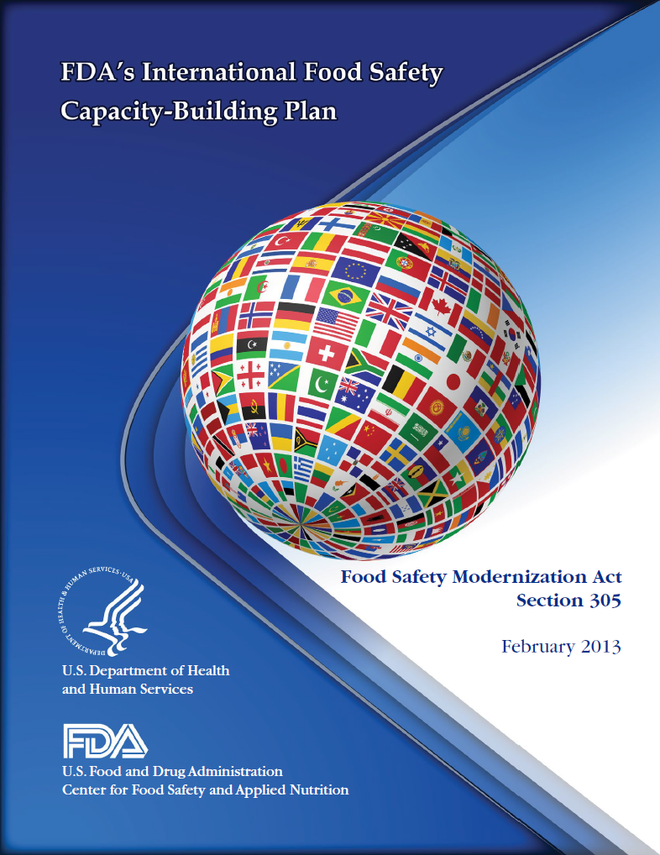
For More Information
You will find the plan here:
http://www.fda.gov/downloads/Food/GuidanceRegulation/UCM341440.pdf

Slide 21
Thank you!
Cathleen McInerney Barnes
U.S. Food and Drug Administration
Center for Food Safety & Applied Nutrition
International Affairs Staff
5100 Paint Branch Parkway
College Park, Maryland 20740
Phone: (240)402-1242
Email: cathleen.barnes@fda.hhs.gov

