Slide 1
Association of Food and Drug Officials (AFDO) Elevating Public Health Globally through Purposeful Engagements
Brenda Smith, Executive Director
ACE Business Office
June 25, 2014
Notes:
Protecting the public, industry and environment from unsafe products is a daunting task in our modern, global, economy where the U.S. is looking at almost $3 trillion in imports each year.
Necessarily we are meeting this challenge by deploying a wide variety of tools; key among these is constructive engagement with our government and industry partners.

Slide 2
CBP’s Mission
CBP is the first line of defense for goods and people entering into and leaving from the United States
CBP’s mission is to protect the nation’s borders while simultaneously facilitating the fast and efficient flow of international trade
CBP personnel play a direct role in protecting/safeguarding the health and well-being of U.S. consumers from potential threats that could enter through U.S. ports of entry
Notes:
CBP is at the front line for all cargo coming in and exiting the country
In addition to being focused on preventing harmful or unsafe drug and food products from reaching consumers, CBP is also focused on protecting U.S. agriculture from harmful pest and diseases
CBP works hand in hand w/ many agencies to ensure safety of incoming food and pharmaceutical products
Personnel are stationed at ports all over the world to process cargo coming into and out of the U.S. to determine if it is safe/compliant or should be further scrutinized
The work of the CBP officers and Agriculture Specialists has an important economic impact on the U.S. agriculture and pharmaceutical industries by helping to keep unsafe items from finding their way into our grocery stores, pharmacies, etc.
In FY13 the total value of goods imported into the U.S was $2.38 trillion
The agriculture industry and prepared products industry, for FY13, imported $127 billion in goods
The pharmaceuticals industry imported $98 billion in goods in FY 13

Slide 3
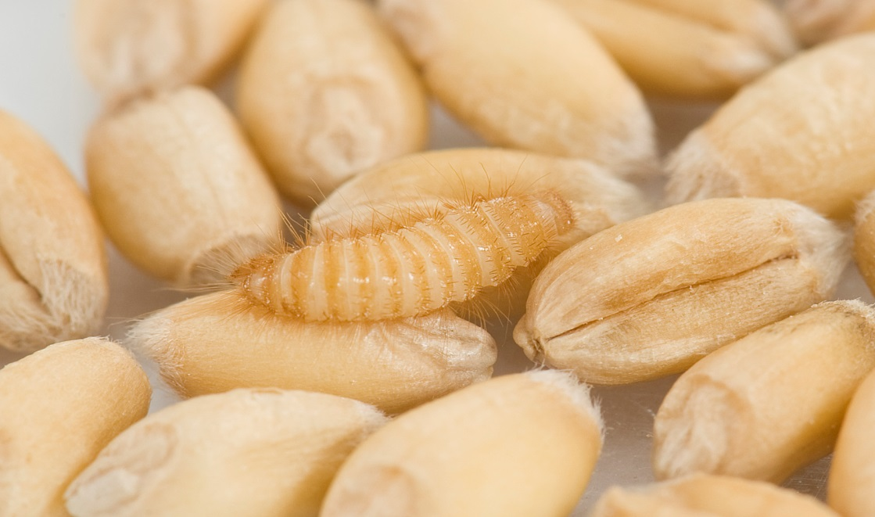
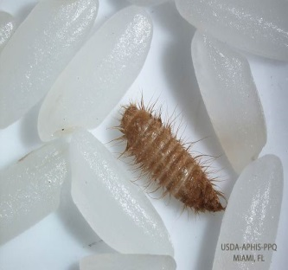
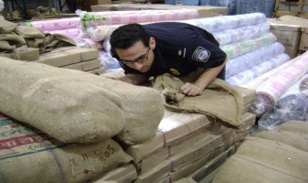
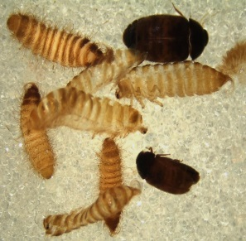
Risks we look for
The intentional and/or unintentional introduction of:
Harmful, high risk pests
Live animals and prohibited animal products which could harbor foreign animal diseases
Attempts to import:
Counterfeit or illegal pharmaceuticals
Controlled substances
Sub-standard pharmaceutical and health-related products
Notes:
We look out for:
Pests that could infest U.S. crops (ex Khapra beetle – a pest that is very destructive to grain products and seeds)
Live animals and prohibited animal products that could contain diseases
Illegal narcotics and counterfeit or illegal pharmaceuticals
We enforce USDA, FDA, etc. requirements and refer suspect cargo to PGAs

Slide 4
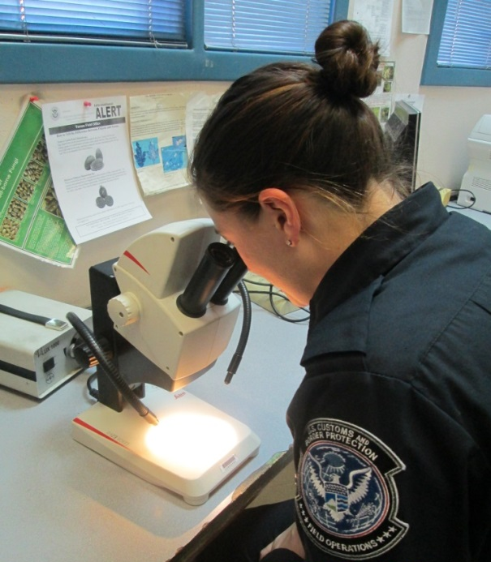
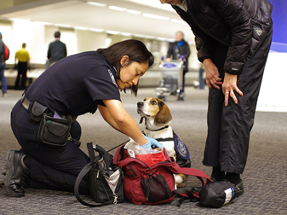
Tools
Data & Technology
Increased automation
Sophisticated screening and targeting capabilities
X-ray machines
Partnerships
Trusted trader programs
Interagency collaboration
Bi-directional training between CEEs and industry
Notes:
Various tools used to improve risk segmentation, enable limited resources to focus on riskier shipments, speed delivery of safe/compliant products through supply chain.
In addition to standard law enforcement equipment, such as x-ray machines and canines, and the expertise of our personnel, we rely heavily on data and technology and partnerships.
Data and Technology
Automating and streamlining trade processes help CBP and PGAs more quickly determine if cargo should be examined or released into commerce.
ACE technology enables CBP Officers to more efficiently assess risk related to each shipment.
Automation supports better data, and enables real-time sharing of data amongst PGAs, leading to better and quicker decisions.
The data enables CBP more easily pinpoint which shipment should be physically examined.
Partnerships
Partnerships b/t agencies and b/t Gov’t and trade are critical – trusted trader programs help identify lower risk supply chains, bi-directional education helps CBP officials understand industry operations better.
CBP and PGAs are working together to further streamline how data is collected for incoming shipments to enable even faster decision making.
CBP and PGAs work together very closely at the border to assess shipments; CBP helps enforce requirements for many other agencies such as FDA, EPA, etc.

Slide 5
Centers of Excellence and Expertise (CEE)
CEEs are virtual organizations that leverage technology to bring work related to specific commodities together in Centers that are coordinated from a strategic location
Notes:
A key partnership program b/t CBP and the trade community are the CEEs
Centers are the next generation of processing for CBP – part of the move to an account-based approach to facilitation.
There are CEEs specifically focused Agricultural and Prepared Products and Pharmaceuticals, Health and Chemicals.
Ten Centers that are aligned by key industry sectors
Provide a single point of processing for participating importers
Serve as resource to the broader trade community and to CBP’s U.S. government partners
CEE Goals:
Facilitate legitimate trade through effective risk segmentation
Increase industry based knowledge within CBP
Enhance enforcement and address industry risks

Slide 6
Commercial Targeting and Analysis Center (CTAC)
CBP hosts ten federal agencies at the CTAC:
Partner agencies share information and systems access
Other appropriate federal agencies may be added to CTAC in the future
FWS
CPSC
NOAA
HSI
NHTSA
FDA
PHMSA
EPA
APHIS
FSIS
Notes:
A key example of interagency partnership is the CTAC.
Federal agencies with authority governing the safety of products imported into the United States acknowledge the need to share information to enhance the Government’s ability to ensure the safety of those products
In response to this need, the Department of Homeland Security (DHS) established the Commercial Targeting and Analysis Center (CTAC)
CTAC is a multiagency fusion center which targets commercial shipments that pose a threat to the health and safety of American consumers
The center functions to:
Enhance information sharing
Increase automation
Expand interagency partnerships
CTAC exemplifies how working together as one U.S. Government at the Border serves to protect the American public

Slide 7
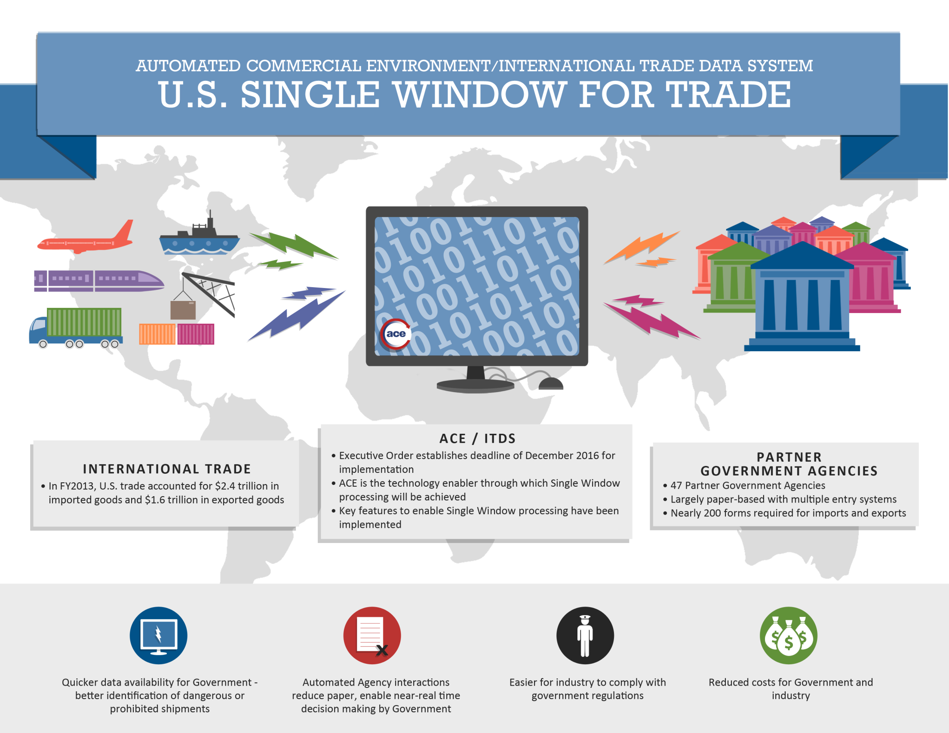
7
Notes:
On February 19, the President signed an Executive Order, Streamlining the Export/Import Process for America’s Businesses.
Directs the 47 U.S. federal agencies with a role in trade to complete development of an electronic “Single Window” by December 2016.
Currently, traders must submit the same data to multiple agencies, multiple times in order to import/export goods.
The Single Window, essentially, will enable filers to send the data once, to one system.
Via the Single Window, traders can more easily provide the data they’re required to and the Government can more easily evaluate it.
Benefits are great for both sides:
Quicker access to data means faster release for legitimate goods and quicker response by Government to those that need scrutiny.
Reduced paper, automated responses and near-real time decision making regarding release of shipments.
Facilitates industry compliance with Government regulations.
Efficiencies will speed trade and lead to significant cost savings on both sides.

Slide 8
Notes:
You can see that CBP uses a variety of tools to meet our mission, but key among these are our efforts to partner with other agencies and industry.

