Slide 1
Food Allergen Policy Issues
Nicole Smith, VP of Government Relations for FAACT – Food Allergy & Anaphylaxis Connection Team

Slide 2
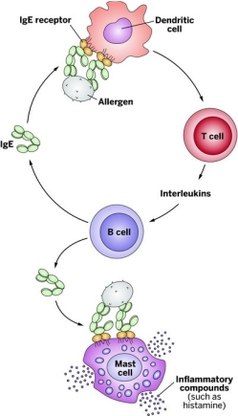
Food Allergy Statistics
Food allergies affect approximately 15 million Americans, including 6 million children.
1 in 13 children
Food Allergy is not Lactose
Intolerance or Celiac Disease

Slide 3
Foods Causing Allergies
Eight foods account for 90 percent of all food allergy reactions:
Peanuts
Tree nuts (cashews, pecans, walnuts, etc.)
Milk
Egg
Wheat
Soy
Fish (halibut, salmon, etc.)
Shellfish (crab, lobster, shrimp, etc.)

Slide 4
Constant Vigilance

Slide 5
Eating Out

Slide 6
School Cafeterias & Classrooms

Slide 7
Accommodations at School

Slide 8
Boy Scouts & Food Allergy

Slide 9
College & Food Allergy

Slide 10
Airlines

Slide 11
www.foodallergyawareness.org
Nicole Smith Nicole.Smith@FoodAllergyAwareness.org
(719) 338-0202

