Slide 1
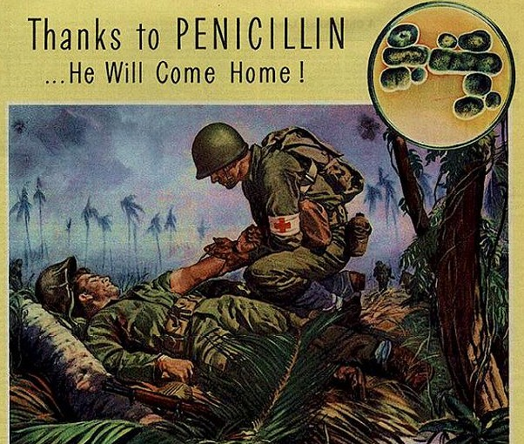
Antibiotic Resistance: Animals, people, and bacteria
Gail R. Hansen, DVM, MPH
Senior Officer
Pew Human Health and Industrial Farming

Slide 2
The problem
Antimicrobial resistance is one of the most significant challenges facing modern public health
All antibiotic use can potentially create antibiotic resistant bacteria
Consequence of resistant bacteria
Infections that would not have otherwise occurred
Infections harder to treat
Increased severity of infections, death
Notes:
If it were a simple problem, we would have fixed it by now

Slide 3
Antibiotic resistance 3 key concepts
1. Bacteria become resistant to antibiotics, animals and people don’t
2. Bacteria generation time is minutes, not years
3. Bacteria share resistance with other bacteria (don’t have to be related bacteria)
Notes:
Once harmful bacteria are generated they are hard to control

Slide 4
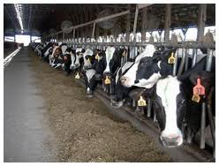
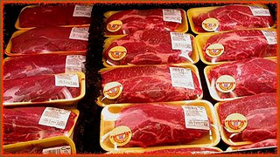
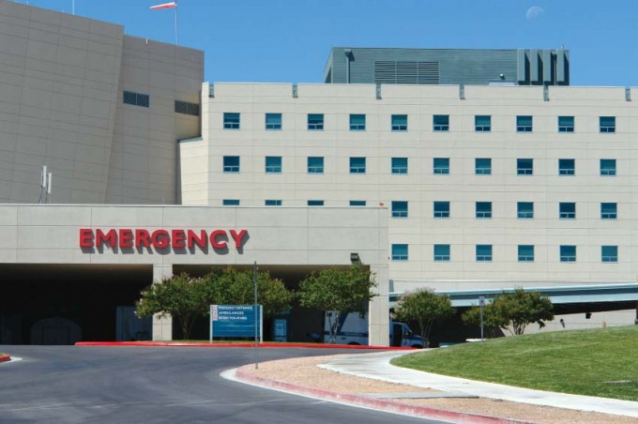
The Problem
Antibiotics overuse in food animals is detrimental to human health
FDA, CDC, USDA
WHO/FAO/OIE recommendations
Antibiotics used for animal production often are the same ones used to treat infections
Notes:
There is over 40 years of science; first big study was the Swann Report in 1969. It is now known that there are broader environmental issues and long term consequences.
WHO: Use of antimicrobial growth promoters … in humans and animals should be terminated or rapidly phased-out in the absence of risk-based evaluations.
The failure of the agricultural community to develop or accept alternatives to nontherapeutic dosing of animals makes the problem politically sensitive. A political solution will only emerge if it is politically acceptable; this requires an educated and concerned population.

Slide 5
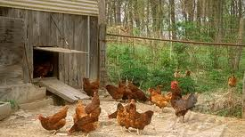
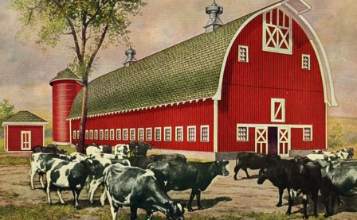
Why it’s not a simple problem
Antibiotics are “societal drugs”
There are a lot of food animals
9 billion food animals /year
Each animal is a potential reservoir and amplifier
Notes:
Antibiotics are unlike most other drugs which have mainly personal consequences (e.g., high blood pressure medication). Antibiotic resistance is a community/public health issue. Antibiotic use affects your community because the drugs work on bacteria not on the animal or human.
One person’s use of an antibiotic may diminish the effectiveness of another’s future use of the same antibiotic
Potential for future harm:
Critically important antimicrobials
Huge potential for spread
No 100% effective down stream control methods
This includes commensals. Even resistance in food-borne pathogens may facilitate infection in people undergoing antimicrobial therapy for unrelated conditions, resulting in cases that would otherwise not have occurred (ref. Mølbak K. (2006). – The clinical importance of animal related resistance. In Antimicrobial resistance in bacteria of animal origin (F.M. Aarestrup, ed.). American Society of Microbiology Press, Washington, DC, 329-337)
Idealized farm vs the eralities of most farms

Slide 6
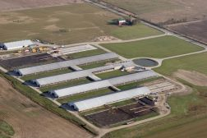
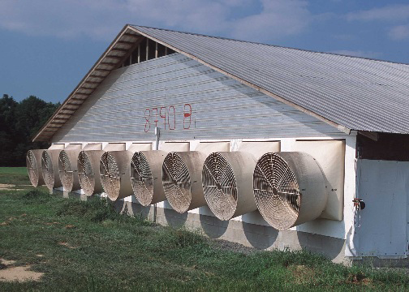
Why it’s not a simple problem
Antibiotics are “societal drugs”
There are a lot of food animals
9 billion food animals /year
Each animal is a potential reservoir and amplifier
Notes:
Antibiotics are unlike most other drugs which have mainly personal consequences (e.g., high blood pressure medication). Antibiotic resistance is a community/public health issue. Antibiotic use affects your community because the drugs work on bacteria not on the animal or human.
One person’s use of an antibiotic may diminish the effectiveness of another’s future use of the same antibiotic
Potential for future harm:
Critically important antimicrobials
Huge potential for spread
No 100% effective down stream control methods
This includes commensals. Even resistance in food-borne pathogens may facilitate infection in people undergoing antimicrobial therapy for unrelated conditions, resulting in cases that would otherwise not have occurred (ref. Mølbak K. (2006). – The clinical importance of animal related resistance. In Antimicrobial resistance in bacteria of animal origin (F.M. Aarestrup, ed.). American Society of Microbiology Press, Washington, DC, 329-337)
Idealized farm vs the eralities of most farms

Slide 7
How antibiotic resistance happens
X
X
X
X
X
X
Add antibiotics
X
X
X
X
X
X
X
X
X
X
X
X
X
A few generations later…
Susceptible bacteria
Resistant bacteria
X
Dead bacteria
Notes:
Within each population of bacteria, there are some unique individual bacteria that thrive rather than die when exposed to antibiotics
A low dose of antibiotics is less likely to kill the intended bacterial targets and resulting in more bacteria with resistance that survive and flourish
What doesn’t kill you makes you stronger

Slide 8
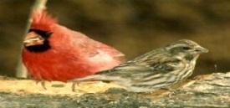
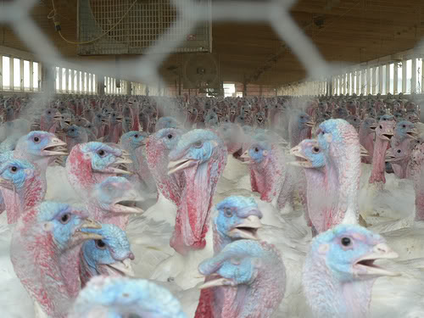
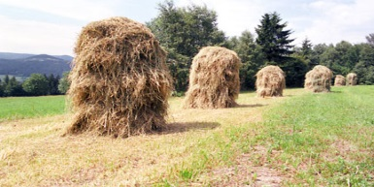
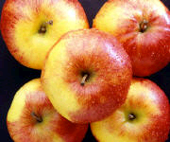
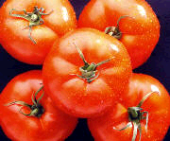
Sources of Antibiotic Resistance
Environmental (Dust, Waste, Water))
Wildlife (Birds, Rodents, Insects)
Food animals
Feeds
Humans
Pets
Produce
Adapted from Nordmann P. 2005 CNFMI
Notes:
Resistant bacteria have been detected in the air more than 160 yards downwind from swine feedlots, multidrug resistant bacteria have been detected in the topsoil of dairies , resistant E. coli have been found in drinking water near hog facilities, the role of cockroaches and flies has been described
Study of meat and poultry consistently find pathogenic bacteria on meat.
Resistant bacteria of livestock origin are spread from the livestock to the operators, who can then pass along the bacteria to their family, friends, and their communities.
And this is just for direct ingestion of enteric pathogens.

Slide 9
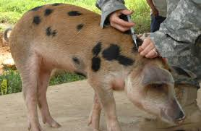
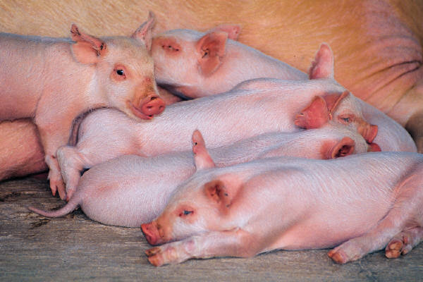
Antibiotic Uses in Animal Production
Treatment
Sick animal(s), high doses
Rx, some OTC
Control
Treat exposed groups
Rx and OTC
Notes:
“In the U.S., antibiotics for many uses, even treatment, are available over the counter, without a veterinary prescription; veterinary oversight is not required.

Slide 10
Antibiotic Uses in Animal Production
Prevention
Ideally for high risk populations for limited time
OTC
Growth promotion/feed efficiency
Low doses
OTC
Notes:
FDA approval given years before resistance criteria were invoked
Little direct veterinary oversight or use monitoring
Same drugs used in human medicine
Often administered at subtherapeutic levels
The "answer" has been to add antibiotics to the feed
Reliance on antibiotics in farming/ranching
Contract requirements
Couldn’t design a better system for resistance, though that was an unintended consequence
Recipe for antibiotic resistance

Slide 11
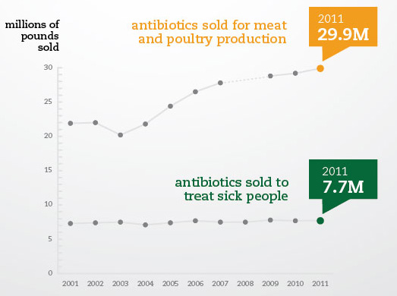
Antibiotic Sales
Notes:
The same antibiotics used to treat sick people are also given to healthy animals — in much greater numbers — to make them grow faster and to compensate for overcrowded and unsanitary conditions. These practices are contributing to the emergence of drug-resistant superbugs that make infections more difficult and costly to treat. In 2011, more antibiotics were sold for use in meat and poultry production than ever before.
We don’t have many details on antibiotic use in animals—which ones, route of administration, indication for use. More about that later.

Slide 12
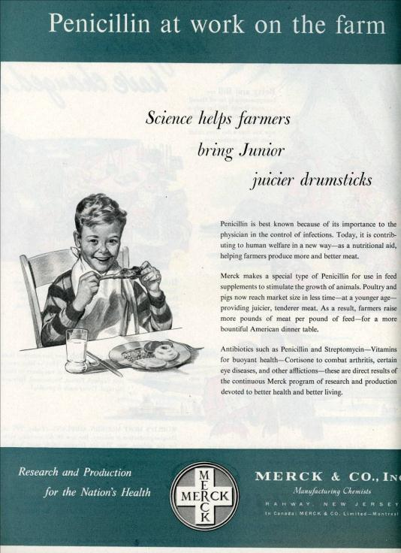
Antibiotic Uses in Animal Production
Antibiotics are regularly given to healthy animals in food and water
Legally OTC, no veterinary oversight
Approvals when residues were the only public health concern
Increase potential reservoirs
Notes:
FDA approval given years before resistance criteria were invoked
Little direct veterinary oversight or use monitoring
Same drugs used in human medicine
Often administered at subtherapeutic levels
The "answer" has been to add antibiotics to the feed
Reliance on antibiotics in farming/ranching
Contract requirements
Couldn’t design a better system for resistance, though that was an unintended consequence
Recipe for antibiotic resistance

Slide 13
Why not antibiotic free?
Sometimes animals get sick too
Humane (and required) to treat sick animals
Treated animals that get well need to go somewhere
ABF producers move treated animals into conventional markets
Sick animals are not allowed in the food chain
Must be healthy to be processed

Slide 14
What’s Congress doing?
Antibiotic Use legislation
PAMTA (H.R. 1150) Preservation of Antibiotics for Medical Treatment Act
PARA (S. 1256) Preventing Antibiotic Resistance Act
Data and tracking
DATA Act (H.R. 820)
ADCA (S. 895)
Notes:
Louise Slaughter in House Preservation of Antibiotics for Medical Treatment Act
Dianne Feinstein/Susan Collins/Kristen Gillibrand in Senate; Preventing Antibiotic Resistance Act
If critically important for use in human disease, don’t squander on healthy animals
HR 820—Delivering Antimicrobial Transparency in Animals Waxman
info from feed mills and drug companies on sales by species, indications, routes of administration, estimates of use
S. 895 Antimicrobial Data Collection Act; FDA--pilot program to look at new data sources to collect more data on antibiotic use in food animals; evaluate compliance with policies; FDA to make more collected data public; government audit to determine if FDA antimicrobial resistance programs are effective for protecting public health.

Slide 15
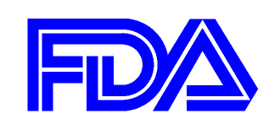
Regulatory—FDA
Guidance #209, #213
Voluntary, no growth promoters after 2016
Veterinary Feed Directive
Help move OTC to Rx
Notes:
Working on the issue for over 35 years
Last April, the FDA issued a pair of “guidances” designed to curb the overuse and misuse of antibiotics in food animal production.
Guidance 213 is not yet finalized, though FDA has said they would have it finalized by the first quarter of 2013.
There are loopholes
These guidelines do not address the use of antibiotics to compensate for the effects of overcrowded and unsanitary conditions.
It’s unclear how FDA will monitor the effectiveness of the guidelines.
We urge the FDA to strengthen Guidance #213 and finalize it as soon as possible.
VFD for more veterinary oversight

Slide 16
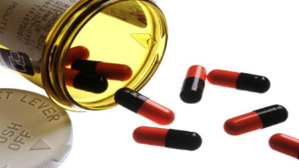
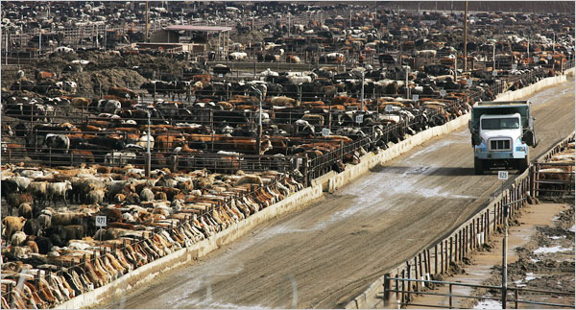
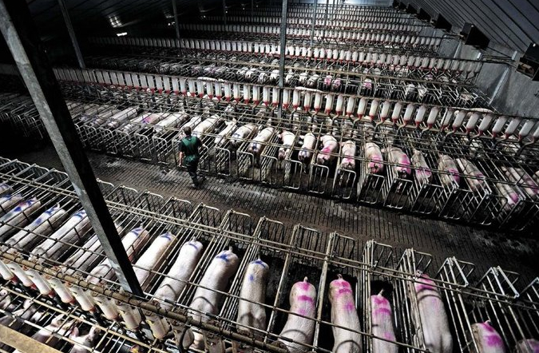
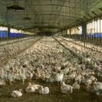
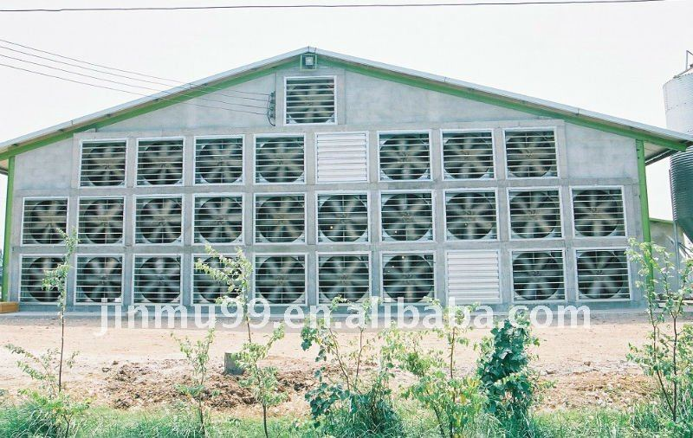
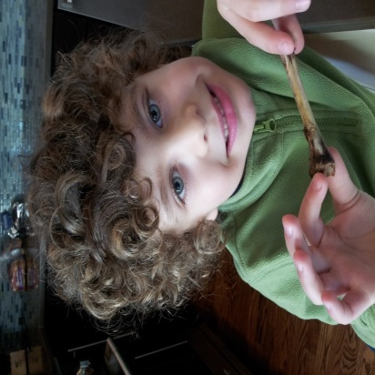
Conclusion
We must all be good stewards
www.SaveAntibiotics.org
Notes:
In the battle to control bacteria, remember that the only necessity for bacteria to spread and cause patients to die is that we do nothing
Because overuse and misuse of antibiotics anywhere can pose a health threat to people and animals everywhere, prudent use of antibiotics are imperative in all cases, whether in people, pets, or farm animals. We must all be good stewards of the precious resource of antibiotics.

Slide 17
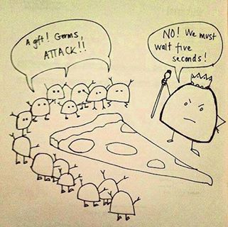
Questions?
ghansen@pewtrusts.org
www.SaveAntibiotics.org

