Slide 1
Consumer Expectations About FSMA Implementation and the Law’s Impact
AFDO Annual Meeting
June 23, 2014

Slide 2
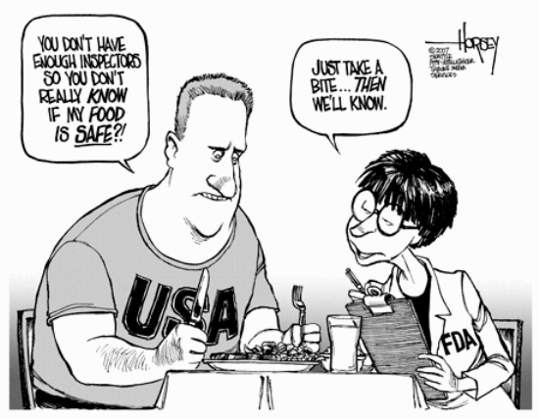
http://www.inspirationgreen.com/assets/images/Food%20blog%202010/Monsanto/cartoon%20horsey

Slide 3
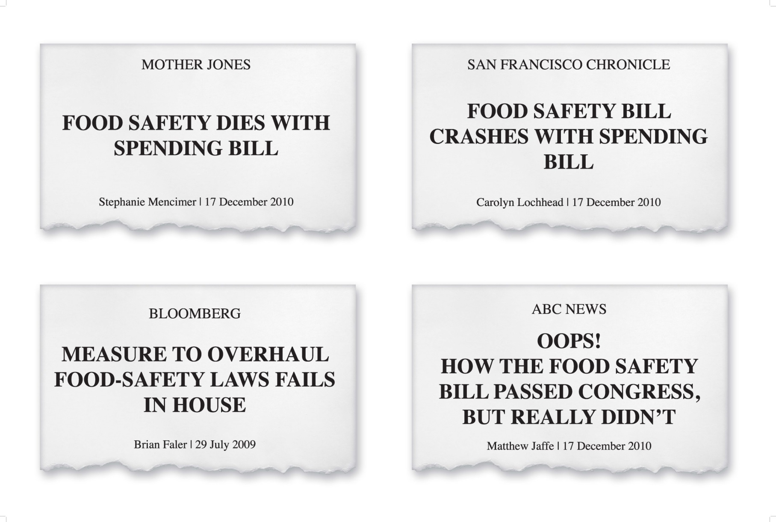

Slide 4
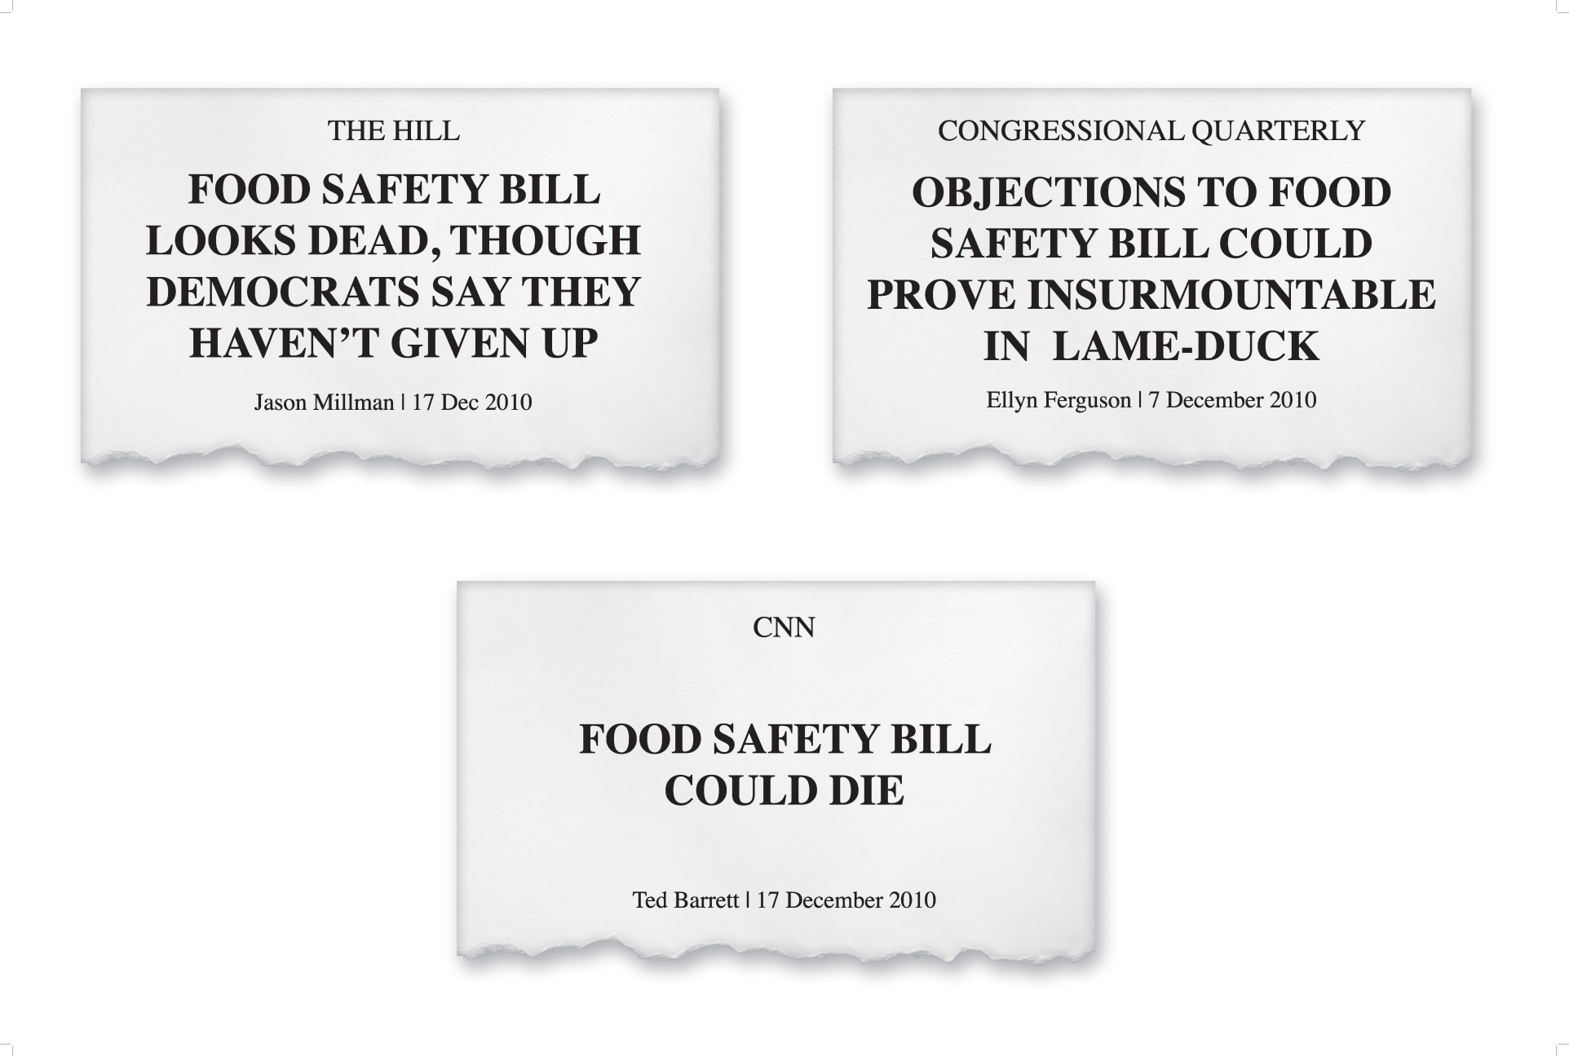

Slide 5
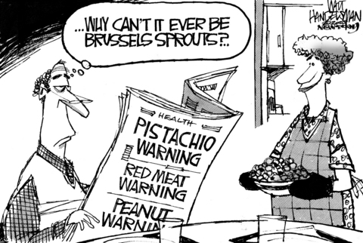
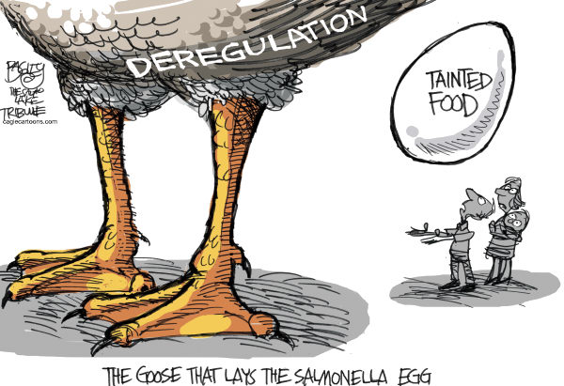
Baltimore Sun – April 7, 2009
Salt Lake Tribune – August 23, 2010

Slide 6
The Perfect Storm

Slide 7
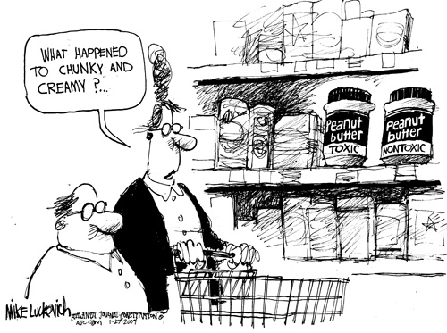
http://www.truthdig.com/images/cartoonuploads/lk0127d5.jpg
“At a bare minimum, we should be able to count on our government keeping our kids safe when they eat peanut butter.”

Slide 8
Success = Enactment + Implementation + Funding

Slide 9
* The first two major proposals were not released until two years after the law was enacted * Multiple public meetings * Campaign to release the rules
Implementation

Slide 11
* Risky practices, not risky products * Ag water standards * Environmental testing in packing houses * Exemptions - “rarely eaten raw” and “Tester” * Long compliance periods
Consumer Advocates’ Priorities
Produce Safety

Slide 12
* Product testing, environmental monitoring, and supplier verification * Limit the number and scope of exemptions
Consumer Advocates’ Priorities
Preventive Controls

Slide 13
* On-site auditing when there is a potential serious health threat * Timeline for finalizing and enforcing * Auditors – adequate oversight, conflict of interest protections, competence and accountability, transparency
Consumer Advocates’ Priorities
FSVP/3rd Party Auditors

Slide 14
* Local = small = safe * Exemptions -- Tester * Division among NGOs
Challenges to Implementation
Small/Sustainable Ag Community

Slide 15
* Reviewing regulations (“M”) - Delays - Changes - Court decision * Developing POTUS budget (“B”) - “Fees”
Challenges to Implementation
OMB’s Role

Slide 16
* Re-proposals * Rogue inspectors * Spent grains * Wood and cheese-making
Challenges to Implementation
FDA’s Missteps

Slide 17
* Federal-State Integration * Processed Foods - AFDO - MFRPS - Funding - Training + Oversight * Produce - NASDA
Compliance/Enforcement Strategy

Slide 18
* How much additional funding? - From FY2011-2014, FDA received +$200 million - $600 million overall? - $400-450 million over two years? - $300 million over two years?
Funding Challenge

Slide 19
Sandra B. Eskin Director, Food Safety The Pew Charitable Trusts 901 E Street NW, 10th Floor | Washington, DC 20004 p: 202.540-6407|seskin@pewtrusts.org| www.pewtrusts.org

