Slide 1
Quality Laboratory Results
Presenting: Kristen Durie
Chemistry Quality Assurance Officer
New York State Food Laboratory

Slide 2
Located in Albany, New York

Slide 3
Food Laboratory Background:
Year | # Samples | Total # Recalls | Class 1 | Class II | Class III
2012 | 23,268 | 308 | 34 Imported | 176 Imported | 19 Imported
 |  |  | 10 Domestic | 61 Domestic | 9 Domestic
2013 | 16,312 | 292 | 31 Imported | 161 Imported | 24 Imported
 |  |  | 12 Domestic | 51 Domestic | 10 Domestic
2014 (to date) | 7,903 | 85 | 12 Imported | 40 Imported | 12 Imported
 |  |  | 3 Domestic | 14 Domestic | 4 Domestic

Slide 4
How is our Quality Ensured?

Slide 5
Management System:
ISO 17025 Accredited
Document Control
Methods
All Methods are revision controlled and distributed
Work Instructions
Revision controlled and distributed
Written in addition to and to enhance methods
Forms
Revision controlled and made available at all times to analysts

Slide 6
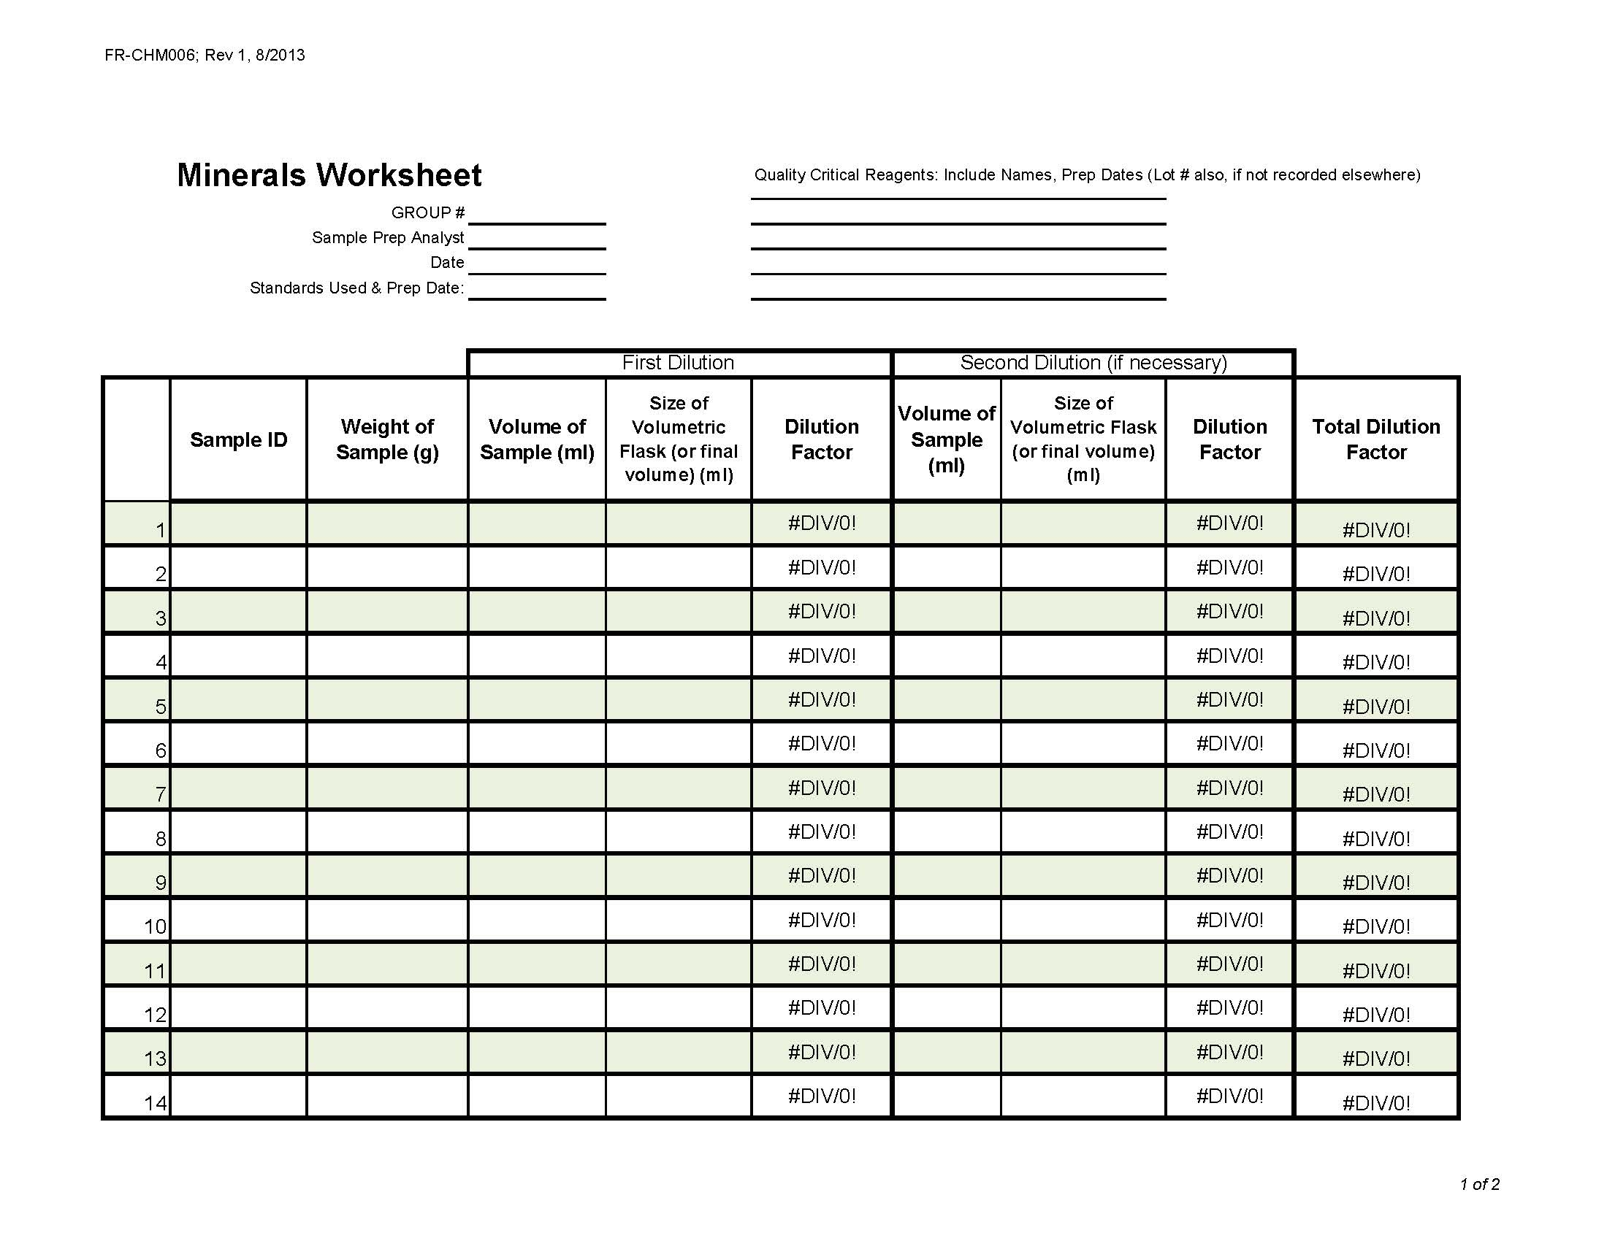
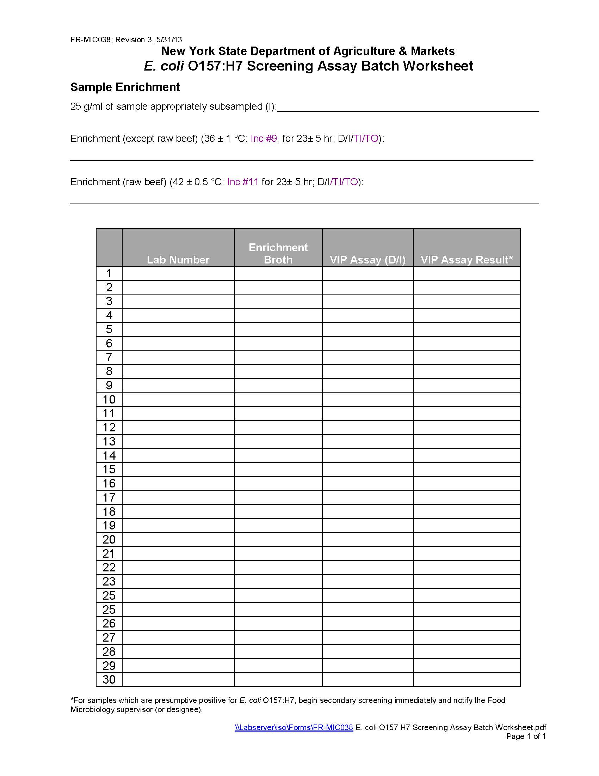
Management System:
Control of Records
Records include but are not limited to:
Bench Worksheets
Instrument Data
Worksheets
Personal Laboratory Notebooks
Databases
Sample information

Slide 7
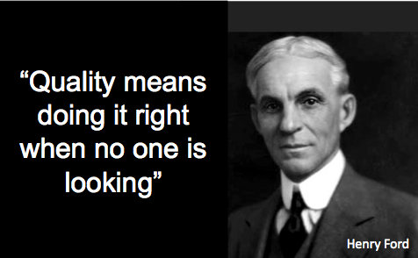
Management System:
Internal Audits
Each member of the Quality Assurance Unit (QAU) receives training to become an auditor
Each General Lab Procedure, SOP (Instrument and Method), Standard Instruction and Corrective action are audited on a 2 year cycle.
By auditing each of the above the QAU have an opportunity to ensure that the method is current and being followed correctly.
External Audits
Every 2 years A2LA audits the laboratory

Slide 8
Management System:
Corrective Actions
Audits
Proficiency test failures
Control chart data

Slide 9
Management System:
Equipment
All fridges, freezers, autoclaves, incubators, and ovens are around the clock monitored using a temperature monitoring program Tempsys by Checkpoint
All instruments are maintained in house with regular maintenance as well as a scheduled preventative maintenance performed by the manufacturer
All pipettes are calibrated every 6 months using an Artel System
Every critical balance is internally calibrated every day and documented by Lab X software

Slide 10
Microbiology:
Every run has a media blank, a positive and negative control prepped and analyzed with the samples
Participates in ~7 proficiency tests a year (Listeria, L.mono, Salmonella, Campylobacter, Staph, and E.coli)
Proficiency tests are broken up between analysts. Each analyst will perform a different part of the analysis per PT.
All food testing samples are done in duplicate

Slide 11
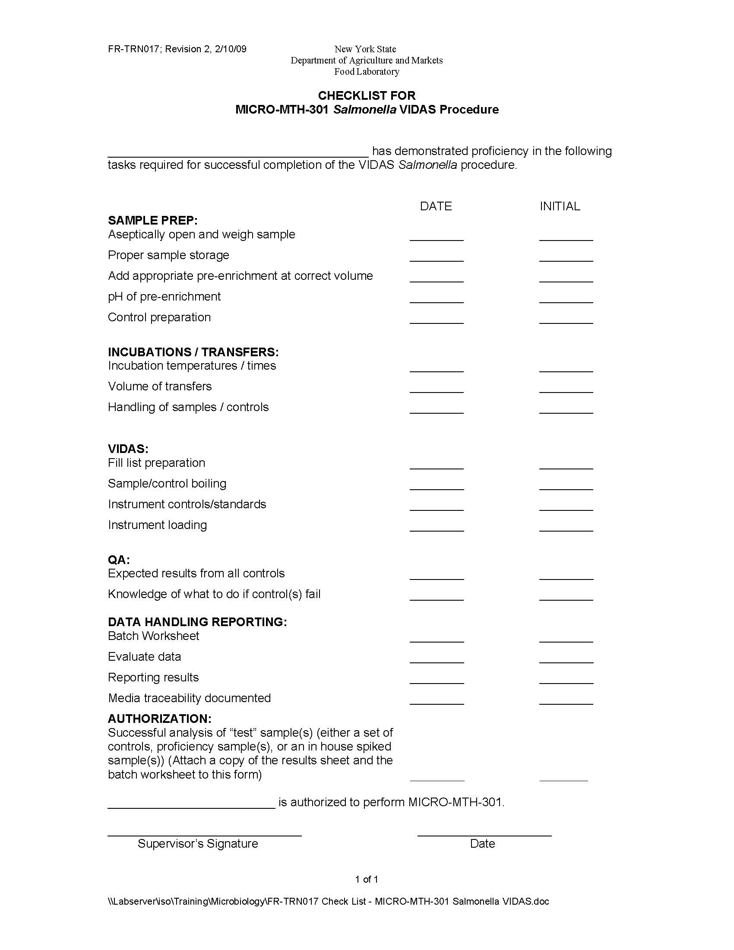
Microbiology:
Training
Micro analysts are sent to outside training when relevant. Most recently a bench microbiologist attended PFGE training and the food microbiology supervisor attended a FERN training covering Anthrax and Plague
In-house training
Training Check lists are used
Control run is performed
Passing proficiency test results

Slide 12
Microbiology: Method Validation
Validate 3 Campylobacter species detection on the BAX (PCR Detector)
Four 25 mL milk samples were set up using the same milk sample.
One was blank matrix, and the other 3 were inoculated with a different Campylobacter control at a reasonable challenge level.
Samples will be enriched and incubated as per MICRO-MTH-321, including standard cultural controls.
Samples will be extracted and run on the BAX, and plated to demonstrate recoverability.
Sample Names/ Species of Campy:
M-Uninoc – uninoculated
M-CJ – C. jejuni spike
M-CC – C. coli spike
M-CL – C. lari spike
Sample Levels:
CJ – 1.7 cfu/mL
CC – 0.3 cfu/mL
CL – 1.2 cfu/mL

Slide 13
Pesticide Data Program (PDP):
Completion of 1 proficiency test per year
With every run there are: (USDA Mandated)
Process Controls (Surrogate)
Matrix Blanks
Reagent Blanks
Fortification Samples
Above and beyond the USDA Mandates:
Spike with all compounds (~200) with each sample set (<25 samples)
Full set of Calibration Standards

Slide 14
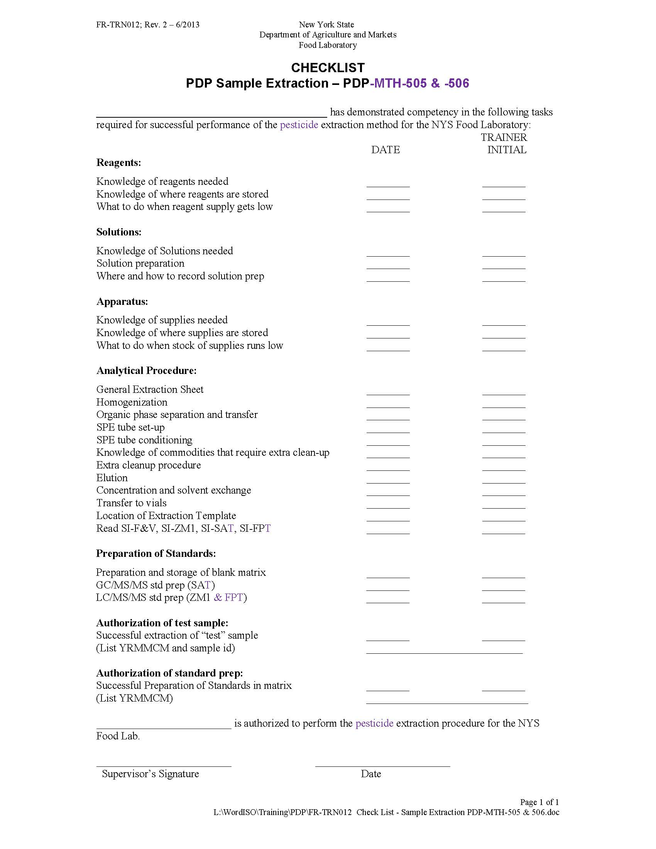
Pesticide Data Program (PDP):
PDP analysts are sent to outside training when relevant. Most recently a number of PDP analysts were sent to PittCon to attend chromatography and mass spectroscopy courses.
In-house training
Training Check lists are used
Training is done concurrently with sample preparation
Passing proficiency test results

Slide 15
Chemistry:
Similar to PDP
Reagent Blanks
Matrix Blanks
Fortification Samples
Standard Curve is generated for all quantitative analyses
Standards purchased from a Guide 34 Accredited Establishment (when possible)
Participate in ~40 proficiency tests a year
Chemistry Specific Quality Measures
Reference Materials (when possible)
Quality Control (QC) Samples (when possible)
When a QC or reference material not available a duplicate analysis is done

Slide 16
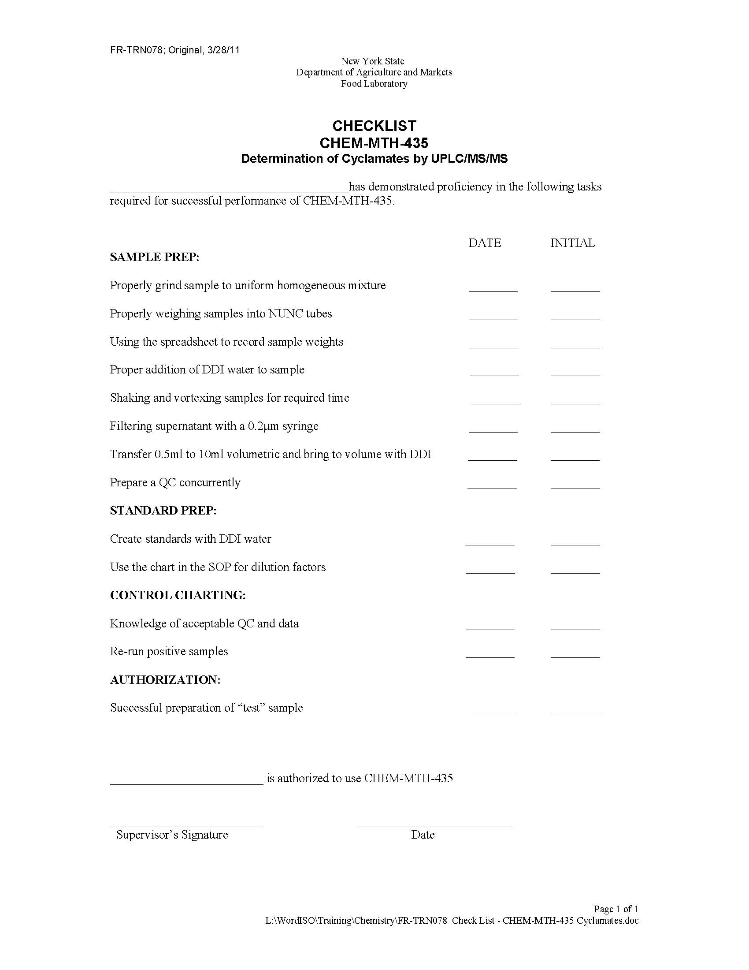
Chemistry Training:
Chemists are sent to outside training when relevant. Most recently a number of Chemists were sent to PittCon to attend chromatography and mass spectroscopy courses.
Training is periodically brought in house for Chemists as well. The most recent training was provided by the Waters Corporation.
In-house training
Training Check lists are used
Training is done concurrently with sample preparation
Passing proficiency test results

Slide 17
Chemistry and PDP Method Validation:
Amantadine in Chicken Jerky Dog Treats
Infant Formula Commodity Validation
Validation: In Clean Matrix 2 Limit of Detection (LOD) Spiked Samples 3 Limit of Detection (LOQ) Spiked Samples 3 x5 LOQ Spiked Samples 3 x10 LOQ Spiked Samples

Slide 18
In Closing:
Management System
Training
System Checks

Slide 19
Thank you

