Slide 1
Areas of Current Study and FDA’s Strategic Direction Relative to Retail Food Safety

Slide 2
Considerations for Risk Factor Study
Focus on One Industry Segment at a Time
2013/2014 - Restaurants (full service & quick service)
Larger Sample Size, Smaller Error, Firmer Conclusions
Use FDA Regional Specialists Again
More Efficient Data Collection Techniques
Electronic Capture; Real-Time Database

Slide 3
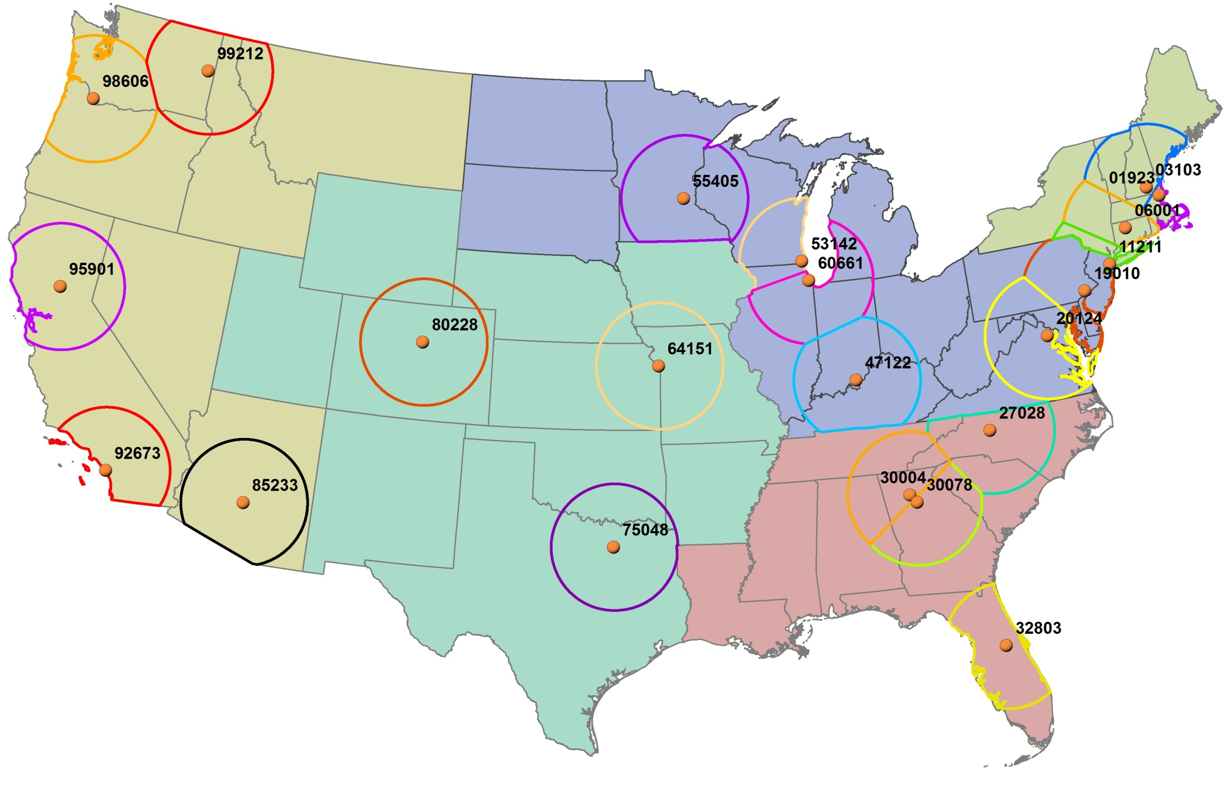
150 mile around 22 FDA Specialists home zip center (restricted by FDA region definitions)
6 States won’t be included:
LA,
MS,
ND,
NM,
SD,
UT

Slide 4
Considerations for Risk Factor Study
Streamlined data collection - fewer data items, more easily communicated
10 Primary Items & 9 Secondary Items
Establish national performance metric
% of establishments with X number of Primary Items Not in Compliance
Examine other correlations based on demographics
Establishment characteristics (e.g. chain vs. independent; size)

Slide 5
Considerations for Risk Factor Study
Examine impact of different interventions and regulatory strategies on specific risk factor occurrence
More in-depth assessment of management practices in place (procedures, training, & monitoring)
Assess degree of non-compliance for select items

Slide 6
Retail Food Safety Initiative
Announced in conjunction with October 2010 release of Risk Factor Study Reports
Recognition that food safety at point of sale and service is important part of FDA’s farm-to-table strategy
Acknowledge key partnerships as part of an integrated food safety system
Retail Initiative Task Force established

Slide 7
FDA’s Strategic Direction for Retail
Increase the presence of certified food protection managers
Strengthen active managerial control at the retail level and ensure better compliance
Improve the quality of, and access to, training of retail food personnel by the industry
Notes:
FDA’s Retail Food Risk Factor Study indicates that despite significant progress over time in the
nine facility types studied, more improvement is necessary to reduce the risk of foodborne illness.
Improvements are especially needed in the areas of personal hygiene, food holding times and
temperatures, and equipment sanitation. FDA believes more can be done at the retail level to
prevent foodborne illness and will continue to partner with the retail food industry; state, local, and
tribal authorities; and other government agencies. FDA will expand efforts in four key areas:
Comments for Bullet 1 – Food safety is enhanced when managers assess their food safety
systems, implement appropriate procedures and training, and actively monitor compliance with
those systems to reduce risk in retail operations. In order to broaden the use of these tools
throughout the industry, FDA will work with its partners to assess the effectiveness of various
managerial control strategies, identifying and sharing best practices, and verifying their
Implementation by food retail facilities. FDA, working with the Conference for Food Protection,
will consider modifications to the FDA Food Code.
Comments for Bullet 2 – Data from the last two collection periods (2003 and 2008) point to a
correlation between the presence of a certified food protection manager and better food safety
practices and behaviors. FDA will work with its partners to develop and provide effective training
and certification for food handlers of various educational and cultural backgrounds. FDA,
working with the Conference for Food Protection, will consider modifications to the Food Code in
this area.

Slide 8
FDA’s Strategic Direction
Promote more widespread, uniform, and complete adoption & implementation of the FDA Food Code
Ensure prevention-oriented, science-based food safety principles are utilized at the retail level
Notes:
Comments for Bullet 3 (slide is fairly self-explanatory). Widespread, uniform, and complete adoption of the FDA Food Code by state, local, and tribal authorities to ensure prevention-orientation, science-based food safety principles are implemented at the retail level. The Food Code sets standards for management and personnel, food operations, equipment, and facilities.

Slide 9
FDA’s Strategic Direction
Create an enhanced local regulatory environment for retail food operations by:
Wider implementation of the Voluntary National Retail Food Regulatory Program Standards
Seeking increased multi-year funding for state/local/tribal programs
Developing programs to ensure universal participation by state/local/tribal regulators in consistent, high-quality training
Notes:
Slide is self-explanatory
4) Widespread and uniform implementation of the FDA Voluntary National Retail Food Regulatory Program Standards at the state, local, and tribal level.
Promote wider implementation by state, local, and tribal retail food protection programs of the FDA Voluntary National Retail Food Regulatory Program Standards,
Seek increased multi-year funding for the state, local, and tribal retail food protection programs as part of an integrated food safety system, and
Develop programs to ensure universal participation by local regulators in consistent, high-quality training.

Slide 10
QUESTIONS, Additional Information Mario Seminara, R.S. Southwest FDA Regional Food Specialist mario.seminara@fda.hhs.gov 303-236-3026

