Slide 1
Listeria Surveillance, Decision Making, and Corrective Actions at Retail
118th AFDO Annual Educational Conference, Denver, CO
Risk-Based Environmental Monitoring and Decision Making
June 23, 2014
Carrie Rigdon, PhD
Rapid Response Team Supervisor
Dairy & Food Inspection Division

Slide 2
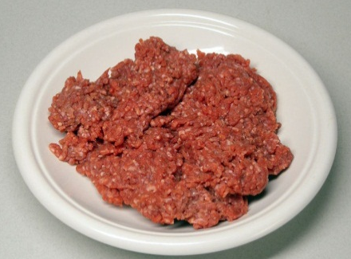
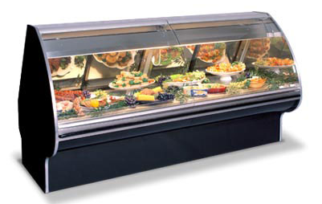
Routine Sampling Plan
Why: Identify issues in potentially risky foods & environments
What: Food and environmental samples at retail and manufacturing
When: New assignments 2 to 4 times a year

Slide 3
Micro Samples by Year – All Sampling
% Positive:
3.0%
7.5%
1.5%
10.5%
2.4%
2.0%
Notes:
Add % positives to chart!

Slide 4
Positives by Year – All Sampling

Slide 5
Listeria Positives by Year – Environmental Sampling
% Positive:
0%
13.0%
2.6%
10.5%
10.8%
2.1%

Slide 6
Listeria Species – Environmental Sampling

Slide 7
Locations of Listeria 2010-14

Slide 8
Why does MDA look for Listeria at Retail?
Monitor operator’s control for risks where RTE PHF are prepared, handled, or stored
Prevent adulteration and possibility for adulteration

Slide 9
What happens when Listeria is found?
Assess whether firm has lost control of their process
Bring operator back into compliance – adulteration statues
Minn. Stat. 34A.02 (Adulteration),
Minn. Stat. 31.02 (Prohibited Acts), and
Minnesota Administrative Rule Chapter 4626.0015 (Food Safety under Food Code)
Corrective Action Plan best guidance for accomplishing this

Slide 10
Firm Actions: Cleaning, CAP, and Verification
Intensely clean and sanitize
Assess causes and contributing factors
Write a Corrective Action Plan (CAP)
Cleaning and Sanitizing – how? where?
Equipment and employee flow
Repairs to equipment or structure
Employee training
Verify that actions have been effective = firm sampling

Slide 11
MDA Actions
Provide guidance but not act as their QA
Review CAP
Confirmatory sampling
Visit operator to observe whether control measures were implemented

Slide 12
Questions?
Carrie Rigdon
carrie.rigdon@state.mn.us
651-201-6453

