Slide 1
Enhancing Organizational Effectiveness – Change Management Principles & Practices
Practical Change Management – as learned through applying that “soft & squishy stuff” with Drillers & Roughnecks
Rick Versen, MPH, MA-OMD, PROSCI Certified Change Management Professional, CLSSMBB, Charter Member ACMP

Slide 2
Future Oriented Information
In the interest of providing Encana Corporation (“Encana” or the “Company”) shareholders and potential investors with information regarding the Company, its subsidiaries, including management’s assessment of the Company’s future plans and operations, certain statements and graphs throughout these presentations contain “forward-looking statements” within the meaning of the United States Private Securities Litigation Reform Act of 1995 or “forward-looking information” within the meaning of applicable Canadian securities legislation. Forward-looking statements in this presentation include, but are not limited to: possible applications of the Lean Six Sigma processes within E&P processes; projected number of improvement projects/events that could use LEAN; and the various possible applications of LEAN in the Company’s operations and processes.
Readers are cautioned not to place undue reliance on forward-looking statements, as there can be no assurance that the future circumstances, outcomes or results anticipated in or implied by such forward-looking statements will occur or that plans, intentions or expectations upon which the forward-looking statements are based will occur. By their nature, forward-looking statements involve numerous assumptions, known and unknown risks and uncertainties, both general and specific, that contribute to the possibility that circumstances, events or outcomes anticipated or implied by forward-looking statements will not occur, which may cause the actual performance and financial results in future periods to differ materially from the performance or results anticipated or implied by any such forward-looking statements. These assumptions, risks and uncertainties include, among other things: risks associated with the ability to obtain any necessary approvals, waivers, consents, court orders and other requirements necessary or desirable to permit or facilitate the proposed transaction (including regulatory and shareholder approvals); the risk that any applicable conditions of the proposed transaction may not be satisfied; volatility of and assumptions regarding oil and gas prices; assumptions contained in or relevant to the company’s current corporate guidance; fluctuations in currency and interest rates; product supply and demand; market competition; risks inherent in marketing operations (including credit risks); imprecision of reserves estimates and estimates of recoverable quantities of oil, bitumen, natural gas and liquids from resource plays and other sources not currently classified as proved reserves; refining and marketing margins; potential disruption or unexpected technical difficulties in developing new products and manufacturing processes; potential failure of new products to achieve acceptance in the market; risks associated with technology; the ability to replace and expand oil and gas reserves; the ability to generate sufficient cash flow from operations to meet current and future obligations; the ability to access external sources of debt and equity capital; the timing and the costs of well and pipeline construction; the ability to secure adequate product transportation; changes in royalty, tax, environmental and other laws or regulations or the interpretations of such laws or regulations; applicable political and economic conditions; the risk of war, hostilities, civil insurrection, political instability and terrorist threats; risks associated with existing and potential future lawsuits and regulatory actions; and other risks and uncertainties described from time to time in the reports and filings made with securities regulatory authorities by Encana. Although Encana believes that the expectations represented by such forward-looking statements are reasonable, there can be no assurance that such expectations will prove to be correct. Readers are cautioned that the foregoing list of important factors is not exhaustive.
Furthermore, the forward-looking statements contained in this presentation are made as of the date of this presentation, and, except as required by law, Encana does not undertake any obligation to update publicly or to revise any of the included forward-looking statements, whether as a result of new information, future events or otherwise. The forward-looking statements contained in this presentation are expressly qualified by this cautionary statement.
Notes:
I will be talking about certain future-oriented information, as such, I need you to be aware of this advisory regarding the use of future-oriented information in this presentation.

Slide 3
What that really means…
I’m just a low level flunky
Don’t go out and buy, sell, or even talk about the company based on what I say
Seriously, don’t think I know more than I know
These are my thoughts and aspirations
I invoke the Tooter the Turtle Philosophy:
  “Be just what you is, not what you is not. Folks what does this is the happier lot.”
  M. Wizard

Slide 4

AFDO/WAFDO/FDA/RMRAS
“Food, Feed, Drug Safety – Mission Critical – Working Together”
Learning Objectives:
  Explore change management fundamentals & concepts
  Practical application for each participant

Slide 5




Your World?
Food Protection
Food Regulation
Emergency Response
GMP’s
Case for Quality
Consumer Protection
Drugs, Devices & Cosmetics
Medical Devices
Body Art
Seafood HACCP
Risk Management
Inspections
Audits
Food Worker Behavior

Slide 6
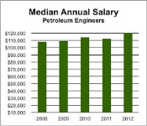
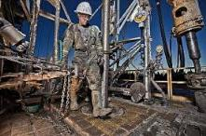

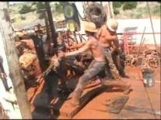

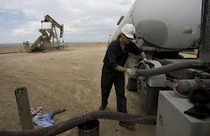
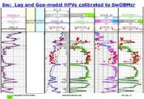
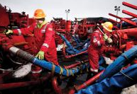
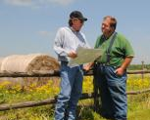
My World - The People
Company Man
Petroleum engineer
The Worm
Roughneck
Drillin’ Boss
Pumper
Petro-geophysicist
Landman
Frac Tech

Slide 7
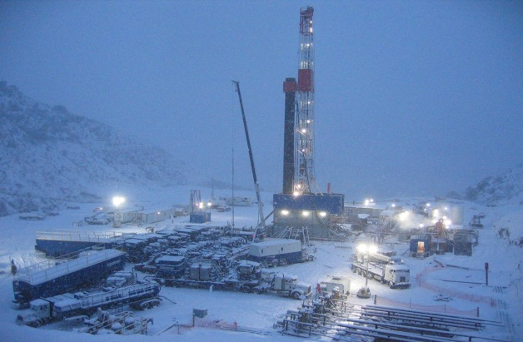
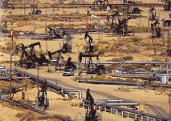


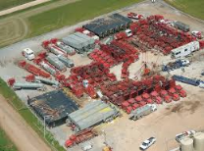
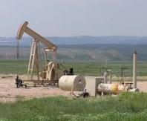
The Environment
Our Factory!?!
“Dirty Oil”
“Clean solar”
NIMBY
“Fracing”
“Cracking the technical nut”
Social License to operate

Slide 8
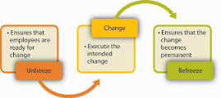
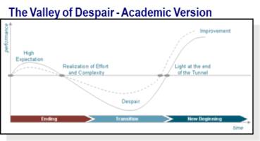
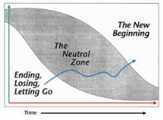
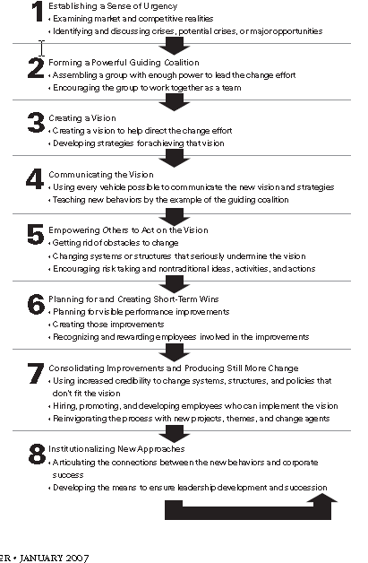
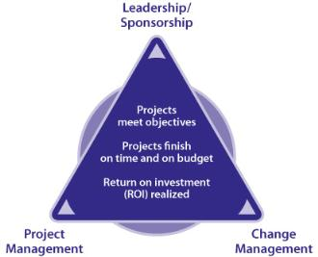
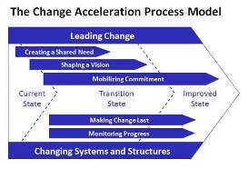
Oodles & Oodles of Models & Models
Lewin
Bridges
Kotter
Jick
PROSCI
Lawler & Worley
Heath & Heath
Peter Block
GE CAP
Peter Sandman
Risk = ƒ(Hazard x Outrage)

Slide 9

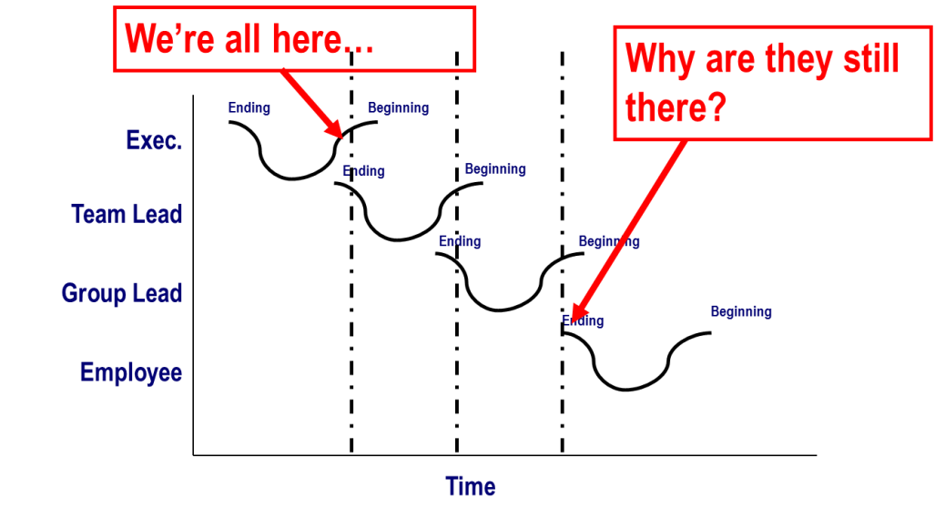
Sidebar on that “Valley of Despair” thing
Most folks grasp the concept & the impact readiness, agility, saturation, and (fill in your favorite buzzword…) can have on the “Amplitude” of the valley…
But, the more important concept for large scale change is….
“Phase Shift”
  Everyone not at same pace
  Don’t learn at same rate
  Don’t have same level of visibility
  Even related to level in organization
  WIFFM is different

Slide 10

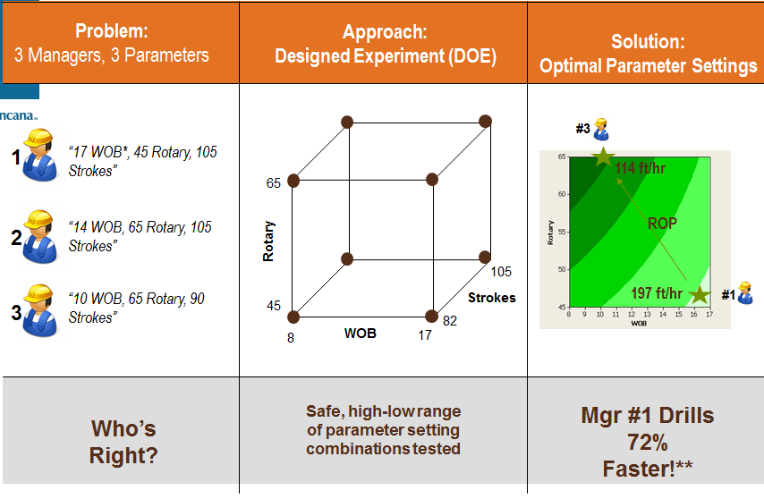
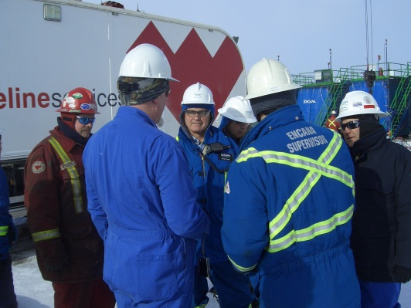
Example 1…
Challenge: What is the fastest way to drill through X formation?
  3 different Drilling Bosses – 3 different approaches
Technical Solution: DOE (Design of Experiment)
  3 factor, 2 level orthogonal Full Factorial Design
What about the Softer Solution: Making it stick?
  Engage all 3 in developing & running the tests
  “On location” work – not office
  Develop implementation plan with the bosses
  Include metrics going forward
  Encourage competition between the teams

Slide 11
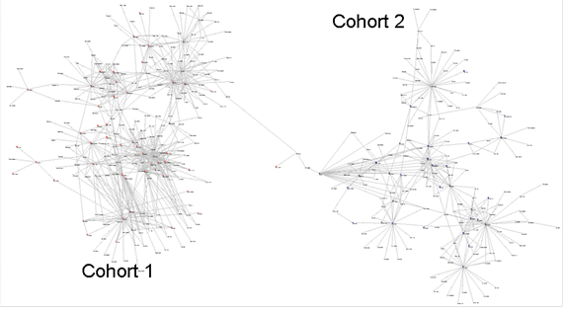
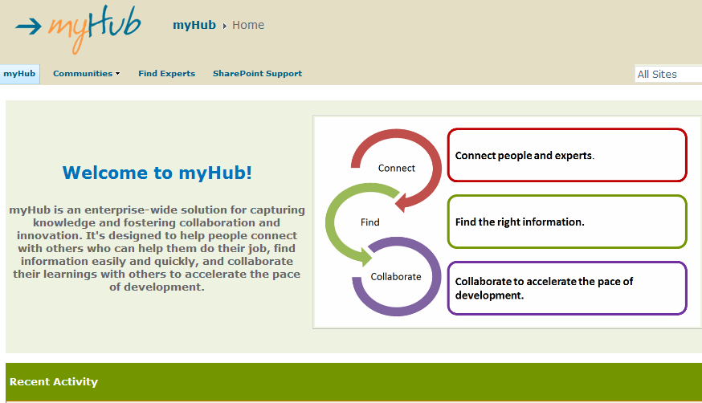
Example 2…
Challenge: Increase collaboration & knowledge sharing in a culture that already collaborates and shares knowledge
Technical solution: Newsgator/Spoint platform for real-time problem solving & knowledge transfer
The Softer (Harder?) Solution:
  Multiple benchmarking studies
  Multiple Consultant pitches – to verify internal strategies
  SNA & VNA, Case Studies, Connector training, etc., etc., etc. (My Master’s thesis!!!)
  Launch, crickets…re-launch, crickets…
  Help Mr. Wizard!!!

Slide 12
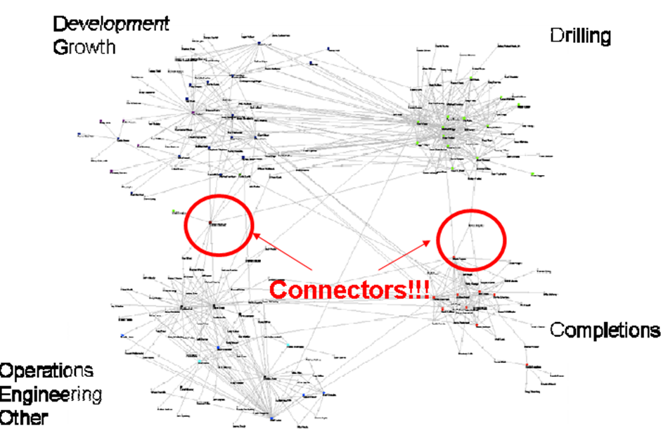
A moment on “SNA”
Social Network Analysis
Finding influencers & connectors
Statistical basis
Simpler tools available
Helps target interventions

Slide 13
So do you hear “Crickets?”
Most of us have experience with change management at some level
  Personal – lifestyle – “Krispy Kreme Konundrum”
  Career – new bosses, new regs, new stakeholders
Bottom line – moving people from bad behaviors/ processes/ risks/ food etc. toward a better/ safer/ healthier alternative

Slide 14
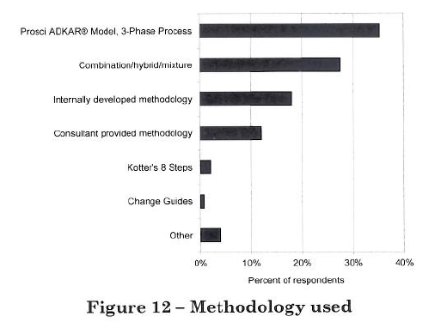
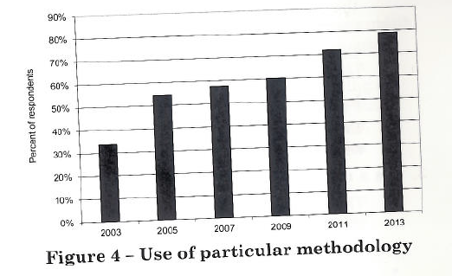
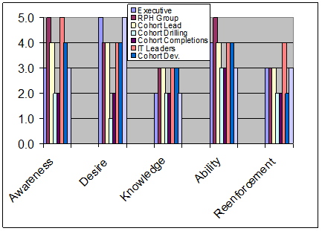
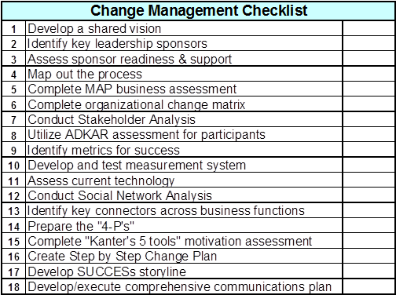
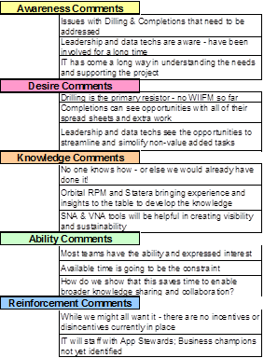
So what’s a humble practitioner supposed to do??
Leverage!
Adapt
Experiment
Standardize
Best Practices in Change Management, 2014 Edition, PROSCI

Slide 15

How do we do this? The ADKAR Model
Awareness |  | of the need for change
Desire |  | to participate and support the change
Knowledge |  | on how to change
Ability |  | to implement required skills and behaviors
Reinforcement |  | to sustain the change
© Prosci 2008
Notes:
ADKAR is framework within which change management tools (communication, coaching, training, resistance management, project management, etc.) can be deployed aligned with the goals and objectives of the change.

Slide 16
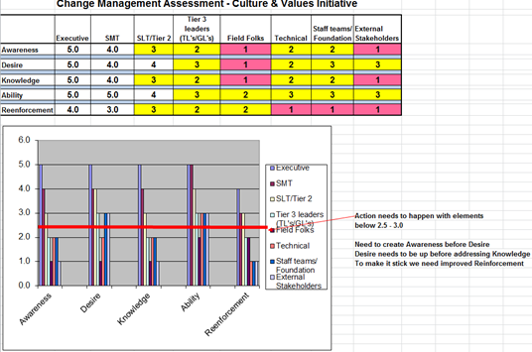
Example ADKAR Assessment
Multiple stakeholders
  Amplitude?
  Phase shift?
Diagnostic tool

Slide 17
Without ADKAR
In the absence of: | You will see:
Awareness and Desire | More resistance from employees. Employees asking the same questions over and over. Lower productivity. Higher turnover. Hoarding of resources and information. Delays in implementation.
Knowledge and Ability | Lower utilization or incorrect usage of new processes, systems and tools. Employees worry if they are prepared to be successful in future state. Greater impact on customers and partners. Sustained reduction in productivity.
Reinforcement | Employees will revert back to old ways of doing work. Ultimate utilization is less than anticipated. The organization creates a history of poorly managed change.
© Prosci 2008

Slide 18
The ADKAR Model
Awareness of the need for change.
  What is the nature of the change?
  Why is the change happening?
  What is the risk of not changing?
  Who delivers the message?
© Prosci 2008
Notes:
Now we want them to use the ADKAR worksheet. Make sure they all have one and have them focus on their project/activity. Walk through each step in ADKAR re-enforcing the key ideas of needing to address the awareness before you get to training!

Slide 19
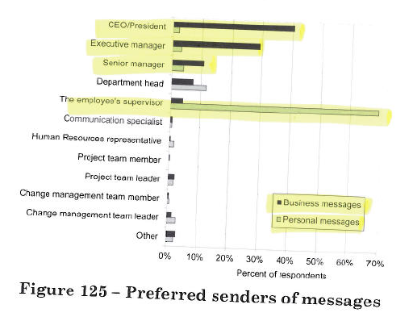
Importance of Matching Message & Sender
For business & strategy messages – Executives
For “WIIFM” – my Supervisor!
What about the general public?
Source: PROSCI 2013 Best Practices research

Slide 20
The ADKAR Model
Desire to support the change.
  Personal motivation to support the change
  Organizational drivers to support the change
  Where’s the WIIFM?
© Prosci 2008
Notes:
Once awareness is up then you can work on desire – normally someone should have an “A” score that is higher than a “D” score from the beginning – since how can someone have a desire for change without being aware of the change?!

Slide 21
The ADKAR Model
Knowledge on how to change.
  Knowledge, skills and behaviors required during and after the change
  Understanding how to change
© Prosci 2008
Notes:
Many times this is where teams jump first – we start to build out training manuals and sessions before building awareness and desire. Tremendous re-work loops occur. People talk about not be capable of doing the new process – when really they might not have the desire to comply.

Slide 22
The ADKAR Model
Ability to implement new skills.
  Demonstrated ability to implement the change
  Barriers that may inhibit implementing the change
    Cultural?
    Intellectual?
© Prosci 2008
Notes:
What is the current ability? Can the current or targeted workers actually “do” the process? Assessing Ability can help reduce complexity in the knowledge development

Slide 23
The ADKAR Model
Reinforcement to sustain the change.
  Mechanisms to keep the change in place
  Recognition, rewards, incentives, successes
© Prosci 2008
Notes:
Just like our control plan – if we don’t sustain it and re-enforce it it won’t happen. Culturally relevant aspects for consideration. Toyota example – once standard work is created it is rigorously adhered too. “It is our process, our cars, our reputation – we’ve mistake proofed it and demonstrated it works…you want to work for us, that is the way you do it.” How is this unlike EnCana? What can work here?

Slide 24
Greatest Contributors to Success
Active & visible executive sponsorship
Structured approach to managing change
Dedicated change management resources
Frequent & open communication about the change and the need for the change
Employee engagement & participation
Engagement & integration with project management
Engagement with & support from middle management
Source: PROSCI 2013 Best Practices research

Slide 25

Resistance: most common reasons managers resist change
Fear of losing control and authority
Lack of time
Comfort with the status quo
No answer to “What’s in it for me?”
No involvement in solution design
[What about your stakeholders?]
Again, it really isn’t about the particular solution
How do you overcome these reasons?

Slide 26
Factors Influencing Awareness
Factor 1 – A person’s view of the current state
  Denial - If it’s not broke – don’t fix it!
  I told you that needed to be fixed a long time ago
Factor 2 - How a person perceives problems
  Adaptive and aware of internal threats?
  How we internalize and approach warnings
Factor 3 – The credibility of the sender
  Who delivers the message is as critical as the message
  Why the change from Execs; How the change by supervisors
Factor 4 – Circulation of misinformation & rumors
  What is real & what is fabricated?
  What analogies to other attempts at change can influence this one?
Factor 5 – Contestability of the reasons for change
  Are their external or internal reasons for doubt?
  Is it debatable about the need for the change

Slide 27
Factors Influencing Desire
Factor 1 – The nature of the change and WIIFM
  What “it” is, is important, what it means for me is more important!
Factor 2 – Organizational or environmental context
  Past changes, Org. history, can some opt out?
  Will vary from person to person
Factor 3 – An individual’s personal situation
  Family & personal life factors influence Desire
  Each person has a unique capacity for change
Factor 4 – Intrinsic Motivation
  Desire to help make things better?
  Desire for power? Respect? Position?

Slide 28
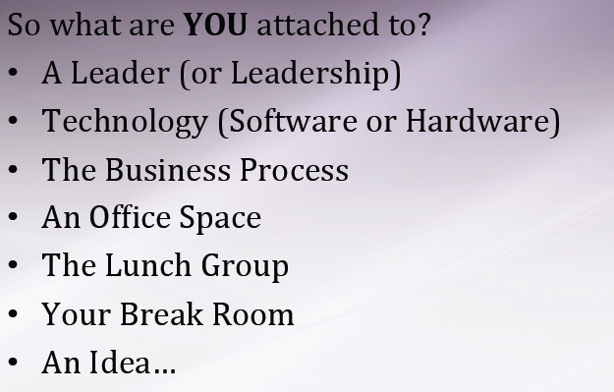
Attachment Impacts Desire
Identifying the “attachments” that people have can help find leverage points around how to move them forward

Slide 29
Factors Influencing Knowledge
Factor 1 – The current knowledge base of the individual
  Is “the knowledge” already present?
  What is the gap between current and future needs? How big?
Factor 2 – The capacity or capability of the person
  Can the person actually perform the new tasks?
  One size fits all training might not work across the board
Factor 3 – Resources available for education/training
  Can we provide the resources to direct the training?
  What job aids can be created to simplify actions required?
Factor 4 – Access to, or existence of, the required knowledge
  Do we have the expertise?
  What would this do to our project timeline?

Slide 30
Factors Influencing Ability
Factor 1 – Psychological blocks
  Is there an inherent fear within the individual that will block ability?
  Public speaking – most people fear it more than death!
Factor 2 – Physical ability
  Are there limitations that will have to be addressed?
  Strength? Dexterity?
Factor 3 – Intellectual capability
  Is there a disconnect between current state requirements and future?
  Will there be technological or learning related problems?
Factor 4 – Time available to develop skills
  Even if the person has the potential to adapt – do we have the time?
  What external factors drive the implementation schedule?
Factor 5 – Availability of resources
  Is there support during the developmental period – financial, tools, coaching, access to SME/Experts?

Slide 31
Factors Influencing Reinforcement
Factor 1 – Meaningful
  Recognition/reward/punishment has to mean something at the individual level
Factor 2 – Association with the actual accomplishment
  Can we celebrate small successes?
  Key metrics need to be established
Factor 3 – Absence of negative consequences
  Need to clarify expectations for non-conformance
  Peer pressure can be good or bad
Factor 4 – Accountability systems
  Performance management systems
  Individual – Boss/Subordinate, Peer/Peer, Mentee/Mentor
  Recognition & continual reinforcement

Slide 32
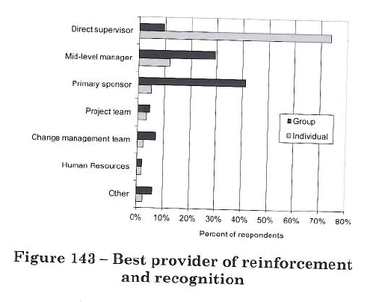
How to reinforce the behaviors…
In contrast to the big strategy messages from Executive Leaders…
Individuals want their direct supervisor to engage on what they do to change behaviors
Source: PROSCI 2013 Best Practices research

Slide 33
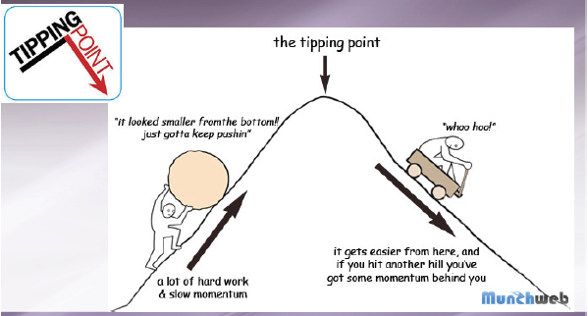
Peer Pressure – another lever
Influence – producing an effect in another person without apparent exertion of force
Peers exert a type of influence that leverages the promise of acceptance
  Social pressure by members of one’s peer group to take a certain action, adopt certain behaviors, or otherwise conform in order to be accepted
Identify “who are the cool kids?”
What are the characteristics of those with informal influence?

Slide 34
Sponsor Engagement
Biggest Mistakes
Failed to remain visible & engaged throughout the process
Failed to demonstrate support in words & actions
Failed to effectively communicate messages
Ignored the people side of the change
Delegated or abdicated the sponsorship role & responsibilities
Effective Tactics
Provide behind-the-scenes assistance to Sponsors
Coach the Sponsor on their role
Hold regular meetings with Sponsor(s)
Ensure Sponsor communicates directly with employees
Hold Sponsor accountable for their role
Source: PROSCI 2013 Best Practices research

Slide 35
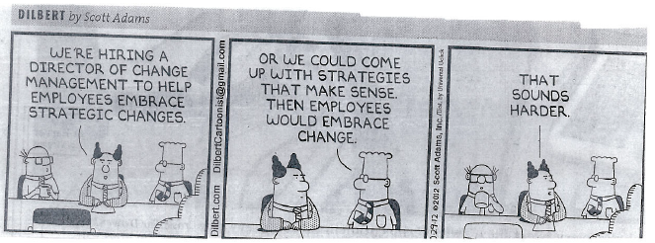

Slide 36
The Soft stuff is the Hard Stuff!!
Moving people from here to there is tough!
  Even when they know “here” is bad!
Change Management is more than a simple communications plan
Actively involving stakeholders at the right time, with the right information, with the right intent is critical
There are processes & tools that help identify the key levers & constraints
You can learn how to lead change!

