Slide 1
Funding Opportunities for State, Local, Tribal, and Territorial Retail Food Regulatory Programs
Cathy Hosman and Pete Salsbury
U.S. Food and Drug Administration
National Retail Food Team
AFDO Annual Education Conference
June 24, 2014
Denver, CO

Slide 2
Topics Covered
Overview of Voluntary National Retail Food Regulatory Program Standards (Retail Program Standards)
Overview of Various Funding Opportunities Supporting the Retail Program Standards
Outcomes/Aims of the Funding Opportunities

Slide 3
Retail Program Standards
Nine “standards of excellence” intended for retail food regulatory programs
Goals:
Intended to serve as a guide to regulatory retail food program managers in the design and management of a retail food regulatory program; and
Intended to help retail food regulatory programs enhance the level of services they provide to the public.

Slide 4
588 regulatory jurisdictions enrolled

Slide 5
Funding Opportunities Supporting the Retail Program Standards
Cooperative agreement versus grant
Funding opportunities supporting the Retail Program Standards:
“Retail Program Standards” Cooperative Agreements
Cooperative Agreement with the Association of Food and Drug Officials (AFDO)
Cooperative Agreement with the National Association of County and City Health Officials (NACCHO)

Slide 6
Then & Now: Investment in Retail Program Standards
 | FY2009 | FY2012 | FY2013 | FY2014
Retail Cooperative Agreements (total) | $250K | $3.24M | $3.20M | $3.31M
“Retail Program Standards” Cooperative Agreements | None | $2.6M | $2.4M | $2.4M
Cooperative Agreement with AFDO | None | None | $600K | $670K
Cooperative Agreement with NACCHO | None | $145K | $202K | $240K
“Micro Purchase” Funds | $250K | $500K | $0 | $0
Enrolled Jurisdictions | 343* | 547* | 563* | 588**
* As of September 30 ** As of April 1, 2014
 |  |  |  | $670K
 | $500K | $500K
 | $250K | $250K
Total Funding | $59.5M | $59.5M |  | $M
6

Slide 7
“Retail Program Standards”
Cooperative Agreements

Slide 8
“Retail Program Standards” Cooperative Agreements
Established in 2012
Direct funding to state, local, territorial, and tribal retail food regulatory programs
Up to $70,000 per year
Most are multiyear (up to 5 years)
Program Goals

Slide 9
“Retail Program Standards” Cooperative Agreements – Funding
2012
2013 & 2014
$2.6M
38 awards
34 five-year awards
1 three-year award
3 one-year awards
$2.4M
35 jurisdictions continue with their projects
3 jurisdictions who requested one-year awards have completed their projects

Slide 10
“Retail Program Standards” Cooperative Agreements
*
*
*
*
*
*
*
*
*
*
*
*
*
*
*
*
Yellow: State Department, Department of Agriculture, Health and Human Services that have 1-yr award. Green: State Department, Department of Agriculture, Health and Human Services that have 3-yr awards. Blue: State Department, Department of Agriculture, Health and Human Services that have 5-yr awards. Red Star: Local (County and City) Health Department

Slide 11
“Retail Program Standards” Cooperative Agreements Outcomes
Formal employee training programs
Learning management systems to track training and standardizations
Standardized inspection programs based on HACCP principles
Electronic inspection reporting systems
Electronic complaint and foodborne illness tracking systems
Compliance and enforcement programs
Risk factor studies
Outreach and training activities to assist industry with achieving active managerial control

Slide 12
Cooperative Agreement with AFDO

Slide 13
Cooperative Agreement with AFDO
Established in 2013
$450,000 in grants to state, local, tribal, and territorial regulatory programs
Managed by AFDO
FDA/AFDO Joint Advisory Group (JAG) provides oversight
Simple application and reporting process
Apply online at AFDO’s Retail Program Standards Website at: http://afdo.org/retailstandards

Slide 14
Cooperative Agreement with AFDO
Category 1 – Small Projects
Up to $3,000
Category 2 – Moderate Projects
$10,000-$20,000
Category 3 – Training
Up to $2,000

Slide 15
Cooperative Agreement with AFDO – Program Requirements
Jurisdictions:
Can apply for up to one grant in each category; total of 3 per calendar year
Should coordinate internally to ensure the maximum number of applications is not exceeded
Submit all required information on applications via online portal

Slide 16
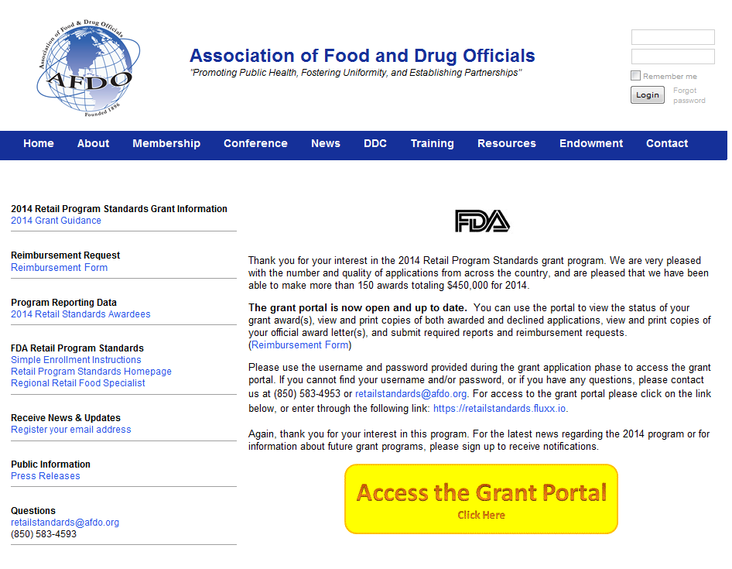
Cooperative Agreement with AFDO

Slide 17
Cooperative Agreement with AFDO – Tentative Timeline for Year 2 Funding
September 2 – Website Opens, new applications accepted
October 10 – Application deadline
November 20 – Award notices sent
December 1, 2014 – September 30, 2015 – Open period for Category 1 & 3 projects
December 1, 2014 – December 31, 2015 – Open period for Category 2 projects

Slide 18
FDA Cooperative Agreement with NACCHO

Slide 19
Cooperative Agreement with NACCHO
What is NACCHO?
Cooperative Agreement established in 2012
Purpose
Program duration

Slide 20
Cooperative Agreement with NACCHO – Four Aims
Aim 1: Increase local health department (LHD) awareness of food safety regulation tools, resources, and practice
Aim 2: Strengthen LHD involvement in food safety regulation
Aim 3: Improve FDA, NACCHO, and LHD knowledge of the connections between the Retail Program Standards and public health accreditation as guided by the Public Health Accreditation Board (PHAB)
Aim 4: Improve NACCHO’s and FDA’s understanding of the effectiveness of food inspection scoring & grading systems

Slide 21
Cooperative Agreement with NACCHO – Mentorship Program
Focuses specifically on accomplishing Aims 1 & 2
Experienced LHDs serve as mentors to newly enrolled LHDs
Mentors assist mentee LHDs in preparing for self-assessments and verification audits and in making progress on specific Standards

Slide 22
Cooperative Agreement with NACCHO - Mentorship Program Funding
Funding per mentor LHD ranges from $8,000 - $18,000
Funding per mentee LHD ranges from $8,000 - $10,000
Travel stipend up to $2,800 for:
Trips to participate in a site visit with mentor LHD
Attend a face-to-face meeting in August

Slide 23
Cooperative Agreement with NACCHO - Mentorship Program Funding
<?xml version="1.0"?><AllQuestions />
<?xml version="1.0"?><AllResponses />
<?xml version="1.0"?><Settings><answerBulletFormat>Numeric</answerBulletFormat><answerNowAutoInsert>No</answerNowAutoInsert><answerNowStyle>Explosion</answerNowStyle><answerNowText>Answer Now</answerNowText><chartColors>Use PowerPoint Color Scheme</chartColors><chartType>Horizontal</chartType><correctAnswerIndicator>Checkmark</correctAnswerIndicator><countdownAutoInsert>No</countdownAutoInsert><countdownSeconds>10</countdownSeconds><countdownSound>TicToc.wav</countdownSound><countdownStyle>Box</countdownStyle><gridAutoInsert>No</gridAutoInsert><gridFillStyle>Answered</gridFillStyle><gridFillColor>255,255,0</gridFillColor><gridOpacity>50%</gridOpacity><gridTextStyle>Keypad #</gridTextStyle><inputSource>Response Devices</inputSource><multipleResponseDivisor># of Responses</multipleResponseDivisor><participantsLeaderBoard>5</participantsLeaderBoard><percentageDecimalPlaces>0</percentageDecimalPlaces><responseCounterAutoInsert>No</responseCounterAutoInsert><responseCounterStyle>Oval</responseCounterStyle><responseCounterDisplayValue># of Votes Received</responseCounterDisplayValue><insertObjectUsingColor>Red</insertObjectUsingColor><showResults>Yes</showResults><teamColors>Use PowerPoint Color Scheme</teamColors><teamIdentificationType>None</teamIdentificationType><teamScoringType>Voting pads only</teamScoringType><teamScoringDecimalPlaces>1</teamScoringDecimalPlaces><teamIdentificationItem></teamIdentificationItem><teamsLeaderBoard>5</teamsLeaderBoard><teamName1></teamName1><teamName2></teamName2><teamName3></teamName3><teamName4></teamName4><teamName5></teamName5><teamName6></teamName6><teamName7></teamName7><teamName8></teamName8><teamName9></teamName9><teamName10></teamName10><showControlBar>All Slides</showControlBar><defaultCorrectPointValue>0</defaultCorrectPointValue><defaultIncorrectPointValue>0</defaultIncorrectPointValue><chartColor1>187,224,227</chartColor1><chartColor2>51,51,153</chartColor2><chartColor3>0,153,153</chartColor3><chartColor4>153,204,0</chartColor4><chartColor5>128,128,128</chartColor5><chartColor6>0,0,0</chartColor6><chartColor7>0,102,204</chartColor7><chartColor8>204,204,255</chartColor8><chartColor9>255,0,0</chartColor9><chartColor10>255,255,0</chartColor10><teamColor1>187,224,227</teamColor1><teamColor2>51,51,153</teamColor2><teamColor3>0,153,153</teamColor3><teamColor4>153,204,0</teamColor4><teamColor5>128,128,128</teamColor5><teamColor6>0,0,0</teamColor6><teamColor7>0,102,204</teamColor7><teamColor8>204,204,255</teamColor8><teamColor9>255,0,0</teamColor9><teamColor10>255,255,0</teamColor10><displayAnswerImagesDuringVote>Yes</displayAnswerImagesDuringVote><displayAnswerImagesWithResponses>Yes</displayAnswerImagesWithResponses><displayAnswerTextDuringVote>Yes</displayAnswerTextDuringVote><displayAnswerTextWithResponses>Yes</displayAnswerTextWithResponses><questionSlideID></questionSlideID><controlBarState>Expanded</controlBarState><isGridColorKnownColor>True</isGridColorKnownColor><gridColorName>Yellow</gridColorName></Settings>
<?xml version="1.0"?><AllAnswers />
Investments in Local Health Departments
Cohort I ~ $145,200 (9 LHDs)
Cohort II ~ $202,000 (15 LHDs)
Cohort III ~ $240,400 (18 LHDs)
Total ~ $587,600* (42 LHDs)
* Totals include $2,800 travel stipend given to each LHD for site visit and end-of-year meeting in Washington, D.C. (~ $117,600)

Slide 24
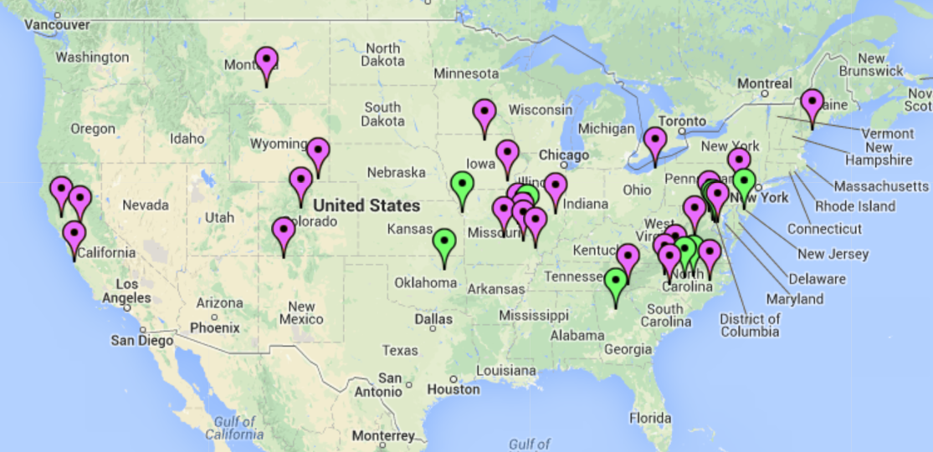
Map of Mentorship Participants
<?xml version="1.0"?><AllQuestions />
<?xml version="1.0"?><AllResponses />
<?xml version="1.0"?><Settings><answerBulletFormat>Numeric</answerBulletFormat><answerNowAutoInsert>No</answerNowAutoInsert><answerNowStyle>Explosion</answerNowStyle><answerNowText>Answer Now</answerNowText><chartColors>Use PowerPoint Color Scheme</chartColors><chartType>Horizontal</chartType><correctAnswerIndicator>Checkmark</correctAnswerIndicator><countdownAutoInsert>No</countdownAutoInsert><countdownSeconds>10</countdownSeconds><countdownSound>TicToc.wav</countdownSound><countdownStyle>Box</countdownStyle><gridAutoInsert>No</gridAutoInsert><gridFillStyle>Answered</gridFillStyle><gridFillColor>255,255,0</gridFillColor><gridOpacity>50%</gridOpacity><gridTextStyle>Keypad #</gridTextStyle><inputSource>Response Devices</inputSource><multipleResponseDivisor># of Responses</multipleResponseDivisor><participantsLeaderBoard>5</participantsLeaderBoard><percentageDecimalPlaces>0</percentageDecimalPlaces><responseCounterAutoInsert>No</responseCounterAutoInsert><responseCounterStyle>Oval</responseCounterStyle><responseCounterDisplayValue># of Votes Received</responseCounterDisplayValue><insertObjectUsingColor>Red</insertObjectUsingColor><showResults>Yes</showResults><teamColors>Use PowerPoint Color Scheme</teamColors><teamIdentificationType>None</teamIdentificationType><teamScoringType>Voting pads only</teamScoringType><teamScoringDecimalPlaces>1</teamScoringDecimalPlaces><teamIdentificationItem></teamIdentificationItem><teamsLeaderBoard>5</teamsLeaderBoard><teamName1></teamName1><teamName2></teamName2><teamName3></teamName3><teamName4></teamName4><teamName5></teamName5><teamName6></teamName6><teamName7></teamName7><teamName8></teamName8><teamName9></teamName9><teamName10></teamName10><showControlBar>All Slides</showControlBar><defaultCorrectPointValue>0</defaultCorrectPointValue><defaultIncorrectPointValue>0</defaultIncorrectPointValue><chartColor1>187,224,227</chartColor1><chartColor2>51,51,153</chartColor2><chartColor3>0,153,153</chartColor3><chartColor4>153,204,0</chartColor4><chartColor5>128,128,128</chartColor5><chartColor6>0,0,0</chartColor6><chartColor7>0,102,204</chartColor7><chartColor8>204,204,255</chartColor8><chartColor9>255,0,0</chartColor9><chartColor10>255,255,0</chartColor10><teamColor1>187,224,227</teamColor1><teamColor2>51,51,153</teamColor2><teamColor3>0,153,153</teamColor3><teamColor4>153,204,0</teamColor4><teamColor5>128,128,128</teamColor5><teamColor6>0,0,0</teamColor6><teamColor7>0,102,204</teamColor7><teamColor8>204,204,255</teamColor8><teamColor9>255,0,0</teamColor9><teamColor10>255,255,0</teamColor10><displayAnswerImagesDuringVote>Yes</displayAnswerImagesDuringVote><displayAnswerImagesWithResponses>Yes</displayAnswerImagesWithResponses><displayAnswerTextDuringVote>Yes</displayAnswerTextDuringVote><displayAnswerTextWithResponses>Yes</displayAnswerTextWithResponses><questionSlideID></questionSlideID><controlBarState>Expanded</controlBarState><isGridColorKnownColor>True</isGridColorKnownColor><gridColorName>Yellow</gridColorName></Settings>
<?xml version="1.0"?><AllAnswers />
Purple Pins – Location of Mentees
Green Pins – Location of Mentors

Slide 25
Mentorship Program Outcomes and Impact
Recognition of the value of the Retail Program Standards
Increased capacity to implement the Retail Program Standards
Increased knowledge among NACCHO and FDA staff on the challenges and strengths of the Program Standards

Slide 26
Mentorship Program Outcomes and Impact (Continued)
Increased opportunities for training, sharing experiences, developing tools, and resources
Strengthened partnerships with peer LHDs to help prevent foodborne illness and outbreaks
The partnership/networking continues long after the mentorship program ends

Slide 27
Timeline for FY14 Mentorship Program
RFA Release: October 1, 2013
Application Deadline: October 31, 2013
Award Notification: November 25, 2013
Kickoff Call: December 18, 2013
Site Visits and Mid-Project Conference Calls: Spring 2014
In-person meeting: August 2014 (Washington, DC)
Submit final report to NACCHO: August 31, 2014

Slide 28
Benefits of Participating in the Mentorship Program
Face-to face meetings
Great networking experiences
Funding
NACCHO staff support
Collaboration and sharing of best practices through FoodSHIELD
Making progress on achieving Retail Program Standards

Slide 29
Important Links
FDA Retail Program Standards Web Page –http://www.fda.gov/Food/GuidanceRegulation/ RetailFoodProtection/ProgramStandards/default.htm
Links to:
The Retail Program Standards
Listing of Enrolled Jurisdictions
Clearinghouse Workgroup Q&A
NACCHO Mentorship Program
AFDO Funding Program
Office of Partnerships Web Page (Funding Opportunities)
Directory of FDA Regional Retail Food Specialists

Slide 30
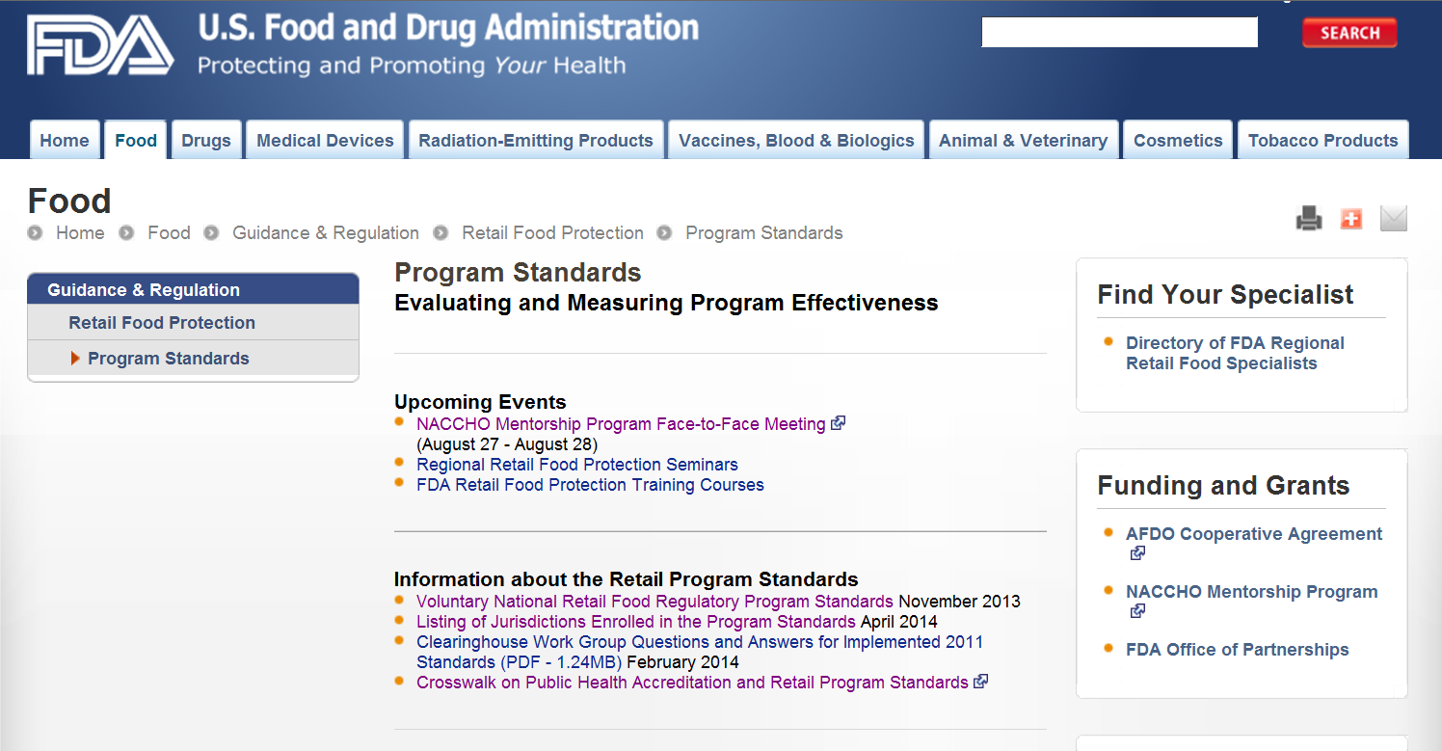

Slide 31
Questions/More Information
Cathy Hosman
Project Officer
Office of Regulatory Affairs (ORA)
Office of Partnerships
Contract and Grants Staff
catherine.hosman@fda.hhs.gov
Pete Salsbury
Project Manager
Center for Food Safety & Applied Nutrition (CFSAN)
Retail Food & Cooperative Programs Coordination Staff
Peter.Salsbury@fda.hhs.gov

