Slide 1
Controlling Listeria monocytogenes (Lm) in Retail Delicatessens
Jerry Elliott, DVM, Director
Compliance and Investigations Division
Food Safety Inspection Service
Office of Investigation, Enforcement and Audit
United States Department of Agriculture

Slide 2
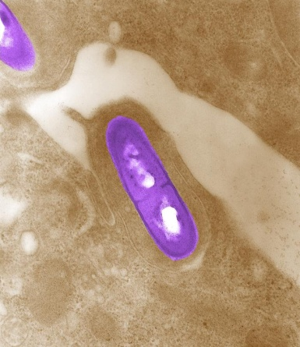
What is Lm?
Bacterium found in moist environments, soil, and decaying vegetation
Transfer of the bacteria is a particular hazard of concern in ready-to-eat (RTE) foods
Notes:
Transfer of the bacteria from the environment, employees, or raw food products is a particular hazard of concern in ready-to-eat (RTE) foods including meat and poultry products

Slide 3
Listeriosis
Serious infection caused by eating food contaminated with the bacterium Lm
Rare, but high fatality rate (16% compared to 0.5% for Salmonella or E. coli O157:H7)
Affects older adults, pregnant women, newborns, and adults with weakened immune systems
http://www.cdc.gov/listeria/statistics.html

Slide 4
Listeriosis
Symptoms: Fever, muscle aches, fatigue,
Estimated 1,600 illnesses, 1,500 hospitalizations, and 260 deaths in the United States each year
http://www.cdc.gov/listeria/statistics.html
Notes:
Symptoms: Fever, muscle aches, fatigue, can be preceded by diarrhea or other gastrointestinal symptoms

Slide 5
Regulation of Meat and Poultry Products at Retail
Food Safety Inspection Service (FSIS) shares jurisdiction at retail
The Federal Meat Inspection Act (FMIA) and Poultry Products Inspection Act (PPIA)
FDA makes recommendations regarding retail practices through the FDA Food Code
Notes:
Food Safety Inspection Service (FSIS) shares jurisdiction at retail with Food and Drug Administration (FDA) and State, local, and tribal authorities for meat and poultry
The Federal Meat Inspection Act (FMIA) and Poultry Products Inspection Act (PPIA) apply to meat and poultry products produced in federally inspected establishments and other entities that produce or handle meat and poultry, including at retail
The Food Code is used by the State and local agencies as a model to establish regulations, ordinances, and actionable policies that can be enforced in their jurisdictions
Operators of retail establishments are required to comply with the conditions of the permit or license under which they operate

Slide 6
The Interagency Retail Lm Risk Assessment
No single action or practice will control Lm contamination of retail foods.
Notes:
Instead there are many steps that retail deli operators and their suppliers can take to help reduce the risk of listeriosis.

Slide 7
Key Findings from The Interagency Retail Lm Risk Assessment
Storage Temperature
Growth Inhibitors
Control Cross-Contamination
Control Contamination at its Source
Continue Sanitation

Slide 8
1. Storage Temperature
If all refrigerated RTE foods are stored at 41°F (5°C) or below, approximately 9% of predicted Lm cases could be prevented
Notes:
If all refrigerated RTE foods are stored at 41°F (5°C) or below, as recommended by the 2013 FDA Food Code (3-501.16(A)(2)), approximately 9% of predicted listeriosis cases caused by contaminated deli products prepared or sliced in the retail deli could be prevented

Slide 9
2. Growth Inhibitors
If all deli products that support Lm growth were reformulated to include growth inhibitors, could prevent 96% of predicted listeriosis cases
Notes:
If all deli products that support Lm growth were reformulated to include growth inhibitors, approximately 96% of predicted listeriosis illnesses caused by RTE products prepared or sliced in the retail deli could be prevented

Slide 10
3. Control Cross-Contamination
Eliminating all points of cross-contamination would decrease the predicted risk of listeriosis by approximately 34%
Notes:
The predicted risk of listeriosis dramatically increases in retail delis as a result of cross-contamination. In particular, slicers are key sources of cross-contamination in retail delis
Eliminating all points of cross-contamination in the deli would decrease the predicted risk of illness from the consumption of RTE products prepared or sliced in the retail deli by approximately 34%

Slide 11
4. Control Contamination at its Source
Elimination of environmental niches in the deli area will reduce the predicted risk of listeriosis in the retail deli
Notes:
Increased levels of Lm from incoming products and the environment (including potential niches), directly increases the predicted risk of illness
Therefore, elimination of environmental niches in the deli area will reduce the predicted risk of listeriosis from the consumption of RTE products prepared or sliced in the retail deli

Slide 12
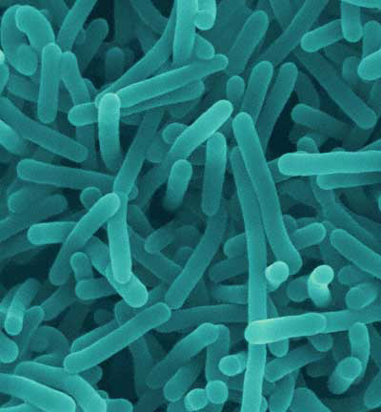
5. Continue Sanitation
Sanitation practices that eliminate Lm from food contact surfaces result in a reduction in the predicted risk of illness
Notes:
Sanitation practices that eliminate Lm from deli food-contact surfaces result in a reduction in the predicted risk of illness
Employees not wearing gloves while serving customers increases the predicted risk of listeriosis from the consumption of RTE products prepared or sliced in the retail deli by approximately 5%

Slide 13
Key Findings from The Interagency Retail Lm Risk Assessment
Storage Temperature – 41°F (5°C) or below – 9%
Growth Inhibitors – 96%
Control Cross-Contamination – 34%
Control Contamination at its Source – decrease
Continue Sanitation – gloves – 5%

Slide 14
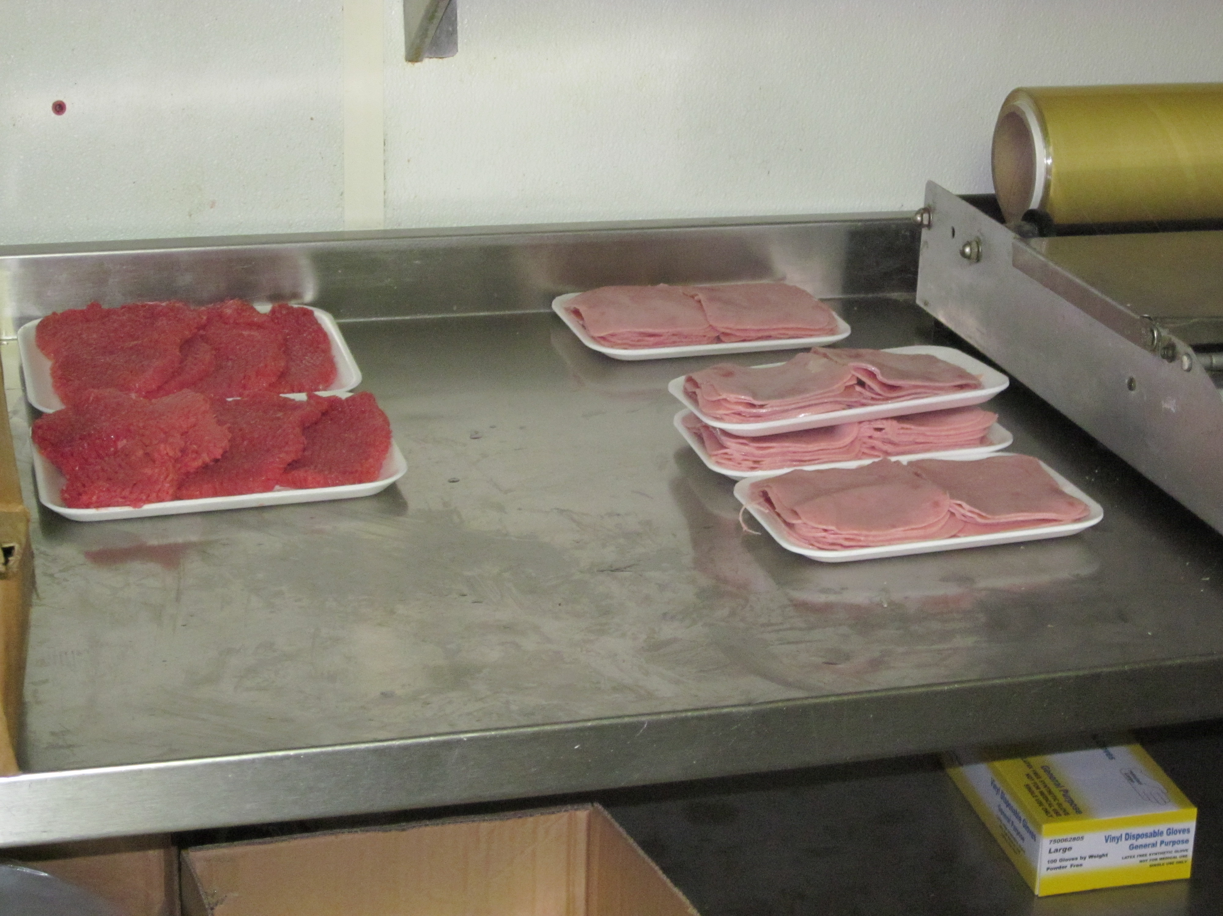
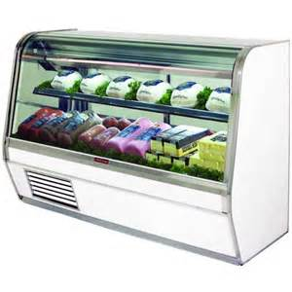
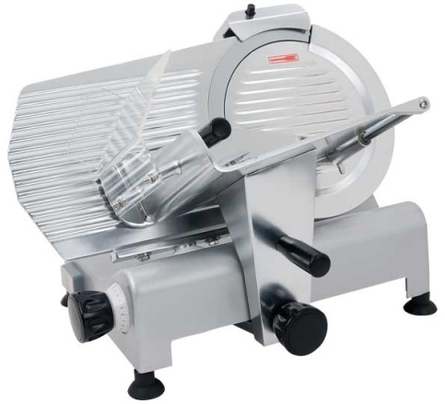
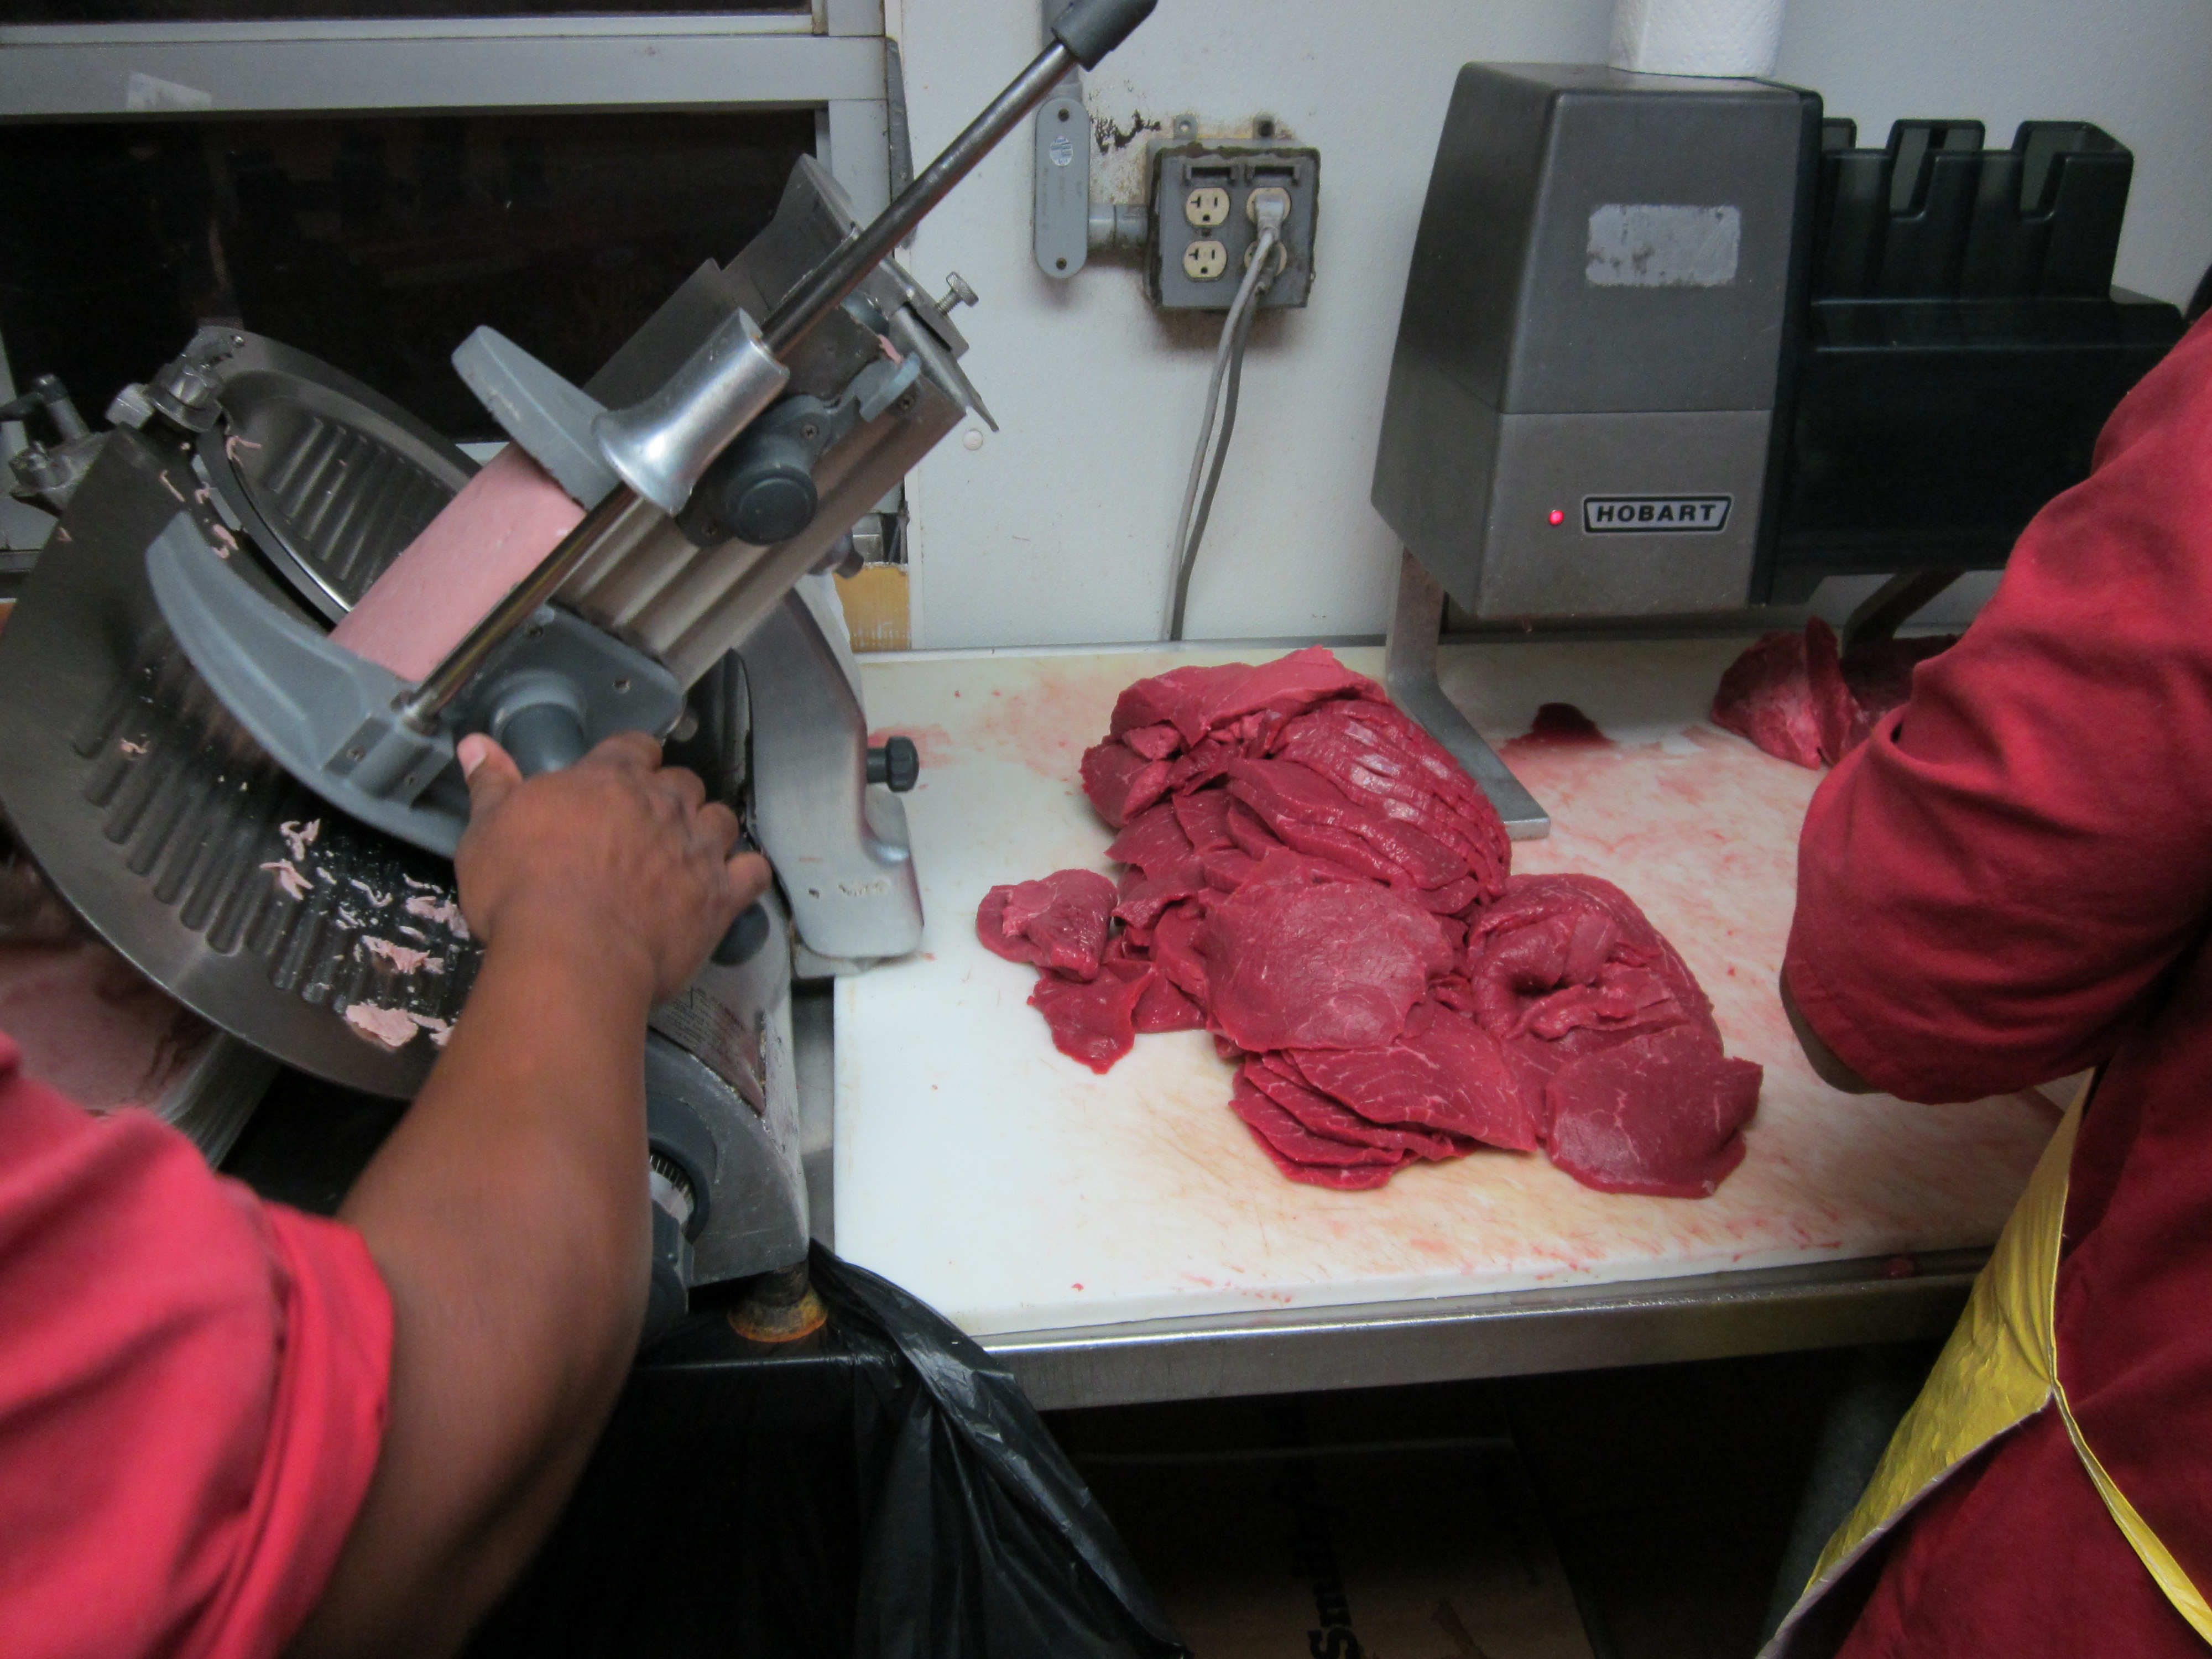
Product Handling

Slide 15
Product Handling
Use products formulated with antimicrobial agents to eliminate or prevent the growth of Lm
Use products that have been treated to reduce pathogens
Monitor the shelf life of RTE products
Do not pre-slice products
Notes:
Use products formulated with antimicrobial agents (e.g., acetic acid, sodium diacetate, lactic acid, citric acid) when possible, to eliminate or prevent the growth of Lm
NOTE: The Interagency Retail Lm Risk Assessment estimated that if antimicrobial agents are used in all products in the deli, the predicted risk of listeriosis could be decreased by approximately 96%
Use products that have been treated to reduce pathogens (e.g., through high pressure processing (HPP))
NOTE: The Interagency Retail Lm Risk Assessment found that if current levels of Lm in RTE foods (e.g., meats, cheeses, and salads) received by the retail deli were reduced by half, the predicted risk of listeriosis could be decreased by approximately 22%
Monitor the shelf life of RTE products opened, prepared, and held in a retail setting for more than 24 hours
Do not pre-slice products in the morning, after cleaning. Retailers should slice the product at the time it is requested by consumers
NOTE: The Interagency Retail Lm Risk Assessment found that pre-slicing the product increases the predicted risk of listeriosis by approximately 6%

Slide 16
Product Handling
Remove products that are likely to be considered adulterated
Promptly return RTE products to refrigeration
Maintain refrigeration units at or below 41°F
Store and handle RTE and raw products separately
Notes:
Remove products that are filthy, putrid, decomposed, slimy, rancid, or in off-condition, which are likely to be considered adulterated, from the deli area as soon as possible
Promptly return RTE products to refrigerated units, after slicing, to prevent pathogen growth
Maintain refrigeration units at or below 41°F (5°C) to slow the growth of Lm, as recommended by the 2013 FDA Food Code (3-501.16(A)(2))
NOTE: The Interagency Retail Lm Risk Assessment found that storing the products at or below 41°F (5°C) decreases the predicted risk of listeriosis by approximately 9%
Store and handle RTE products in a separate area from raw products
RTE products that are prepared, held, or stored near raw products can become contaminated (e.g., because of aerosolization or dripping)

Slide 17
Cleaning and Sanitizing

Slide 18
Cleaning and Sanitizing
Eliminate insanitary conditions
Develop written sanitation procedures
Document daily sanitation actions
Clean and sanitize frequently
Notes:
Develop written sanitation procedures that describe how utensils and equipment (e.g., slicers) will be cleaned and sanitized daily prior to use
NOTE: The Interagency Retail Lm Risk Assessment found that the predicted risk of listeriosis increases by approximately 41% if wiping, washing, and sanitizing activities are not performed
Insanitary conditions (e.g., flies, rodent droppings, mold, or dirty surfaces) should not be present in retail areas
Retailers should document the actions they perform to ensure that sanitation procedures are performed on a regular basis
Clean and sanitize utensils and equipment used to handle, prepare, and store RTE products frequently (e.g., at least every 4 hours)
NOTE: The Interagency Retail Lm Risk Assessment found that control of Lm cross-contamination at all points (including slicers) would reduce the predicted risk of listeriosis by approximately 34%

Slide 19
Cleaning and Sanitizing
Clean and sanitize items routinely handled
Disassemble equipment to clean and sanitize
Follow the manufacturer’s recommendations for sanitizer strength and application
Change sanitizers to provide bacterial control
Notes:
Clean and sanitize items that employees routinely handle, such as on/off switches, slicer handles, display cases, cooler handles, and similar surfaces
Disassemble RTE food-processing equipment to clean and sanitize on a regular basis to ensure that hard to reach areas where Lm can hide are addressed
Follow the manufacturer’s recommendations for sanitizer strength and application to ensure it is effective
Note: Many sanitizers, when used as recommended, are effective against Lm, including those containing quaternary ammonia compounds, chlorine solutions, and organic acids. Generally, increasing the sanitizer strength above the recommended levels will not increase the efficacy of the sanitizer and may result in harmful levels of the sanitizer in foods
Change sanitizers as needed to provide more effective bacterial control
Note: Lm and other bacteria can adapt to the environment over time and can form biofilms, which are thin layers of microorganisms that adhere to product contact surfaces

Slide 20
Cleaning and Sanitizing
Develop a procedure to sanitize cleaning aids
Use low water pressure
Use separate sinks
Eliminate or remove unnecessary items
Notes:
Develop a procedure to sanitize cleaning aids or have single-use items that are discarded after use
Note: Cleaning cloths, brushes, sponges, mops, and similar cleaning aids can become contaminated with bacteria and then can spread the bacteria to every surface they contact. Cleaning cloths and other items should be cleaned of visible material and soaked in clean sanitizer between uses.
Use low water pressure when cleaning in the deli areas
Note: Splashing and overspray from high-pressure hoses can aerosolize microorganisms and distribute them into the air and onto nearby surfaces
Use separate sinks for hand washing and cleaning product or equipment
Eliminate or remove unnecessary items (such as supplies and equipment) from the deli area

Slide 21
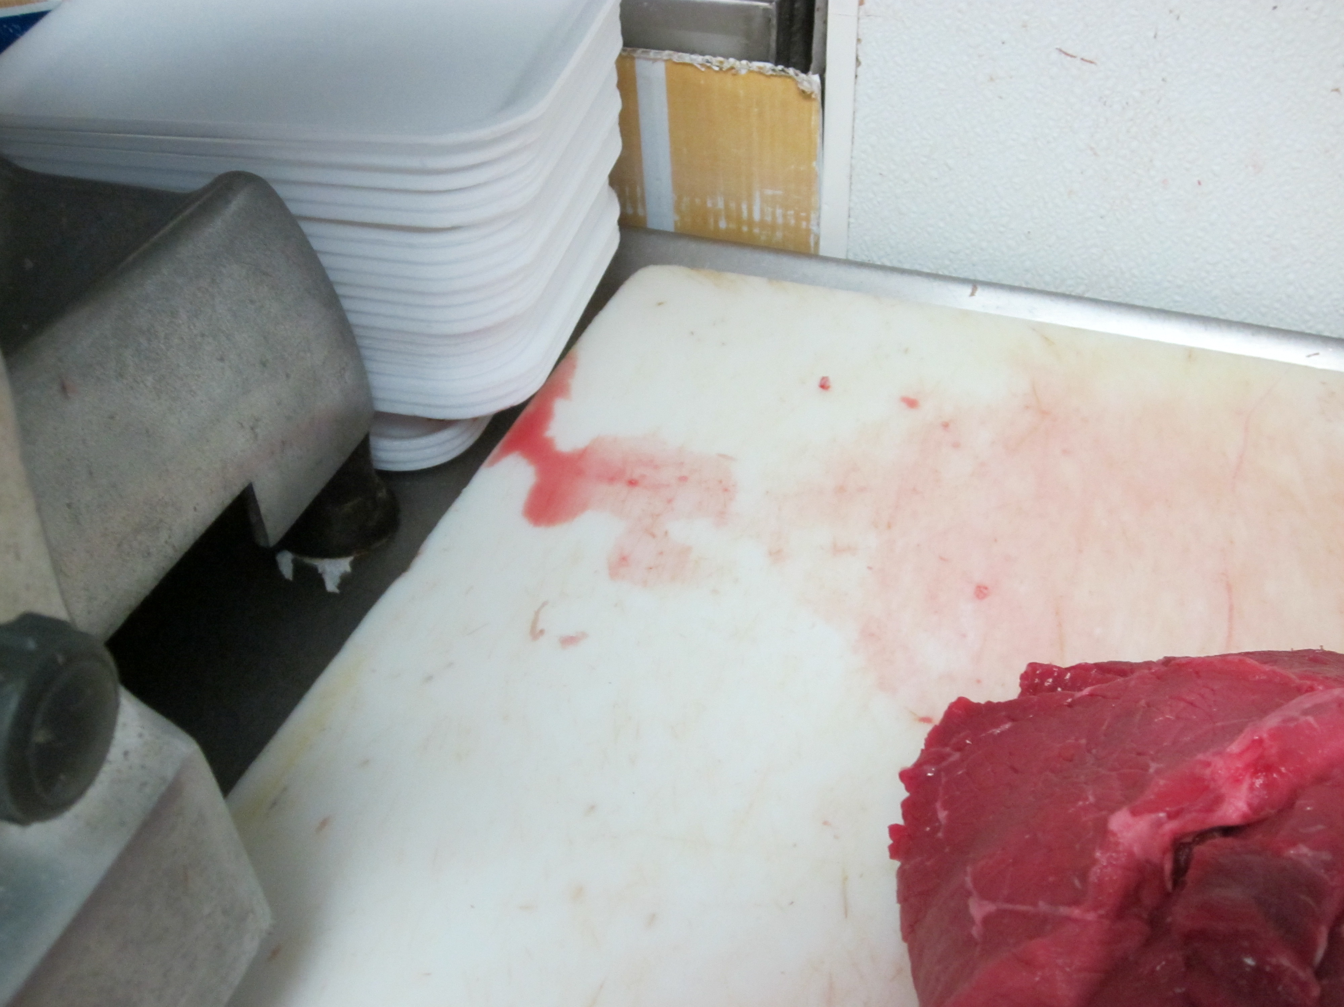
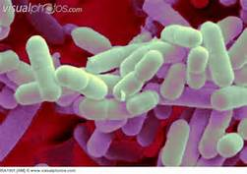
Facility and Equipment Controls

Slide 22
Facility and Equipment Controls
Monitor conditions that could cause adulteration
No construction when exposed RTE product is present
Assure food contact surfaces are easily cleanable
Keep water from pooling
Keep overhead structures clean
Notes:
Do not allow conditions in the retail facility that could cause the product to become adulterated.
Note: These could include condensation dripping on exposed product, construction dust on product or food contact surfaces, or broken equipment. Ensure that walls, floors, drains, and overhead structures in the RTE deli and cooler areas are smooth, durable, easily cleanable, and in good repair
Do not perform construction (e.g., replacing floors, walls, or ceilings) when exposed RTE product is present in the deli.
Note: Lm can be harbored behind the walls and carried by dust. Therefore, the product should be protected during construction, and the deli area should be cleaned and sanitized after construction and before use
Maintain tables, slicers, and other food contact surfaces so that they are easily cleanable.
Note: Rough surfaces created by welds, cracks, and other defects can be difficult to clean and can create areas where bacteria can hide. Worn, missing, or degraded seals or gaskets should be replaced because they may become contaminated with Lm
Keep water from pooling on the floor or other surfaces within the deli area.
Note: Doing so will reduce the likelihood that splash could contaminate food products or food contact surfaces. Standing water can serve as a vehicle for Lm and other pathogens
Clean overhead structures as often as necessary to keep them free of condensation and ensure that sanitary conditions are maintained.
Note: Overhead items (e.g., cracked light fixtures) can be Lm harborage points. Condensation on overhead structures can lead to contamination of food or food preparation surfaces

Slide 23
Employee Practices

Slide 24
Employee Practices
Ensure that employees wear gloves
Train employees in sanitation practices
Provide adequate facilities for hand washing
Ensure ill employees do not work with open food items
Limit traffic in the deli area
Ensure employees change clothing when soiled
Notes:
Ensure that employees wear gloves or use suitable utensils when handling RTE products, as recommended by the 2013 FDA Food Code (3-301.11(B))
NOTE: The Interagency Retail Lm Risk Assessment found that employees not wearing gloves increases the predicted risk of listeriosis by approximately 5%
Train employees in sanitation practices and safe food handling procedures
Provide adequate facilities, including soap and running water, for employees to wash their hands
Implement a policy to ensure that ill employees do not work with open food items, including RTE foods
Limit traffic in the deli area and develop traffic-flow plans for product, employees, and other items to prevent contamination by consumers and employees
Ensure that employees change aprons or outer clothing, such as frocks or smocks, when the clothing is soiled with food or dirt particles that could transfer to food or food contact surfaces

Slide 25
Resources
FDA Flyer: Keep Commercial Deli Slicers Safe, http://www.fda.gov/downloads/Food/GuidanceRegulation/UCM240674.pdf
FSIS Listeria Guideline
http://www.fsis.usda.gov/PDFwps/wcm/connect/d3373299-50e6-47d6-a577-e74a1e549fde/Controlling_LM_RTE_guideline_0912.pdf?MOD=AJPERES
Penn State Control of Listeria monocytogenes in Retail Establishments
http://pubs.cas.psu.edu/freepubs/pdfs/uk137.pdf
FMI Listeria Action Plan for Retail Delis
http://www.fmi.org/docs/food-safety-best-practice-guides/listeria-action-plan-for-retail-delis.pdf?sfvrsn=9

Slide 26
Questions?
Contact Info
Jerry Elliott, DVM, Director
Compliance and Investigations Division
jerry.elliott@fsis.usda.gov

