Slide 1
Sanitation: Examples of Common Challenges and Deficiencies
Karl Thorson
Food Safety and Sanitation Manager
Sanitation Center of Excellence

Slide 2
Why Sanitation?
At your table discuss the question:
“Why Focus on Sanitation & Sanitary Design?”
Be prepared to discuss.
Notes:
Expected responses
Allergens
Micro
Spoilage
Pathogens
Regulatory compliance
Pest control
Quality
Human safety
Housekeeping
Foreign material
Equipment Reliability

Slide 3
Benefits Of Sanitation & Sanitary Design
Allergen control
Micro control
Foreign material control
Pest control
Regulatory compliance
Life cycle cost reduction
Quick changeover execution
Product quality
Human safety
Housekeeping
Equipment reliability
Dietary compliance (Kosher, Halal, organic, gluten free)

Slide 4
Objectives
Communicate the risks being managed
Describe the 6 critical steps in risk management
Identify deficiencies and remediation options
Review case studies
Identify key learnings

Slide 5
Sanitation Program 6 Critical Steps
Step 1
Conduct Needs Analysis
Determine risks to be managed (allergens, micro, pests, etc)
Step 2
Plan of Action
Effectively reduces/eliminates risks (sanitary design, SSOPs)
Step 3
Validation
Ensure plan addresses specific risks
Step 4
Implement Effectively
Communication and training to stakeholders
Step 5
Document
Defensible plan and records
Step 6
Verify Effectiveness
On-going measures and observations to ensure sustainability
Notes:
Slide Title:
Sanitation Basics
Audio / Narration:
(SO_6step-001.wav) A robust sanitation program is comprised of 6 critical steps.
First, we must conduct a needs analysis to understand the reasoning for cleaning and what risks are being managed.
Secondly, we need to put together a plan of action that can be followed and effectively reduces or eliminates any risks.
In step 3, we validate that the plan addresses our specific risks.
Effectively implementing the program by communication and training to all stakeholders, which include those directly involved in the cleaning process as well as those leading sanitation tasks, is step 4.
We also need to make sure we have a defensible plan and that it is appropriately documented.
After the program has been effectively implemented, on-going measures and observations that are as objective as possible must be conducted to verify that the identified needs have been addressed.
Designer Notes:
Developer Notes:
On slide start, fade in title. Sync ‘step’ graphic to come in 1x1 with narration.

Slide 6
Conduct Needs Analysis
Assessment
Chemical
Physical
Biological risks
Step 1
Step 2
Step 3
Early Management (EM) focus
Project success criteria
Food safety – early & often
Step 4
Step 5
Step 6
Notes:
The first step in any sanitation program is to conduct a needs analysis. This process includes assessing physical, chemical, and biological risks within your site, which incorporates the grounds, facilities and equipment.
Early management is key to ensuring success with any project and that food safety is addressed early and often.
Risk assessment is used to identify a threshold at which action needs to be taken to ensure control to an acceptable level

Slide 7
Risk Criteria
Product design
RTE (ready to eat) product
Aw (water activity)
Sanitation practices
Allergen changeovers
Cleaning methods
Sanitary design flaws
Accessibility for cleaning and inspection
Environment
Pathogens
Notes:
Utilize this info to prioritize work and resources (human and $)
No action if accessible and cleanable to a visibly clean standard, control of environmental pathogens, within criteria for indicator microorganisms, no failed results on ingredient or finished product pathogen testing.
Risk grid to define acceptable risk level (severity and likelihood of occurrence)
True risk vs perceived risk (spoilage vs pathogenic organisms)

Slide 8
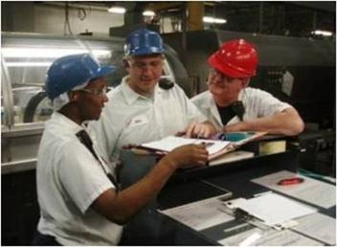
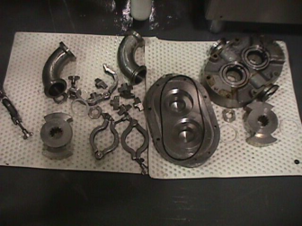
Plan of Action
Key Components:
Sanitary design
Facility, grounds, equipment cleaning
Changeover
Periodic
Event based
Cleaning method
Wet vs. dry
Step 1
Step 2
Step 3
Step 4
Step 5
Step 6
Notes:
Slide Type:
Slide Title:
Audio / Narration:
(QROS6C_step2_01.wav) Step two in the sanitation program is developing a plan of action that addresses and effectively manages the risks identified in step one.
A robust plan of action should include:
Identification of the equipment, area, or utensil to be cleaned or sanitized.
Adequate frequency of sanitation tasks.
Detailed cleaning and sanitizing procedures.
Any necessary chemical information for detergents and sanitizers.
A list of equipment and tools needed to execute the plan.
A breakdown of roles and responsibilities so that staffing needs can be met.
Tools such as SSOPs, OPLs, Maximo and other work instructions can be used to outline how to execute the plan of action.
Designer Notes:
Developer Notes: Title on slide enter, followed by step image fade in. Sync bullets with * & images ^ in narration.

Slide 9
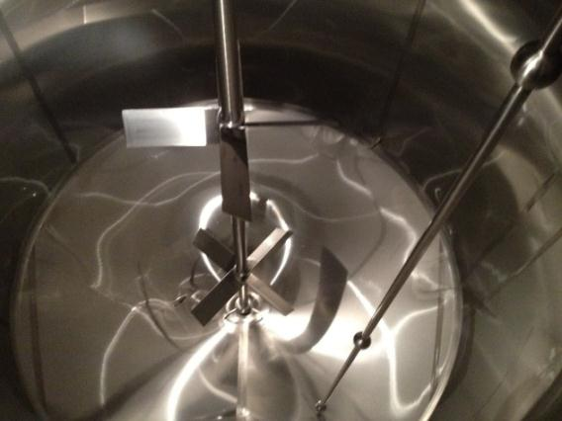
Allergen Control
Success criteria: visibly clean, analytical data
Notes:
Allergen control
Design issues preventing access for disassembly, cleaning and inspection to meet acceptable risk criteria (visually clean, anaylical LOD) – enrober, slide gates
Cleaning method not matching with design
Sparkle example, pnuetic line s, slide gates, ancchor bearing
Cleaning method not executed properly
4X4, no detergent, no mechanical action, wrong or no tools, hot water, correct conc, CIP designed and executed properly
Poor GMP during cleaning, inspection and reassembly
Micro control
Poor water management
Use during full cleaning cycle
Use during quality changeover or on a low Aw system
Control of environment
Foreign material control
Poor execution of sanitation after maintenance or construction work or a contamination event
Pest control
Poor design to prevent harborage
Areas left wet and dirty for extended periods of time – drain fly example
Voids that are difficult to access, clean and inspect – Avon example
Poor execution of periodic cleaning to prevent infestation
Lack of deep clean, sheeted down lines, electrical boxes, conduit, etc

Slide 10
Common Deficiencies – Allergens
Poor sanitary design
Limited or no access for maintenance, disassembly, cleaning and inspection
Solution
Utilize sanitary design checklists
GMA, AMI
Use 3A, EHEDG, BISSC for proper design

Slide 11
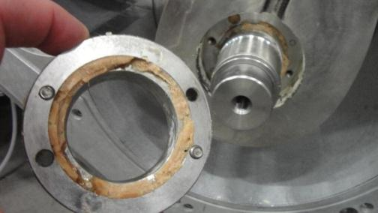
Poor Sanitary Design - Hidden Spaces

Slide 12
Poor Sanitary Design – Difficult to Disassemble

Slide 13
Good Sanitary Design - Tool Free
Principle 3
Notes:
Examples of quick release clamps. There are several different styles of quick release clamps.

Slide 14
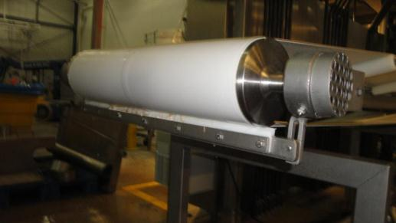
Poor Sanitary Design - Hidden Spaces
Notes:
The scraper blade shown here was attached with bolts making it difficult to remove and required the use of tools.

Slide 15
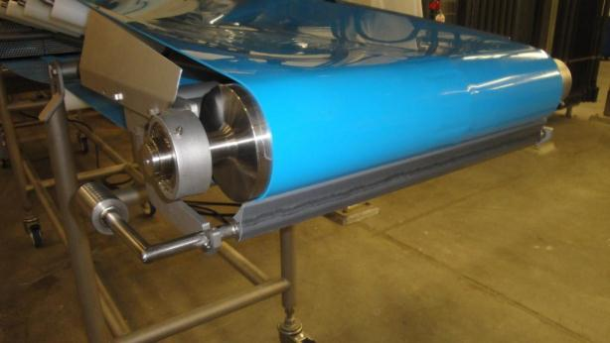
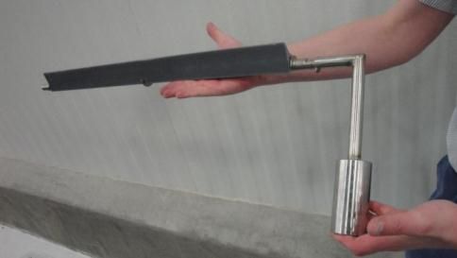
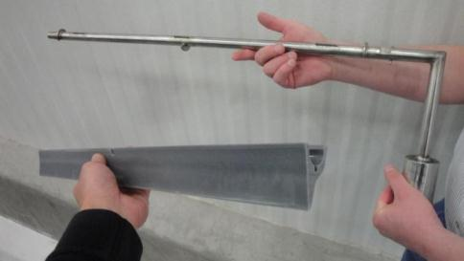
Good Sanitary Design - Tool Free
Notes:
In this picture you will see a snap-in snap-out of place scraper blade. The manufacturer of this system shown in the bottom two pictures is manufactured by Kofab.

Slide 16
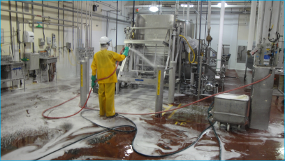
Common Deficiencies – Allergens
Cleaning method doesn’t match equipment design
Wet vs dry cleaning
Automated cleaning
CIP – Clean in Place
Solution
Focus on validating then verifying cleaning procedures

Slide 17
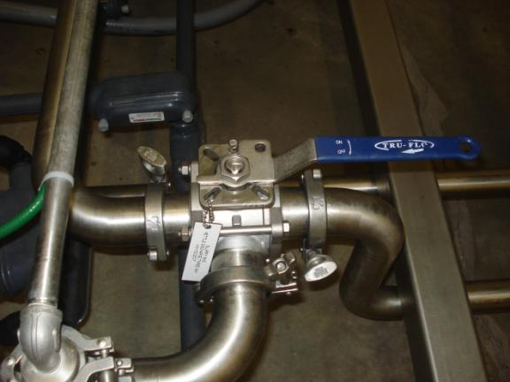
Poor Sanitary Design – Not CIPable

Slide 18
Poor Sanitary Design – Not CIPable

Slide 19
Good Sanitary Design –CIPable

Slide 20
Sanitary Design Case Study

Slide 21
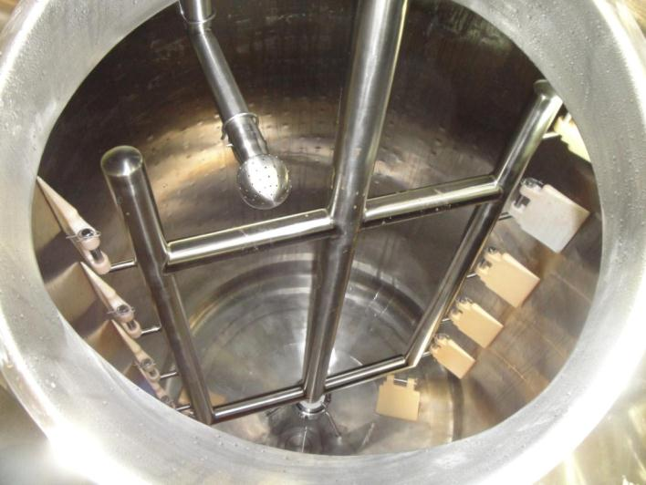
Bearing Located at Bottom of Shaft

Slide 22
Removed Bearing After CIP Cleaning

Slide 23
Soil Trapped Between Surfaces

Slide 24
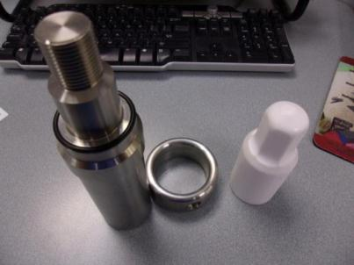
Sanitary Redesign - Final

Slide 25
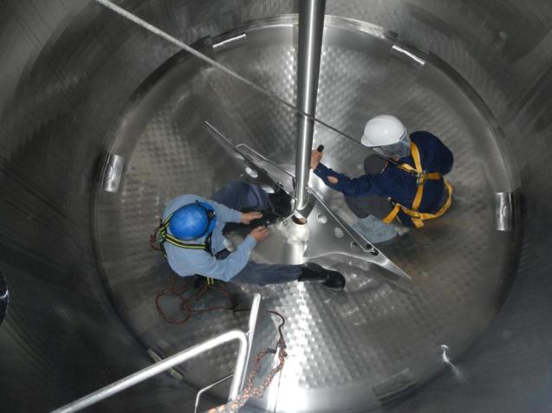
Other Options: Eliminate or Clean

Slide 26
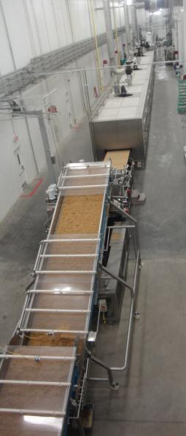
Granola Bar Risk Reduction Case Study

Slide 27
Risk Assessment
Why did we prioritize granola bars?
High risk product/process based on the following:
Allergen
changeovers
Micro
Wet cleaning, RTE, raw ingredients, equipment design
Notes:
Big 8 allergens
RTE (ready to eat)
Ambient, shelf-stable, low Aw
Family & child oriented; includes high-risk groups
Includes known high-risk micro ingredients – raw agricultural products (primarily Salmonella risk)
FSMA identified product
FSMA validation/verification focus
Post-process risks
Environment (process contamination) controlled through EMPs, GMPs, and good sanitation.

Slide 28
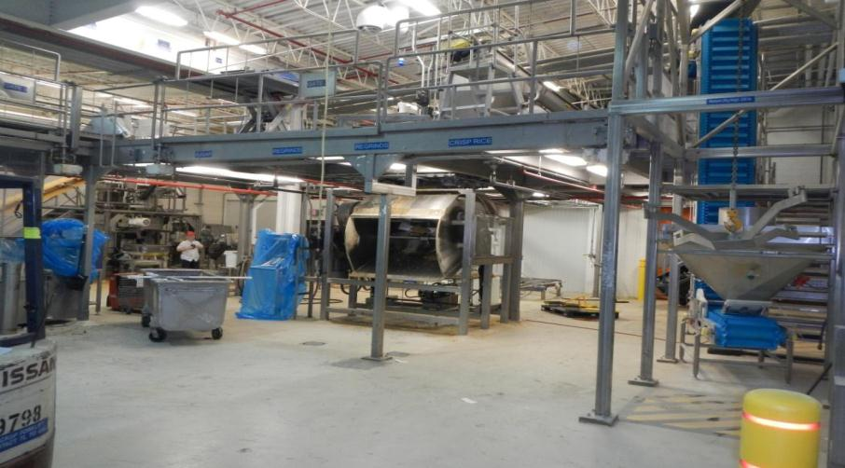
Wet/Dry Zoning Conflict

Slide 29
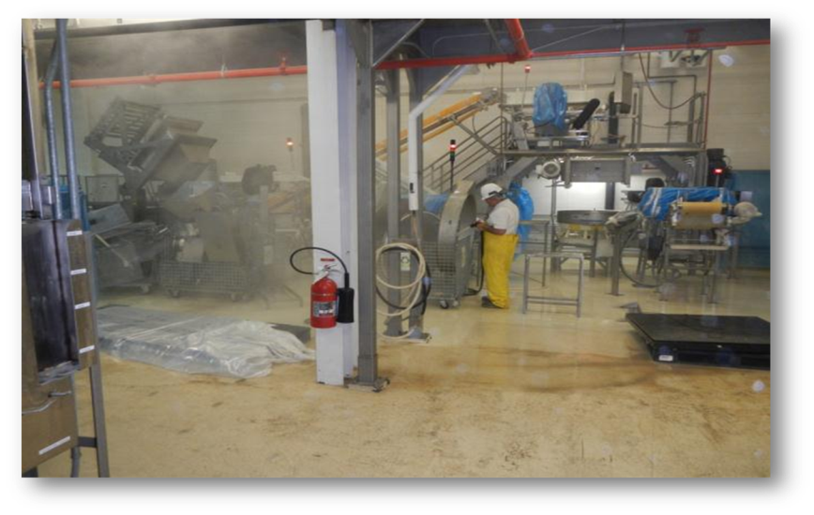
Wet/Dry Zoning Conflict
Notes:
Another example of poor sanitary design “zone control.” The regrind equipment in the back of the picture is a regrinds system for crunchy granola which is a dry system. The equipment in the foreground was design for wet cleaning. The wet washing adds increased challenge and risks to the dry system. Note the high level of humidity suggested by the steam during sanitation.

Slide 30
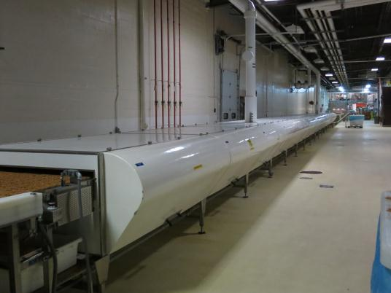
Baked Product Cooler
Dry Design + Wet Clean = Micro Risk
Notes:
The picture on the right is an interior shot of the cooling tunnel shown on the left.
During a sanitation assessment sanitary design concerns cooling tunnel The cooling tunnel contained heavy condensation within the product contact zone post kill step.
Condensation may have the potential to create ideal micro growth conditions.
Cooling tunnel structural integrity was also determined to possibly contribute to micro risk due to current sanitary design deficiencies.
The cooling tunnel interior and exterior construction primarily consists of fiberglass wrapped around wood framing. Interior and exterior seams are caulked
Doors and section junctions utilize gasket seals
The first step was dehumidifying the air and then switched from wet to dry cleaning. When wet cleaning was being used the system had a 100% failure rate as measured with a indicator organism. When dry cleaning was implemented the system had a 100% approval process with same indicator organisms.

Slide 31
Condensation – pooling and corrosion

Slide 32
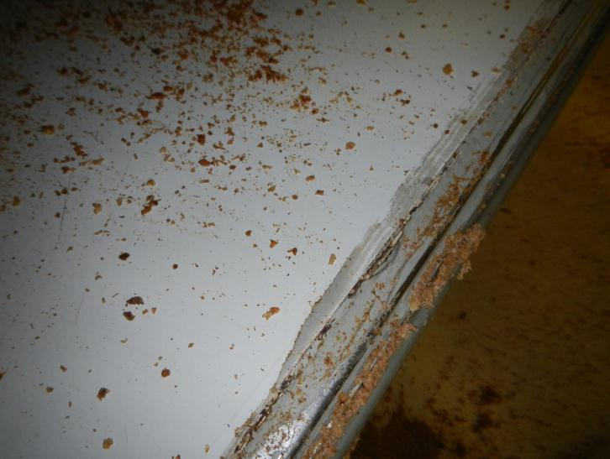
Poor Sanitary Design – Fiberglass and Wood
Failed caulk seams and exposed wood framing

Slide 33
Poor Sanitary Design – Hollow Rollers

Slide 34
Corrective Action Plan
Short Term:
Re-caulked seams above product zone
Enhanced environmental sampling
Confirmed no pathogens

Slide 35
Environmental Mitigation
Short Term:
Re-caulked seams above product zone
Enhanced environmental sampling
Zone 3 and 4 - Salmonella and Listeria
All negative

Slide 36
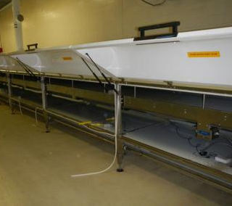
Corrective Action Plan
Long term:
Redesigned air handling to ensure dehumidified air
Replaced ceiling and floor panels
Converted to dry cleaning
Micro risk reduced!
quality indicator organism verification

Slide 37
Common Deficiencies – Allergens
Cleaning method not executed properly
Poor SSOP development and execution
Written procedures do not match on floor activities
No chemicals or wrong concentration
Wrong tools for the job
Limited or no hot water
CIP not designed and executed properly

Slide 38
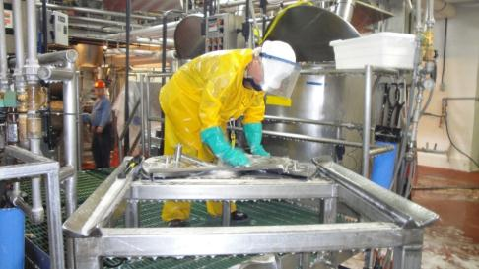
Wet Sanitation Process
Sanitation preparation (disassemble)
Pre-rinse
Wash
Concentration
Temperature
Time
Mechanical force
Rinse & inspect
Remove water & assemble
Pre-operational inspection & verification
Sanitize

Slide 39
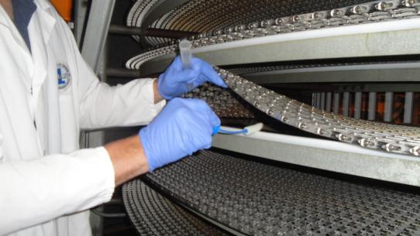
Micro Control
Success criteria: visually clean & quality indicator organisms below defined criteria post sanitation

Slide 40
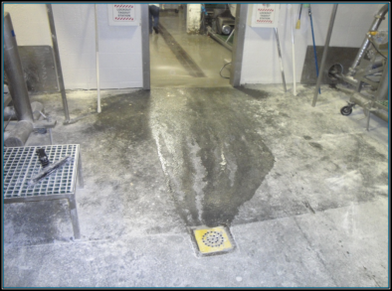
Common Deficiencies – Micro Control
Poor water management
Uncontrolled use for cleaning
Use during quality changeovers
Use on low Aw systems
Control of environment
Poor ventilation, condensation, leaks
No wet/dry zoning

Slide 41
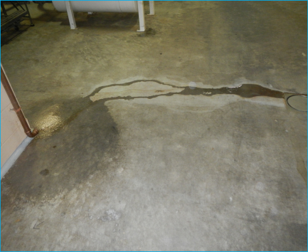
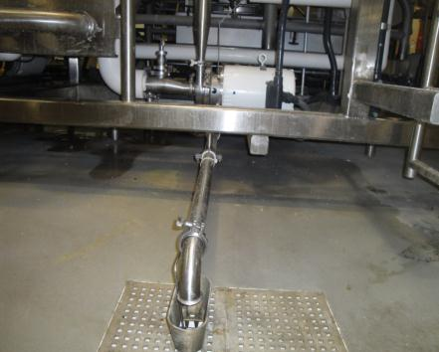
Water Control – Drainage
Principle 3
Notes:
Left picture - Poor example of wet sanitation design. The vertical pipe discharges water to the floor increasing micro risk profile.
Right picture - This is an excellent example of a CIP diversion directly to a floor drain. Note that the drain has a physical disconnect to the floor drain to prevent backflow. When engineering a system such as this – you need to make sure that drain capacity is greater than the discharge capability of the CIP to prevent ponding at the floor drain.

Slide 42
Keys to Success
Good Sanitary Design
Risk Assessment/Management
Training & Education
Prioritization processes
Clearly defined success criteria
Robust sanitation programs that are validated, verified and monitored
Special event planning
Visual inspection: it is everyone's best sanitation tool!

Slide 43
Objectives Met?
Communicate the risks being managed
Describe the 6 critical steps in risk management
Identify deficiencies and remediation options
Review case studies
Identify key learnings

Slide 44
Thank You! Questions?

Slide 45
Resources
GMA Sanitary Design Checklists
Equipment Design Checklist for Low Moisture Foods
Facility Design Checklist

Slide 46
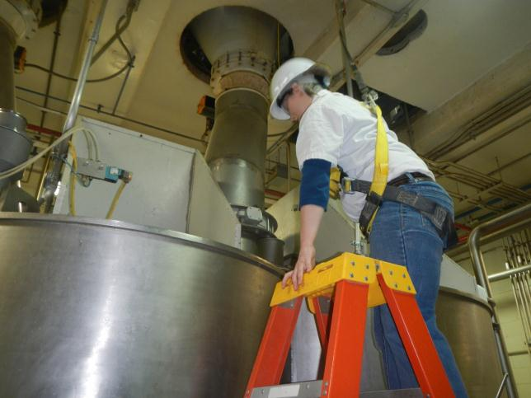
Poor Sanitary Design – Wet/Dry Interface

Slide 47
Poor Sanitary Design – Wet/Dry Interface

Slide 48
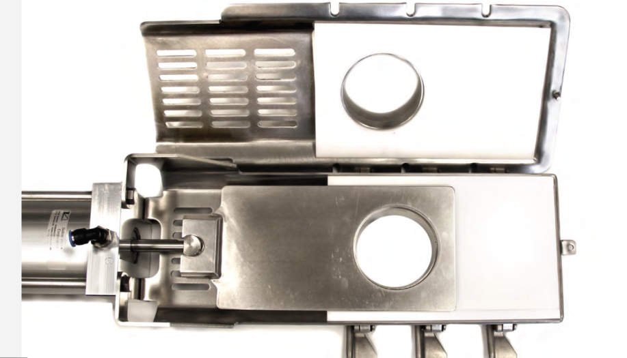
New Sanitary Design

Slide 49
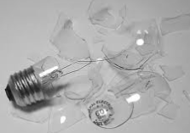
Physical Hazard: Foreign Material Control
Goal: No plastic, wood, metal, glass, or other misc. contaminates in and around the product zone
Success criteria – absence via visual inspection

Slide 50
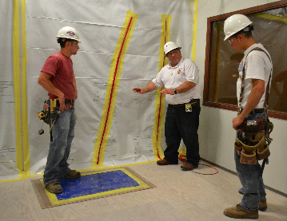
Common Deficiencies – Foreign Material Control
Poor sanitation
Following maintenance repairs
During and after construction work
After a contamination event
Notes:
Allergens
Micro
Spoilage
Pathogens
Regulatory compliance

Slide 51
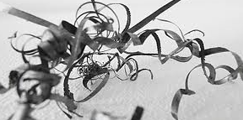
Swarf
Grindings: the fine metallic shavings removed by grinding or cutting tools

Slide 52
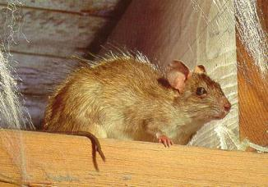
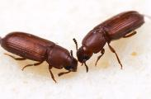
Pest Control
Goal: No pest infestation on the property and no pest activity in the facility
Success criteria – absence via visual inspection

Slide 53
Common Deficiencies – Pest Control
Poor design to prevent harborage
Voids difficult to access, clean and inspect
Lack of deep cleaning
Wet, dirty stagnate areas
Notes:
Allergens
Micro
Spoilage
Pathogens
Regulatory compliance

Slide 54
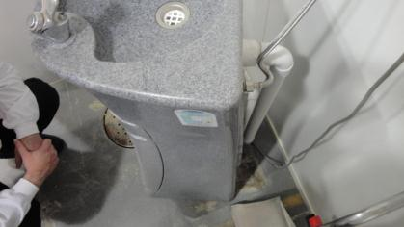
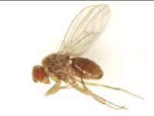
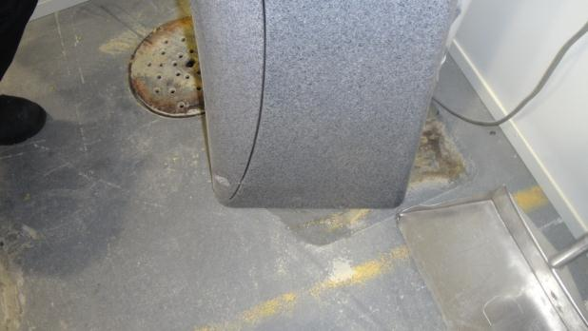
Periodic Clean – Remove Soil & Water

